Slide 1

Mainstreaming the Small-scale Fisheries (SSF) Guidelines into Caribbean Fishery Value Chains
Barbados: communication and visibility content

Slide 2

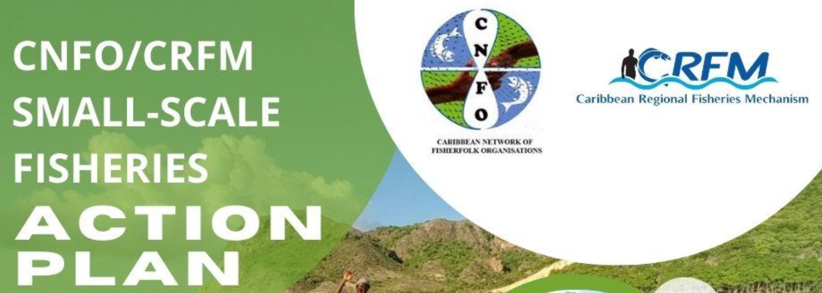
Project Profile and Partnerships
To equip stakeholders at all levels with the knowledge and skills necessary to effectively integrate the Voluntary Guidelines for Securing Sustainable Small-Scale Fisheries in the Context of Food Security and Poverty Eradication (SSF Guidelines) into seafood value chains with a specific focus on market dynamics and the role of the private sector.
Executing Agency: Caribbean Regional Fisheries Mechanism (CRFM)
Co-Implementing Agencies: Development Bank of Latin America and the Caribbean (CAF) and Food and Agriculture Organization (FAO) of the United Nations
Funder: Global Environment Facility (GEF)
Co-financing project countries: Barbados, Belize, Guyana, Jamaica, Saint Lucia, and Panama

Slide 3
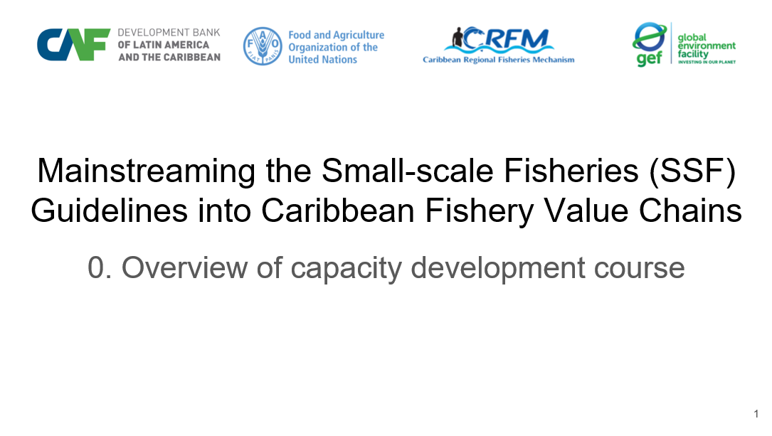
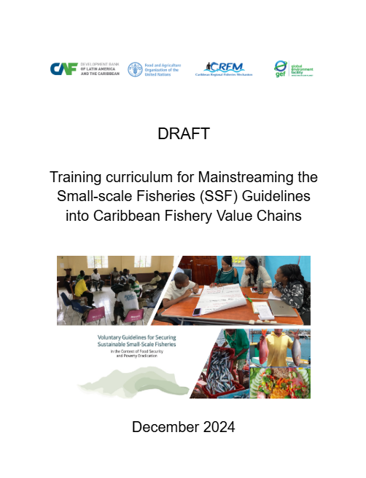
Contributions to Country Capacity Development
Training Curriculum - A structured guide of key module topics with learning objectives for integrating the SSF Guidelines into fisheries value chains.
Training Manual - A detailed manual on curriculum delivery modes, module design, resources and instructional materials informed by fisheries leaders. Training Modules - Fifteen capacity development slide modules setting out the relevance of the SSF guidelines to Caribbean fisheries value chains.
Training Workshop - Report on and validation of practical sessions to train leading fisherfolk by demonstrating the effectiveness of the training materials. Reference Resources - Global, regional and national lists of documents, videos, slides and other training materials suitable for Caribbean fisherfolk. Country Resources - Project country collection of slides, photographs, documents, videos etc, suitable to be built upon by fisherfolk trainers.

Slide 4
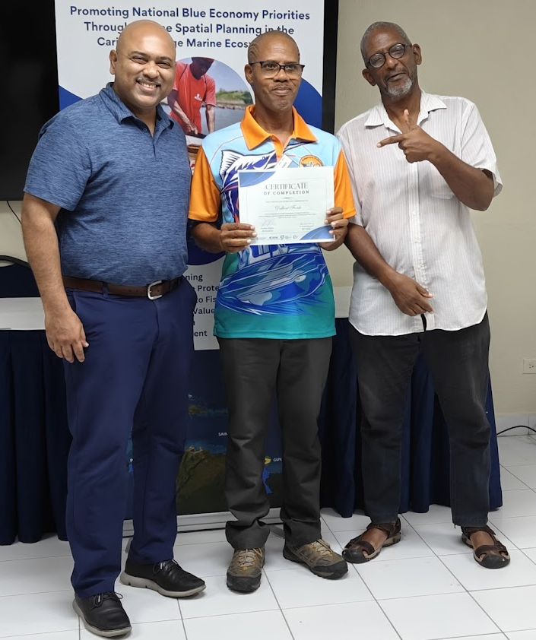
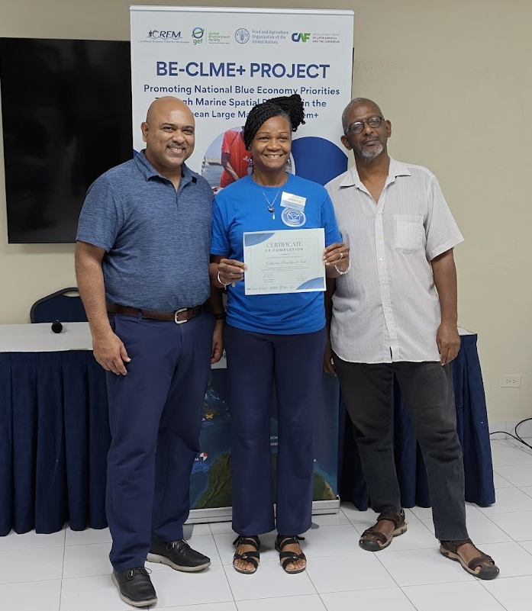
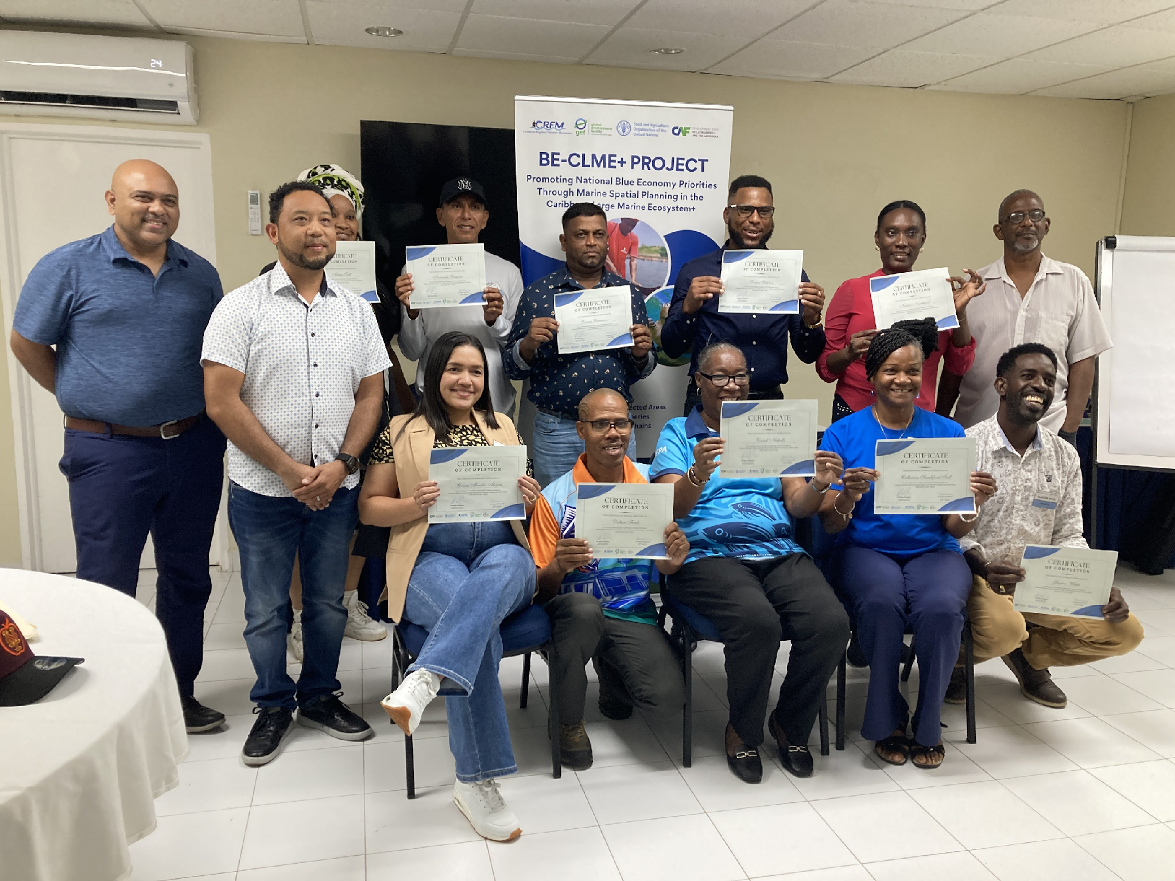
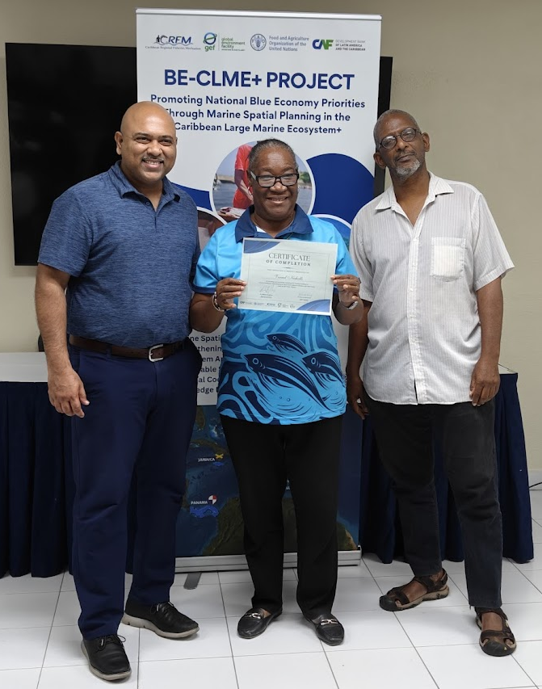
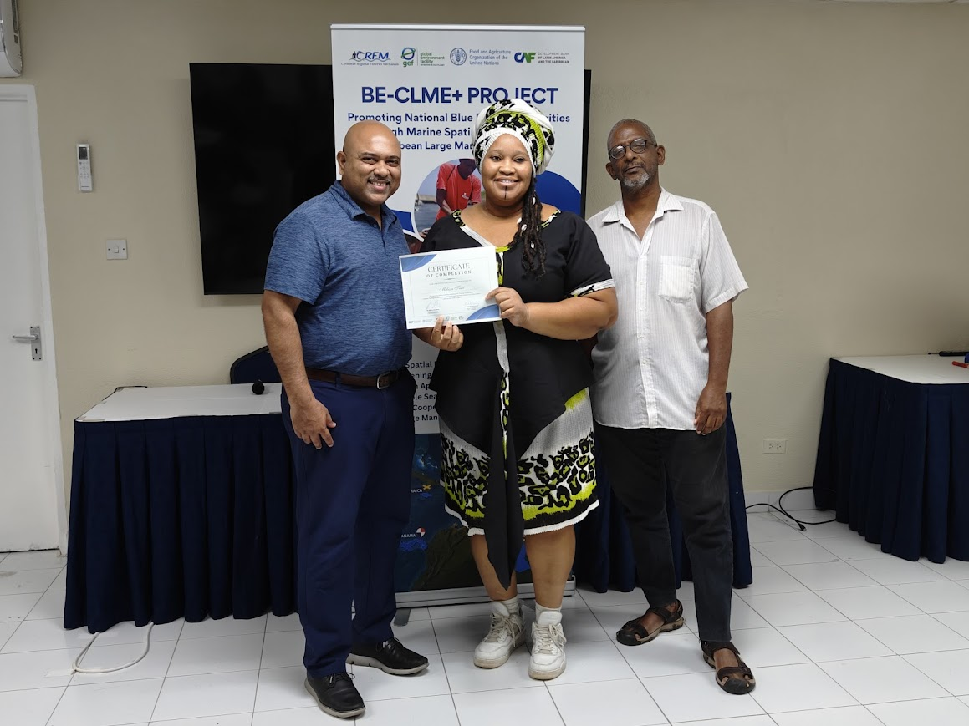
Participants
Workshop participants after receiving certificates of participation. Barbadian participants clockwise:
Delbert Forde, Catherine Sandiford-Tull, Melissa Taitt and Vernel Nicholls with Regional Project Coordinator, Dr. Dayne Buddo and Dr. Patrick McConney

Slide 5
Project benefits
The project equipped fisherfolk leaders as trainers with the knowledge and tools to integrate SSF Guidelines into fisheries value chains. This can increase the resilience of Barbados' fisheries sector to future climate and disaster shocks like Hurricane Beryl.
Enhancing fisheries sustainability and economic stability for fishers and coastal communities is clearly a national priority. This value chain capacity development strengthens initiatives such as the recent suite of fisheries legislation.
By integrating the SSF Guidelines into fisheries management, the trained fisherfolk leaders can, amongst many other things:
support fisher organisations in adopting disaster-resilient practices, such as improved early warning systems, climate-smart fishing gear, and diversified income sources for members.
Strengthen gender responsive social protection through promoting inclusive policies and financial mechanisms to support fisherfolk in times of crisis.

