Slide 1

Mainstreaming the Small-scale Fisheries (SSF) Guidelines into Caribbean Fishery Value Chains
Jamaica: communication and visibility content

Slide 2

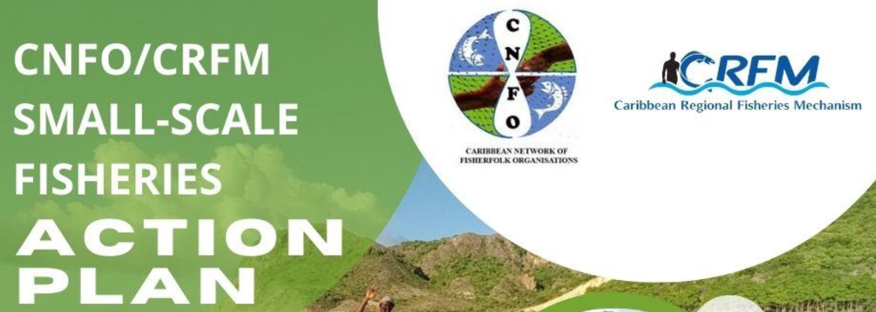
Project Profile and Partnerships
To equip stakeholders at all levels with the knowledge and skills necessary to effectively integrate the Voluntary Guidelines for Securing Sustainable Small-Scale Fisheries in the Context of Food Security and Poverty Eradication (SSF Guidelines) into seafood value chains with a specific focus on market dynamics and the role of the private sector.
Executing Agency: Caribbean Regional Fisheries Mechanism (CRFM)
Co-Implementing Agencies: Development Bank of Latin America and the Caribbean (CAF) and Food and Agriculture Organization (FAO) of the United Nations
Funder: Global Environment Facility (GEF)
Co-financing project countries: Barbados, Belize, Guyana, Jamaica, Saint Lucia, and Panama

Slide 3
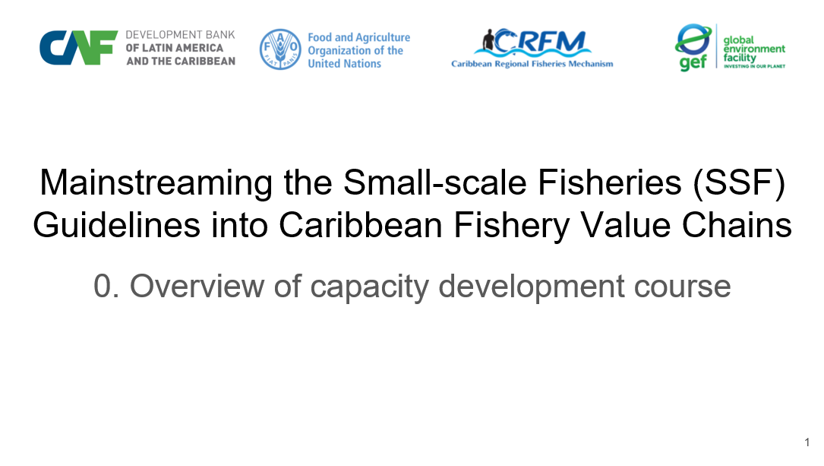
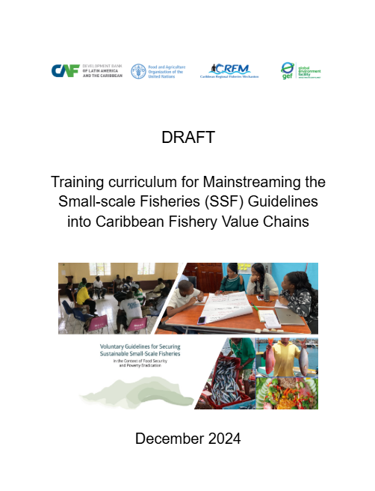
Contributions to Country Capacity Development
Training Curriculum - A structured guide of key module topics with learning objectives for integrating the SSF Guidelines into fisheries value chains.
Training Manual - A detailed manual on curriculum delivery modes, module design, resources and instructional materials informed by fisheries leaders. Training Modules - Fifteen capacity development slide modules setting out the relevance of the SSF guidelines to Caribbean fisheries value chains.
Training Workshop - Report on and validation of practical sessions to train leading fisherfolk by demonstrating the effectiveness of the training materials. Reference Resources - Global, regional and national lists of documents, videos, slides and other training materials suitable for Caribbean fisherfolk. Country Resources - Project country collection of slides, photographs, documents, videos etc, suitable to be built upon by fisherfolk trainers.

Slide 4
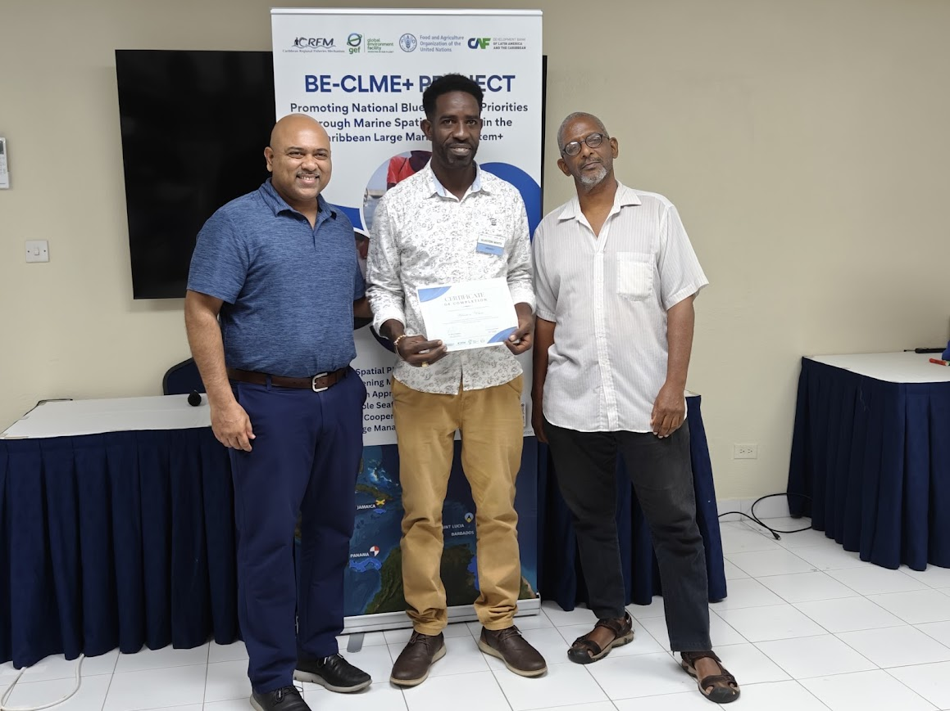
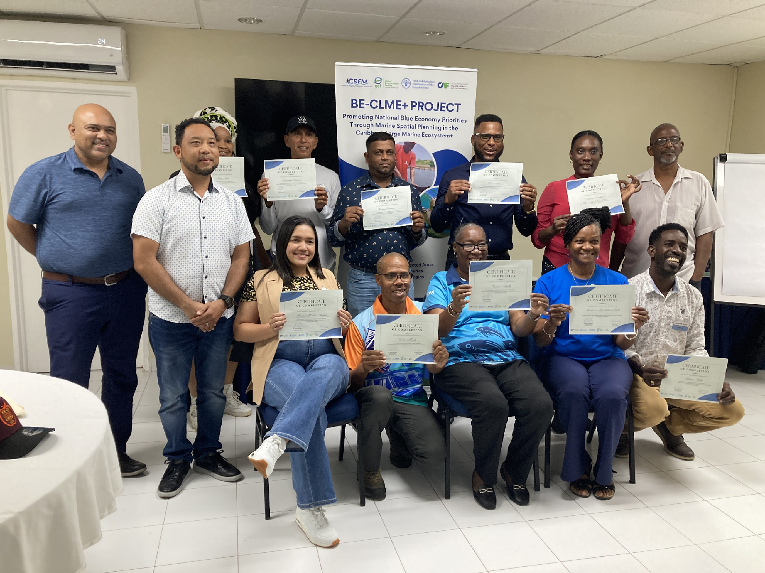
Participants
Workshop participants after receiving certificates of participation. Participant from Jamaica Glaston White receives certificate from Regional Project Coordinator, Dr. Dayne Buddo and Dr. Patrick McConney

Slide 5
Project benefits
The fisherfolk leader from Jamaica, Mr. Glaston White, as an experienced decision maker of the Caribbean Network of Fisherfolk Organizations (CNFO) is in an excellent position to promote and practically spearhead the integration of the SSF Guidelines into the small-scale artisanal fisheries value chains of the country. The capacity development under the project (training and diverse resources) was designed the compliment, the mission of the National Fisheries Authority (NFA), and fisherfolk organizations.
The NFA mission is to “facilitate the sustainable development of the Jamaican fisheries sector, including aquaculture, through effective and efficient management, regulation, administration, and participatory governance for the benefit of all Jamaicans”. The SSF Guideline provides the most appropriate framework for achieving this mission, and now fisherfolk leaders are in a better position to more actively support its attainment
Jamaica fisheries sector plays an important role in the country’s economic growth and the sector is being positioned by the NFA and fisherfolk organizations to yield greater economic returns. Recent official fisheries statistics attribute as much as 92% of Jamaica's total marine production to artisanal fishing. Within the value chain development the SSF Guidelines can inform directions such as the increase of women involvement in fisheries that has been noted by the authorities in Jamaica and is consistent with gender mainstreaming. The project resources cover these and many other aspects of SSF value chain development.

