Slide 1



BE-CLME+ Project: Promoting National Blue Economy Priorities Through Marine Spatial Planning in the Caribbean Large Marine Ecosystem Plus (GEF Project ID 10211)
NATIONAL CONSULTANCY TO CONDUCT
DATA GAP AND NEEDS ASSESSMENTS
TO INFORM MARINE SPATIAL PLANNING
IN THE REPUBLIC OF PANAMA.

Slide 2
BE-CLME+ Project: Promoting National Blue Economy Priorities Through Marine Spatial Planning in the Caribbean Large Marine Ecosystem Plus (GEF Project ID 10211)
Regional Initiative (Barbados, Belice, Guyana, Jamaica, Santa Lucía y Panamá)
Promotion of the BLUE ECONOMIA in la region
Marine Spatial Planning(MSP)
Marine Protected Areas
Ecosystem Approach to Fisheries
Development of sustainable climate smart fisheries
Value chains and
Knowledge management
Caribbean Regional Fisheries Mechanism (CRFM), Global Environment Fund (GEF), Development Bank of Latin America and the Caribbean, Food and Agriculture Organization of the United Nations (FAO)

Slide 3
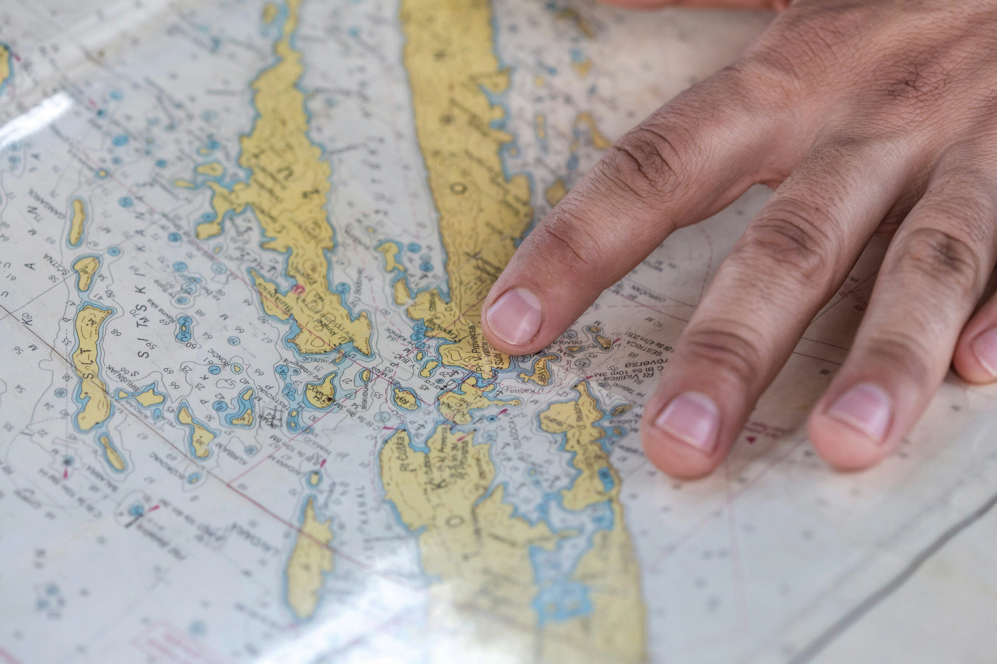
Marine Spatial Planning
A marine spatial planning process involves the development of a comprehensive vision for ocean governance that involves and includes ALL KEY STAKEHOLDERS.
The aim is to develop a map and framework that identifies different ocean users, maximizes the benefit of sea users and minimizes negative environmental and economic impacts.
Notes:
https://www.seasketch.org/bdos/surveys/407/0
Barbados is currently laying the groundwork for the management of Barbados’ ocean space through the development of a marine spatial planning process.

Slide 4
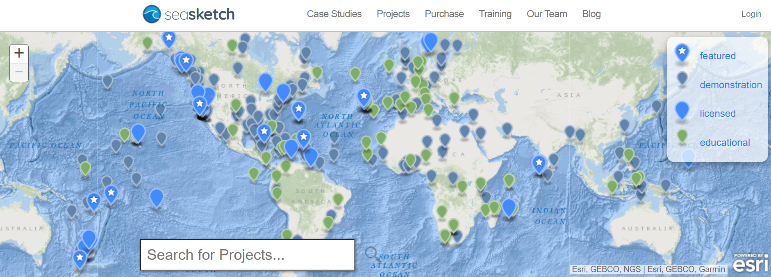
Marine Spatial Planning

Slide 5
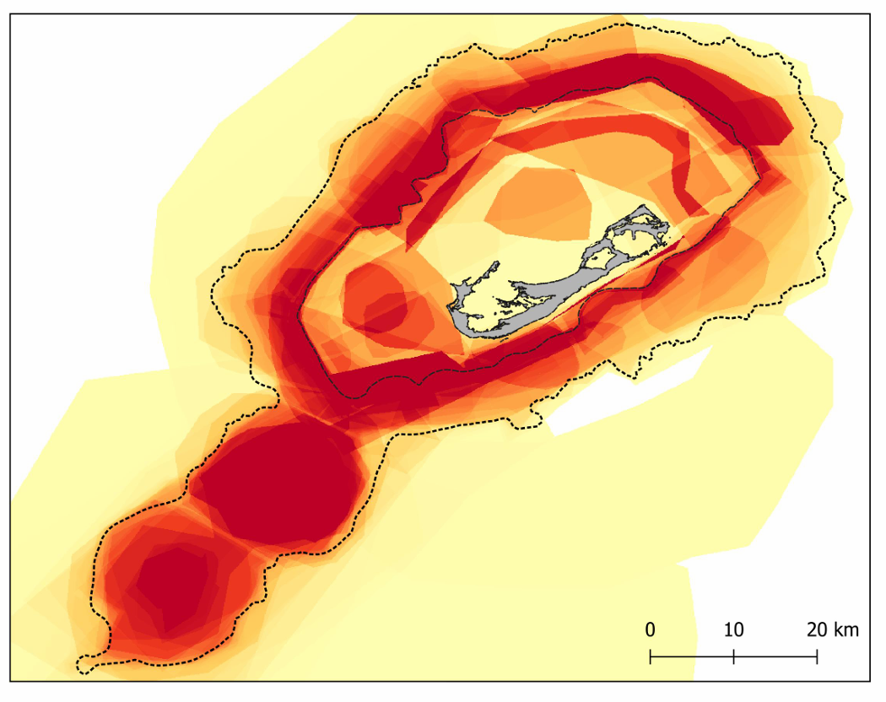
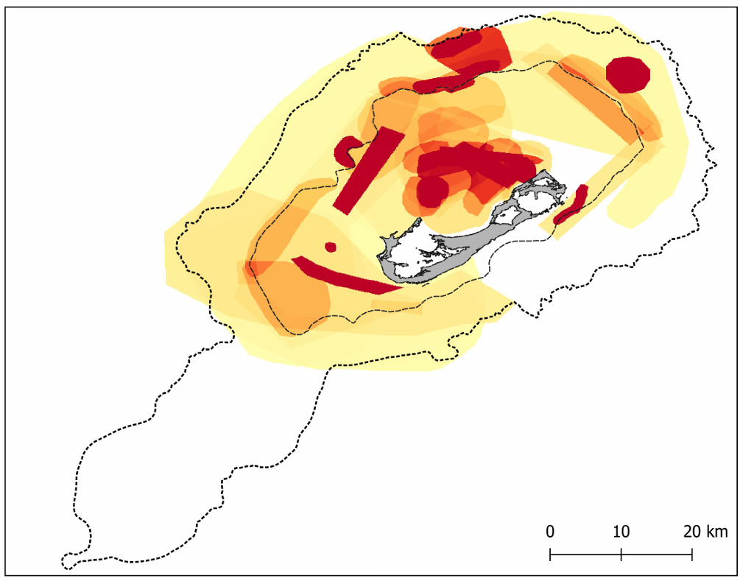
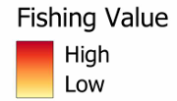
Marine Spatial Planning —Bermuda
Trolling pelagic species
Pargo fishing
Fisheries
High
Low

Slide 6

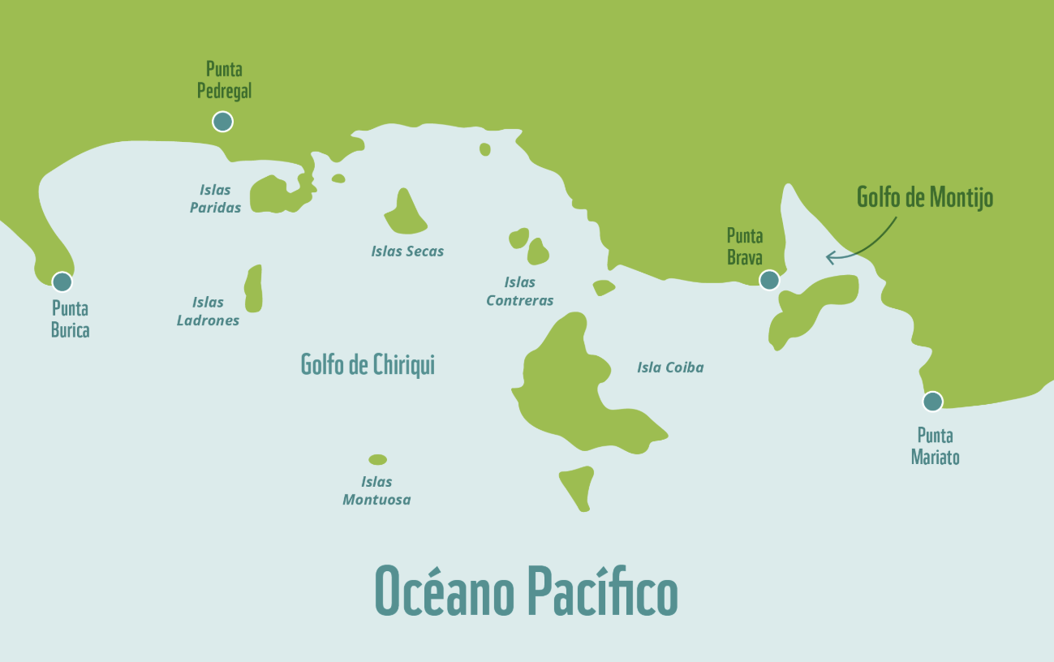
Marine spatial plan for the area of influence of the Coiba National Park and its Special Marine Protection Area
Chiriquí Gulf in Panama
Important habitats:
Mangle,
Coral reefs
Sea turtles anidation
Sharks
Whales
Fisheries:
Artisanal
Industrial
Recreational
Tourism
Problems identified:
Unregulated fisheries,
Law enforcement limitations
Increase pressure from tourism sector
The pilot project in Panama was a participatory process that sought to reduce conflicts and protect biodiversity resources through a participatory governance approach, development of participatory processes to define zoning, and promotion of communication and replicability.

Slide 7



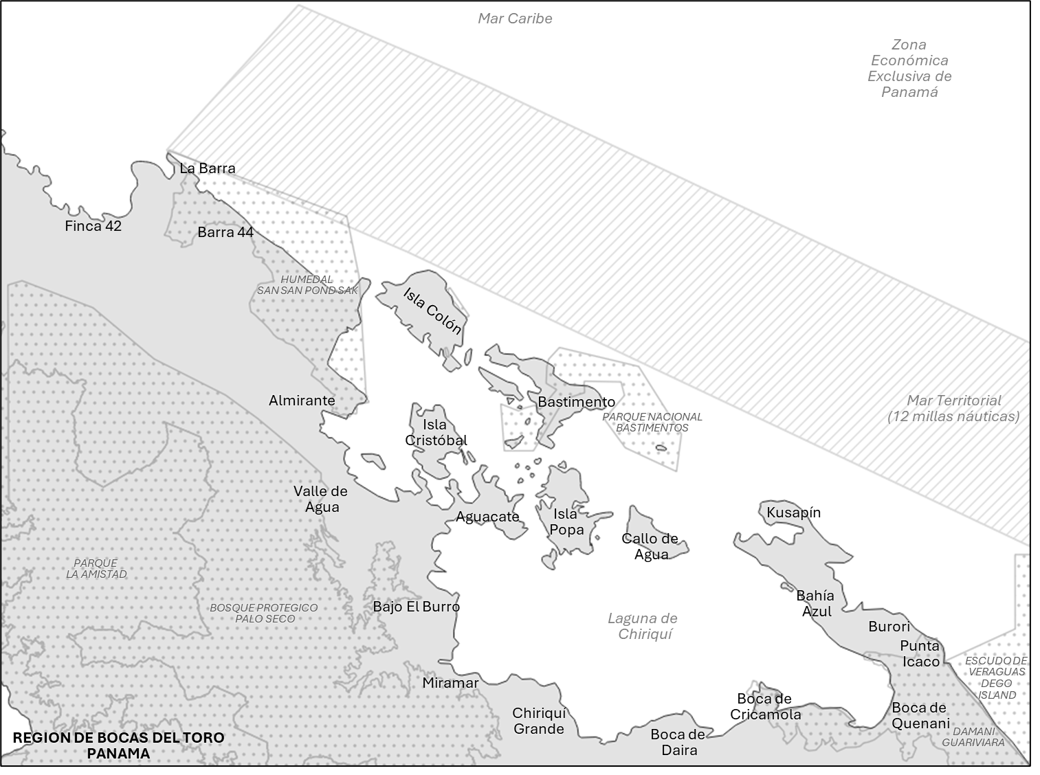





MSP— Benefits
Empowerment and commitment The participation of maritime users in the mapping allows them to actively participate in the decision-making processes that affect their revenues
Inclusion of local knowledge Allows the knowledge of people who use the sea to be included in planning processes, so decisions include practical experience.
Increase map and location awareness It helps sea users visualize and understand maps and locations within marine environments.
Conflict resolution By identifying and understanding areas or locations of potential conflicts among ocean users, stakeholders can find solutions and compromises.
Improving Resource Management Mapping activities and locations helps identify sustainable fishing practices and areas that require conservation efforts.

Slide 8

Marine Spatial Planning
One size
Doesn’t fit all

Slide 9
Consultancy Objective
The objective of this consultancy is to comprehensively assess data availability, data gaps, and an assessment of needs to inform MSP in Panama.
Scope of Work
Types and sources of data being used to inform MSP
Assess spatial and temporal data needs relevant to Blue Economy planning
Terms to access data, including an assessment of barriers to access data
Recommend data sources, acquisition costs
Capacity needs for data analysis and interpretation to inform MSP

Slide 10
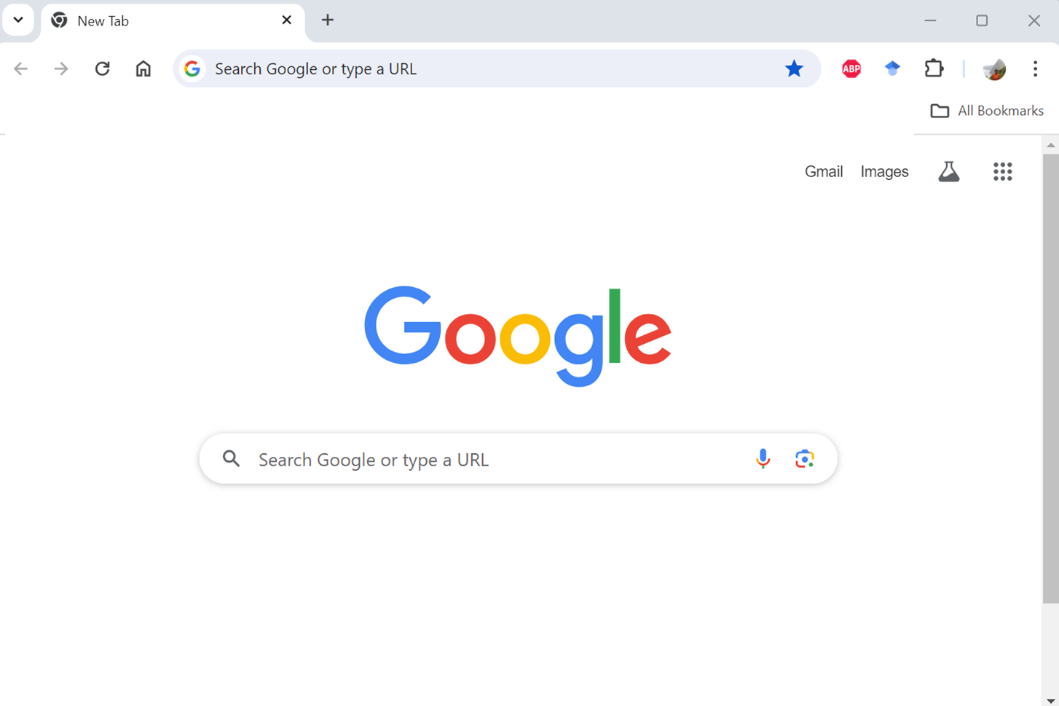

Consultancy Objective
The objective of this consultancy is to comprehensively assess data availability, data gaps, and an assessment of needs to inform MSP in Panama.
Methodology
Literature review
Interviews
Validation workshop

Slide 11
Methodology
Instructiones:
1. Participants introductions:
Name
Organization/asociation/cooperativa
Role

Slide 12
Methodology
2. What is the best way to get people involved?
3. Have you experienced conflicts over the use of marine space? With other activities?
With regulations?

Slide 13
Metodología para esta actividad
4. How do you record the location of your activity(s) at sea?
5. Do you know of any maps that show areas in the sea that are important for the activity(s) you do?
6. What maps do you think would be useful to show areas in the sea that are important for the activity you do?

Slide 14
Metodología para esta actividad
7. Have you taken any classes or training related to the activity(s) you do in the water? (e.g., fishing log, safety on the high seas, use of maps, etc.)
8. What trainings related to your activities at sea would you be interested in participating?

Slide 15
Marine Spatial Planning
Questions?

