Slide 1
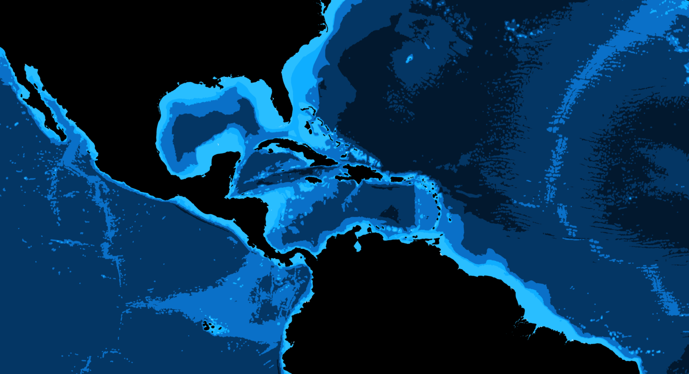
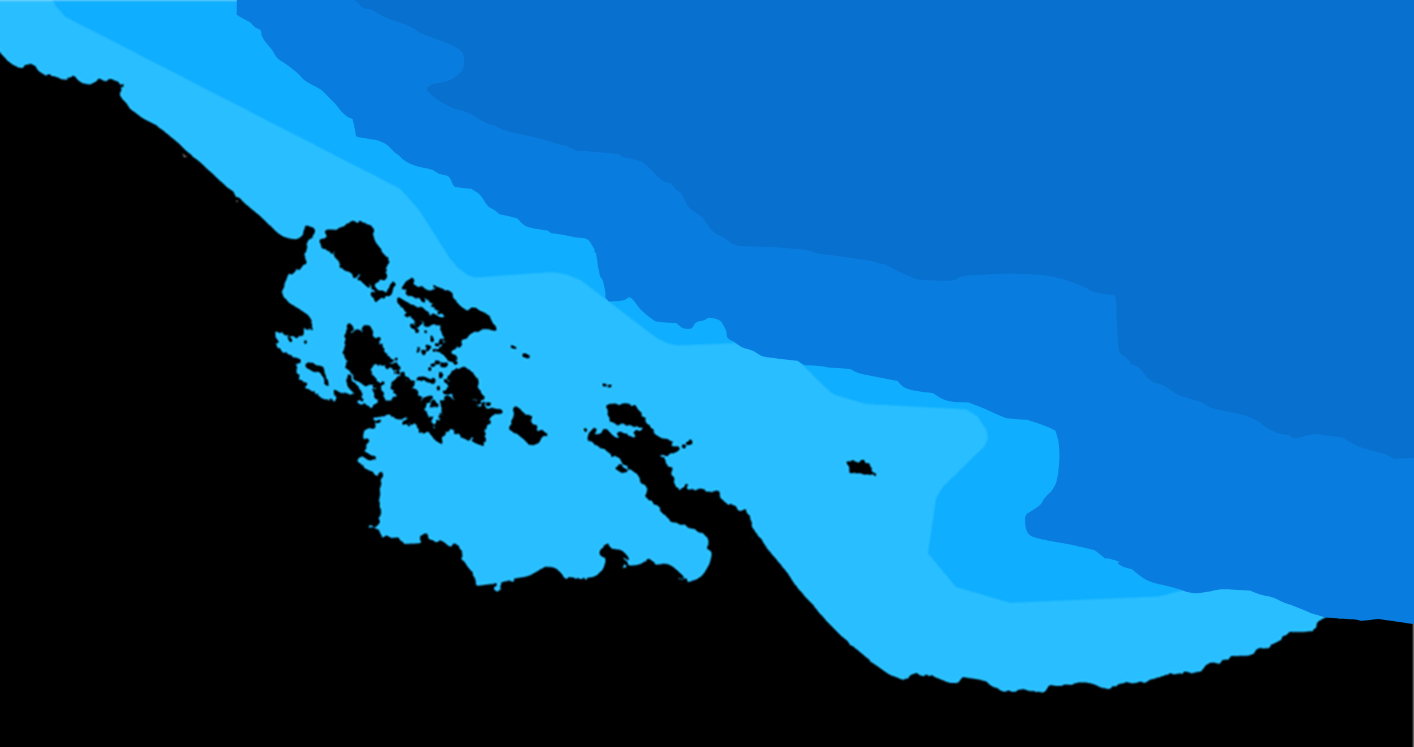
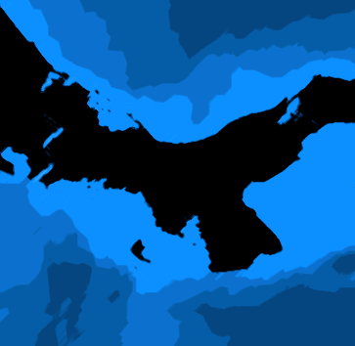

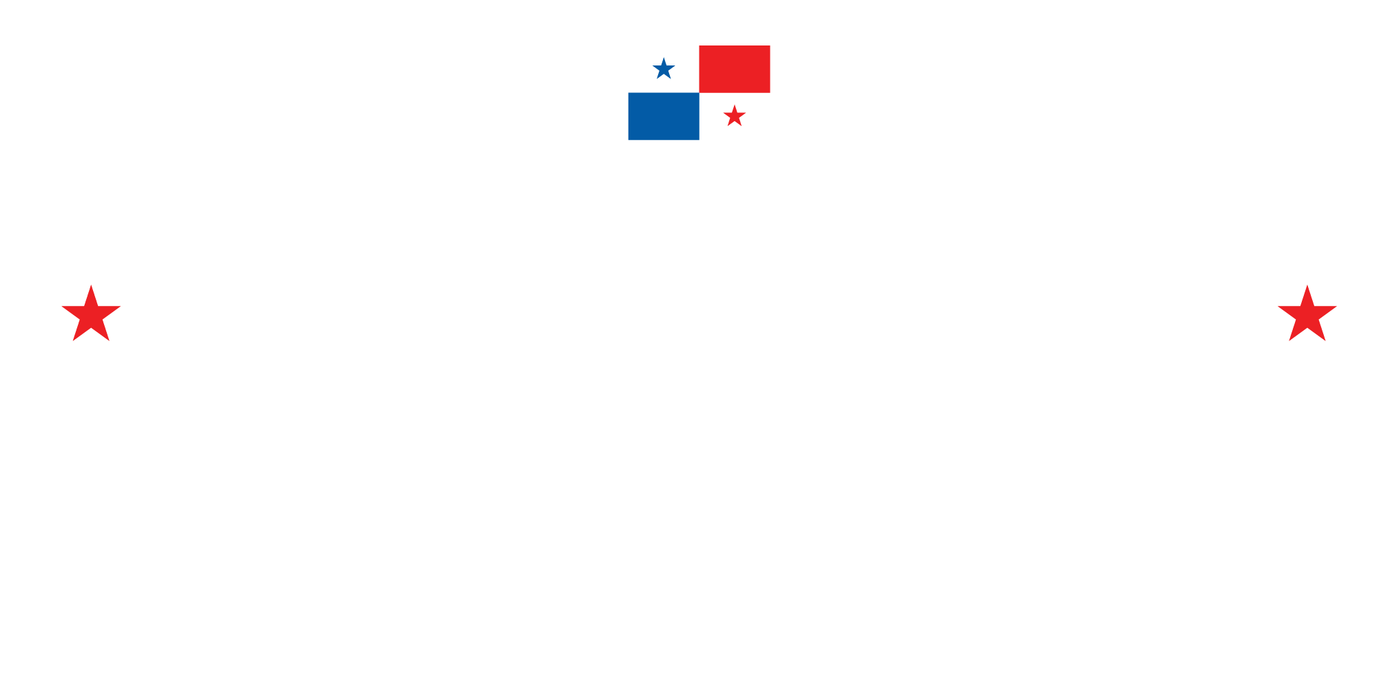





MARINE
SPATIAL PLANNING
Data gap and needs assessment
Isla
Colon
Almirante
Bastimentos
Bocas del Toro Archipelago
Kusapín
Laguna de Chiriquí
Dr. Nancy Montes
PANAMA
Chiriquí Grande

Slide 2
Agenda
WELCOME AND WORKSHOP SUMMARY
SUMMARY OF BE CLME+ PROYECT
DATA GAP AND NEEDS ASSESSMENT TO INFORM MSP IN BOCAS DEL TORO
Available information
Data gaps
Data needs
Capacitation and resources
RECOMENDATIONES
1
2
3
4
Isla
Colon
Almirante
Bastimentos
Kusapín
Laguna de Chiriquí
Chiriquí Grande

Slide 3
BE-CLME+ Project: Promoting National Blue Economy Priorities Through Marine Spatial Planning in the Caribbean Large Marine Ecosystem Plus (GEF Project ID 10211)
Regional initiativa (Barbados, Belice, Guyana, Jamaica, Santa Lucía and Panamá)
MAR
CARIBE
Promoting BLUE ECONOMY in the region
Marine Spatial Planning (MSP)
Protected Marine Areas
Ecosystem Approach to Fisheries (EAF) and the
Development of climate-smart sustainable fisheries Value chains and
Knowledge management
Executing Agency: The Caribbean Regional Fisheries Mechanism (CRFM) Executing agencies: Global Environment Facility (GEF): Development Bank of Latin America and the Caribbean (CAF) and the Food and Agriculture Organization of the United Nations (FAO).

Slide 4

Consultancy Objective
The objective of this consultancy is to assess data AVAILABILITY, data GAPS, and information NEEDS to inform the PEM in Panama.
Scope of Work
Conditions to access data, including an assessment of barriers to access
Capacity requirements for the analysis and interpretation of information for the MSP
Types and sources of data used to inform the MSP
Assess relevant spatial and temporal data needs
Recommend data sources, acquisition costs

Slide 5
Methodology
Online information search
Interviews
Google Scholar (893 results)
“Bocas del Toro” “GIS” “Panamá”
“PEM” ”Mapeo participativo”
Following information from found documents
Suggestions from interviewees
Atlas and online space platforms
The objective was to collect information on:
Knowledge/perception of the interviewees about spatial information in the area
Find relevant documents,
Understand the level of expertise in GIS and spatial analysis, as well as other technical areas relevant to the EMP process
Obtain suggestions and prioritization of information needs to inform the MSP in Bocas del Toro.
The list of actors invited to participate in these meetings was developed in coordination with the Directorate of Coasts and Seas of MiAmbiente and ARAP.

Slide 6
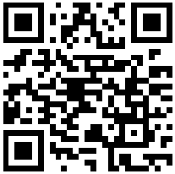
Resultados
1
2
3
4
Información disponible:
Experiencias con PEM en Panamá
Atlas y portales
Información de proyectos específicos
Actividad 1:
¿CONOCE ALGUNA OTRA INFORMACION ESPACIAL PARA LA PEM DE BOCAS DEL TORO?
Instrucciones: Por favor use esta forma para decirnos de otra información espacial (por ejemplo, mapas, coordenadas GPS, shapefile, etc.) que usted conoce pero que talvez no se ha incluido en este reporte.
https://encr.pw/BxIiJ

Slide 7
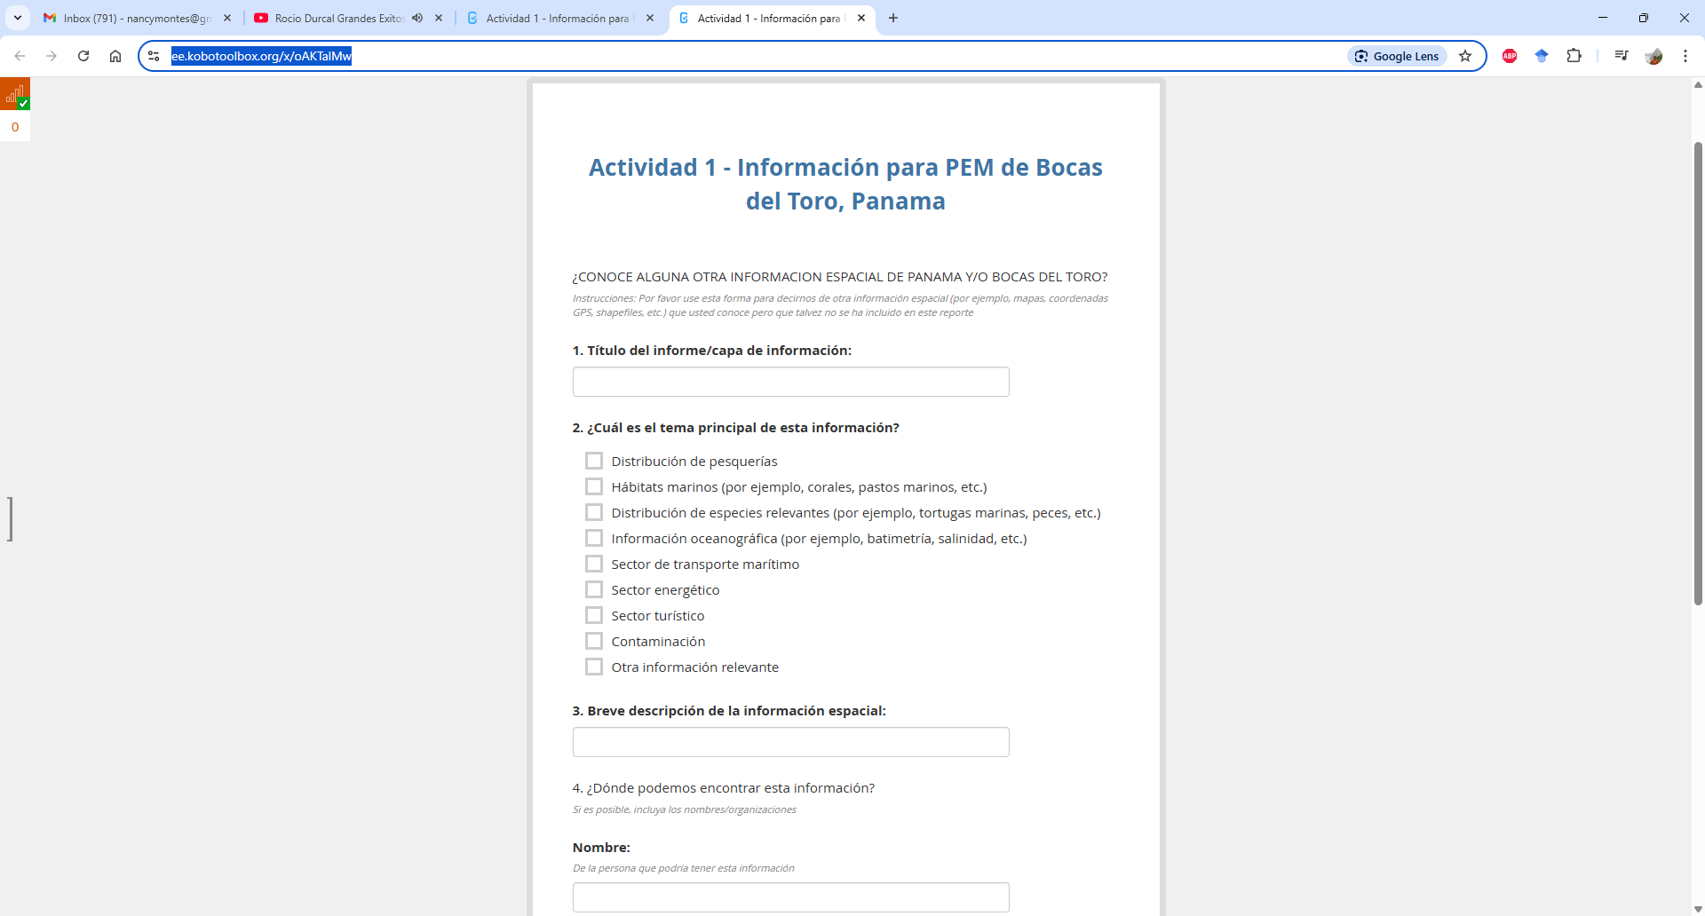
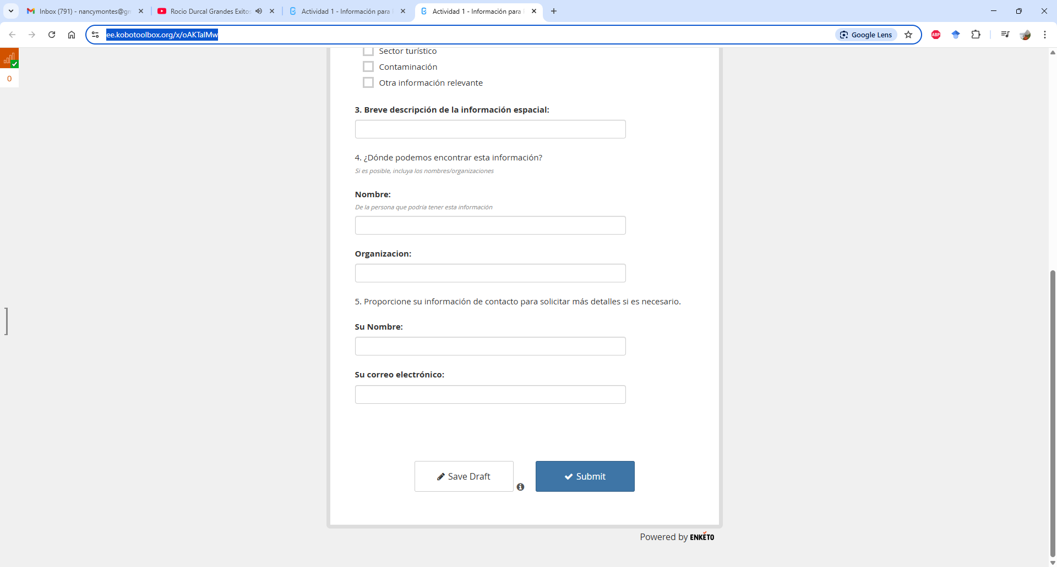

The deadline to submit suggestions is May 7, 2025
1
2
3
4
https://encr.pw/BxIiJ

Slide 8
The deadline to submit suggestions is May 7, 2025
1
2
3
4
https://encr.pw/BxIiJ

Slide 9
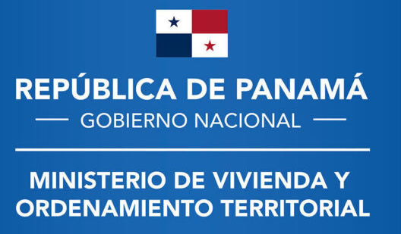

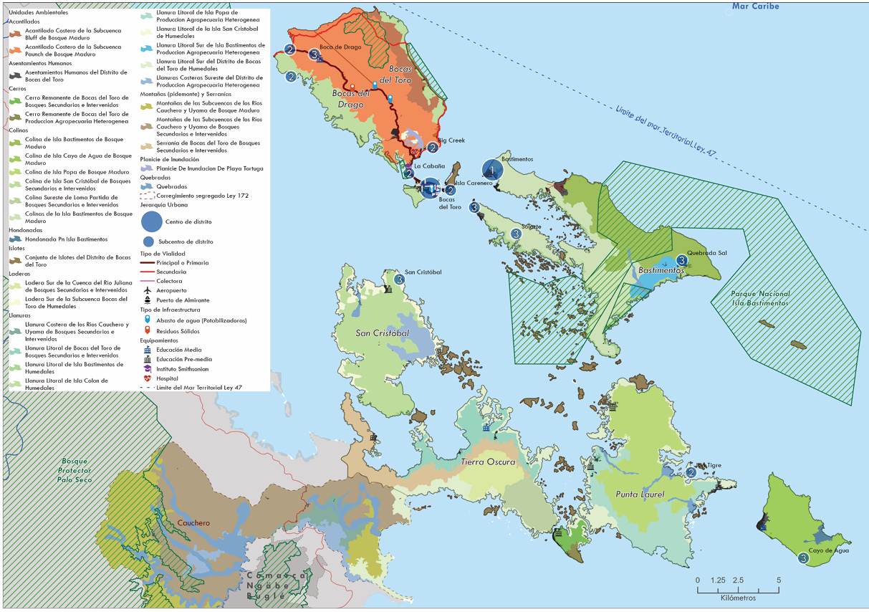
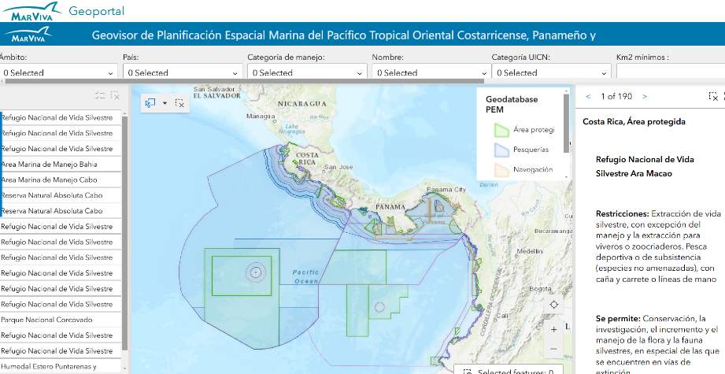
Results
Available information:
Previous Experiences with MSP:
Pacific Ocean
Golfo de Chiriquí
Geovisor PEM
Plan local de ordenamiento para el distrito de Bocas del Toro

Slide 10

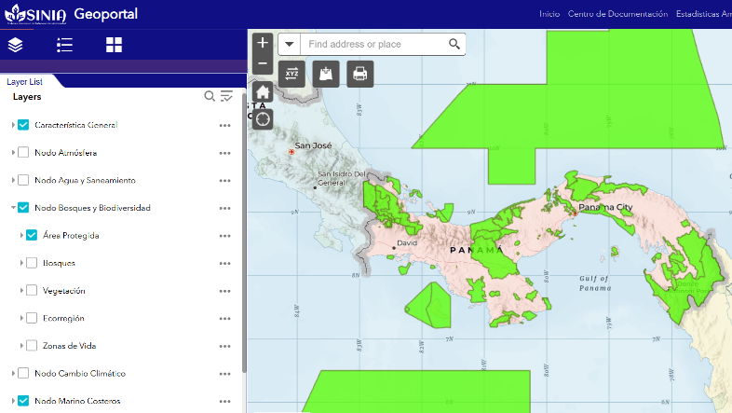
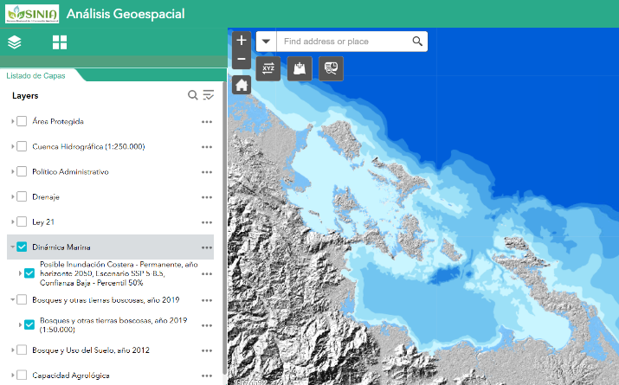
Results
Available information:
Atlases y Portals

Slide 11
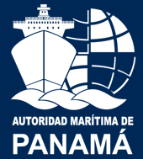
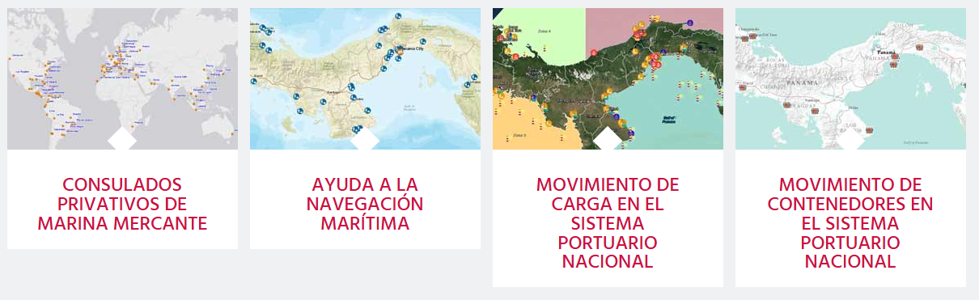
Results
Available information:
Atlases y Portals
Geoportal Marítimo

Slide 12
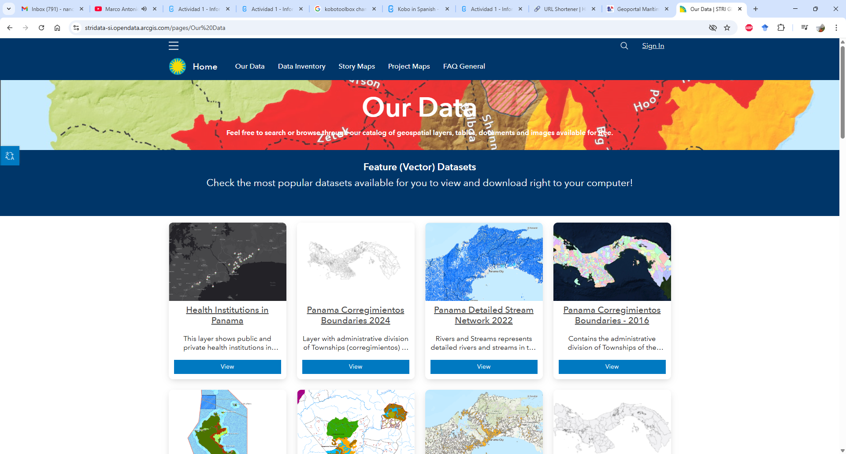
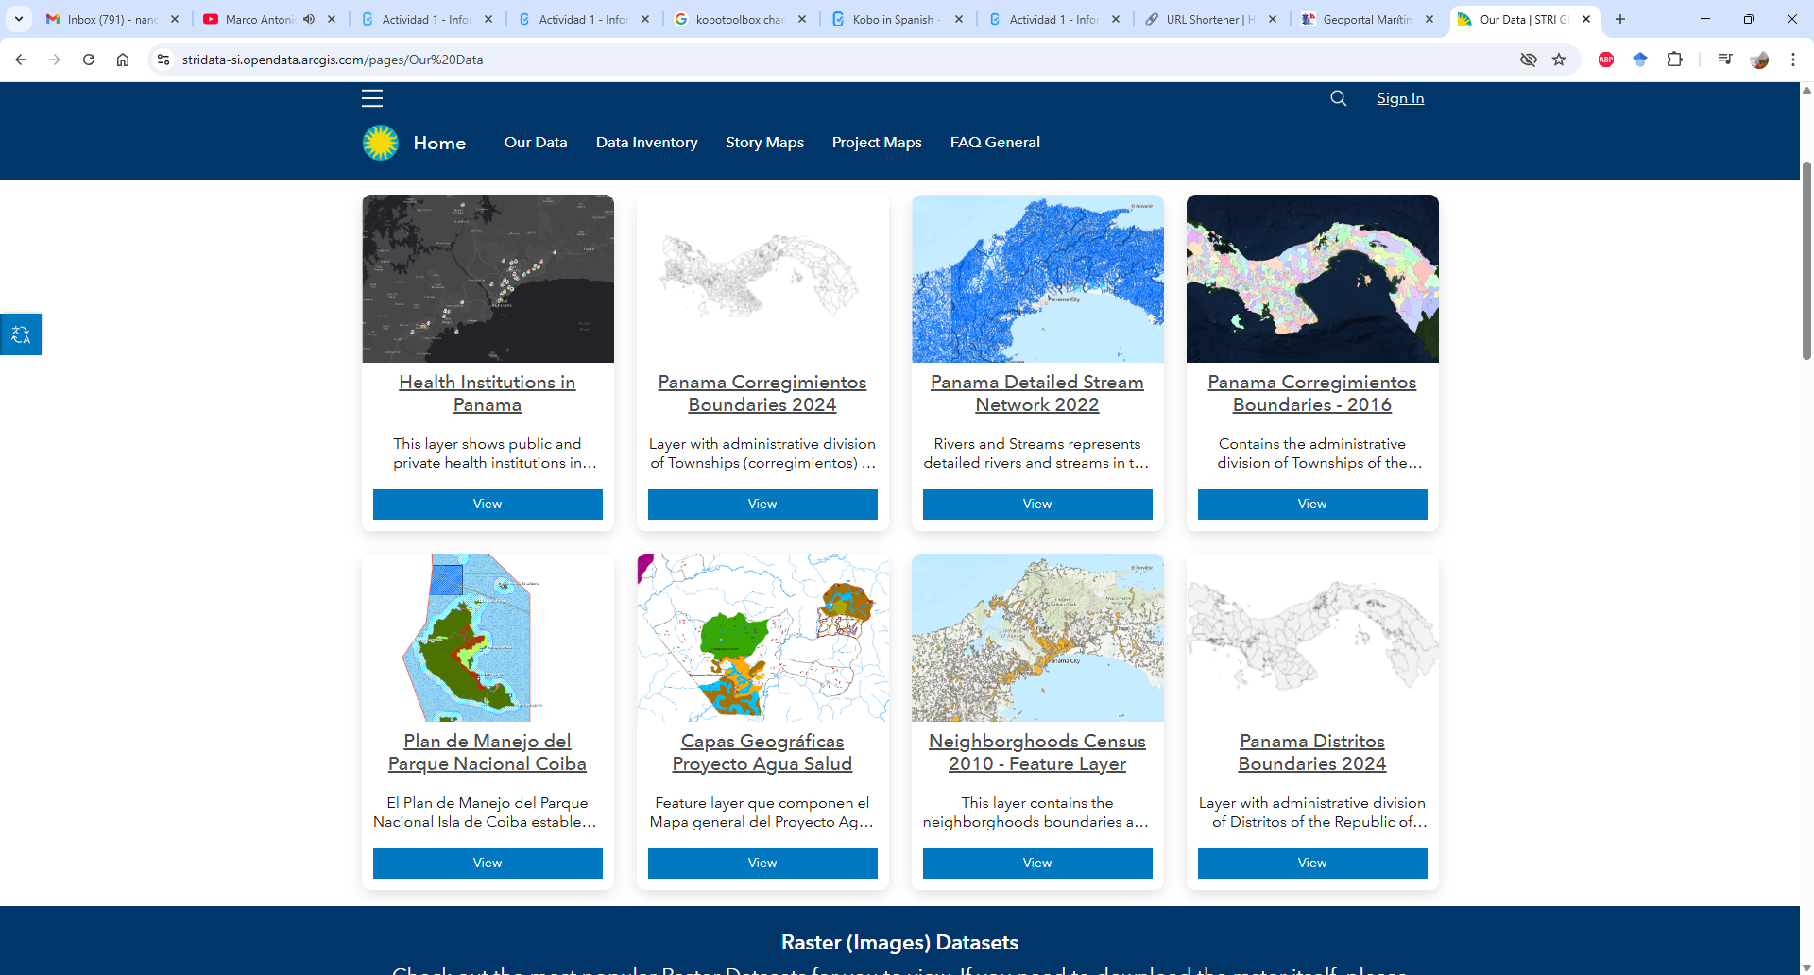
Results
Available information:
Atlases y Portals
Smithsonian Tropical Research Institute
STRI GIS Data Portal

Slide 13
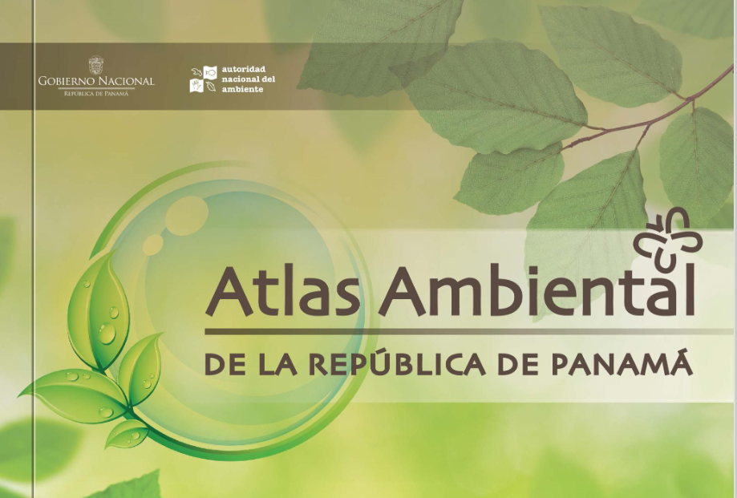
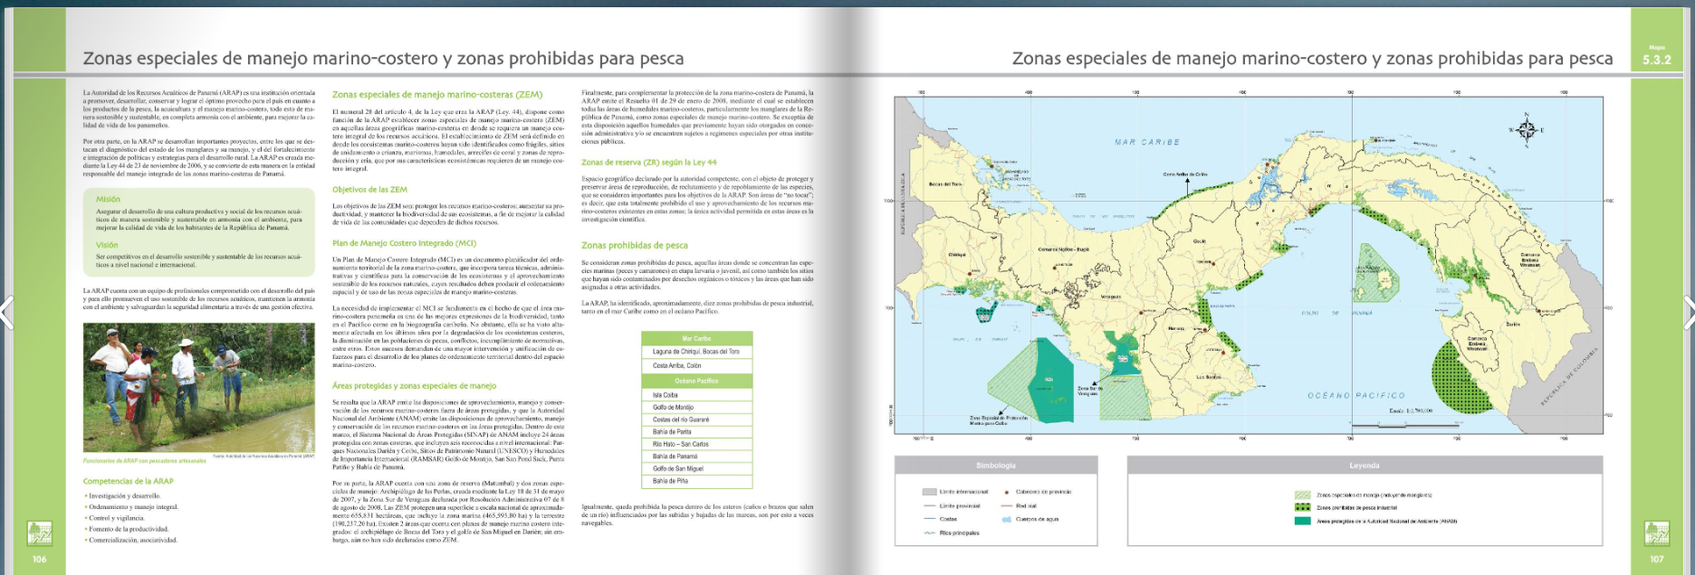
Results
Available information:
Atlases y Portals
Atlas Ambiental República de Panamá (2010)

Slide 14
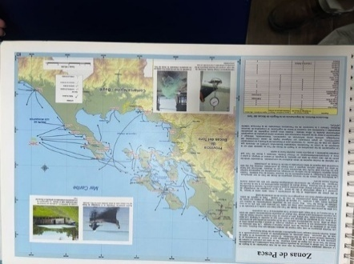
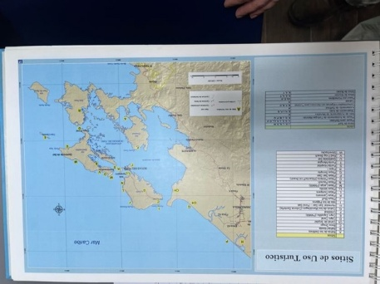
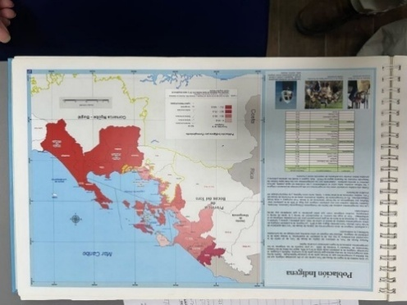
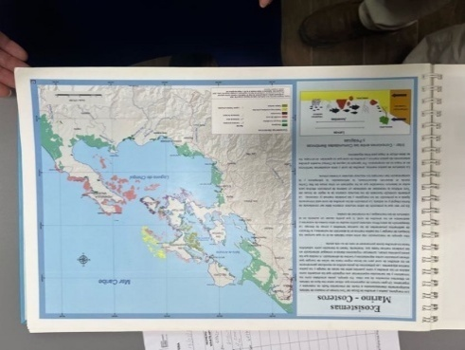
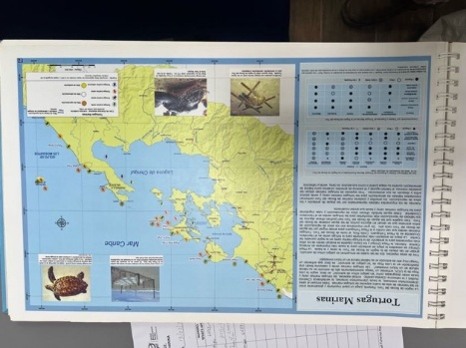
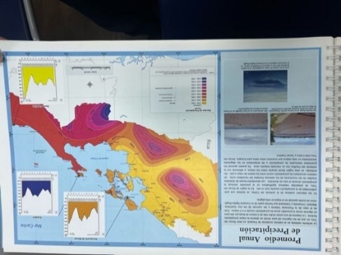
Results
Available information:
Atlases y Portals
Atlas de los Recursos Marino-Costeros de Bocas del Toro (2008)
Fishing Zones Touristic Sites Indigenous Population
Marine-coastal ecosystems Sea Turtles Annual Precipitation (mean)

Slide 15
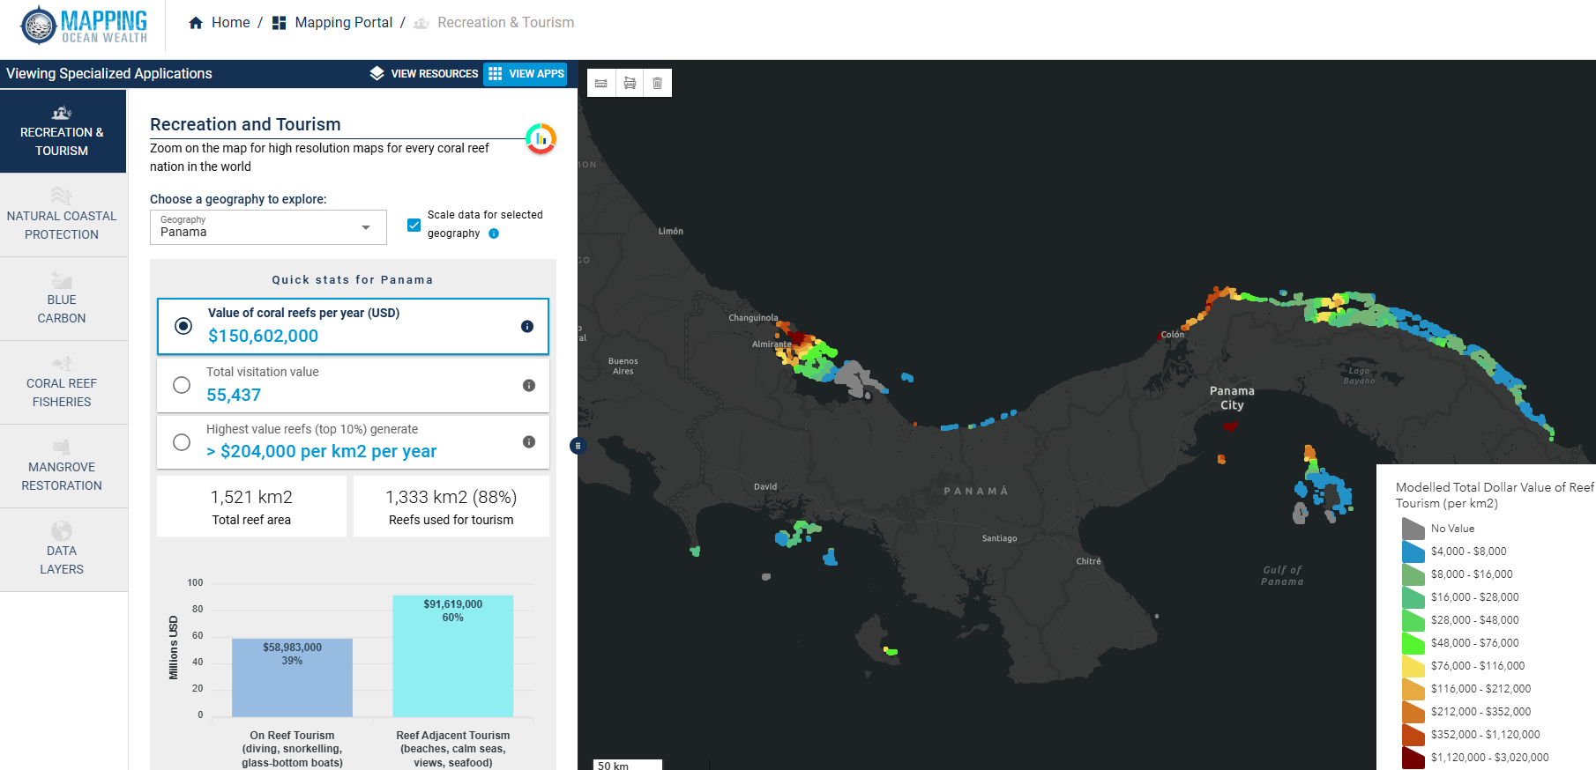
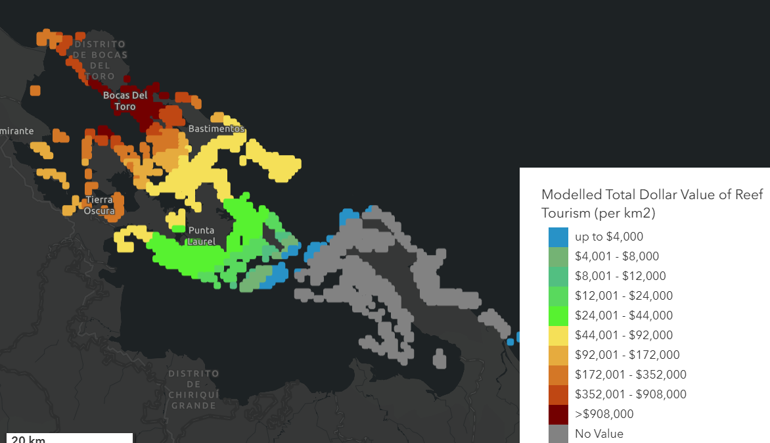
Results
Available information:
Atlases y Portals
Ocean Mapping Wealth

Slide 16
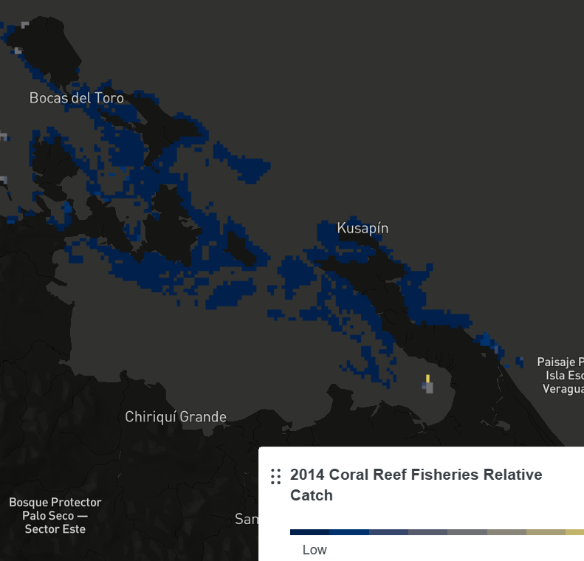
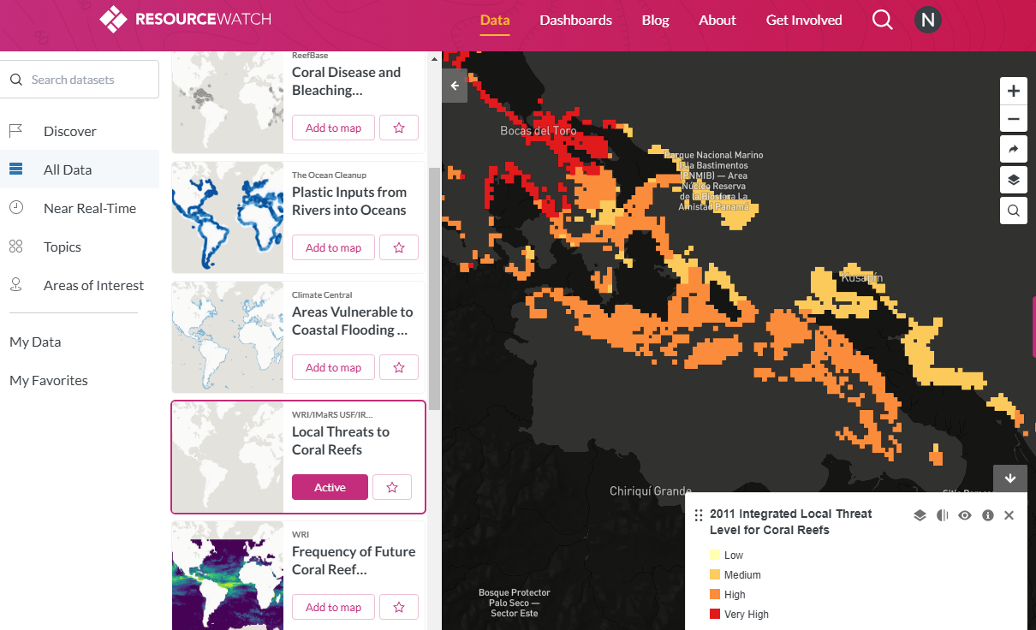
Results
Available information:
Atlases y Portals
Resource Watch

Slide 17
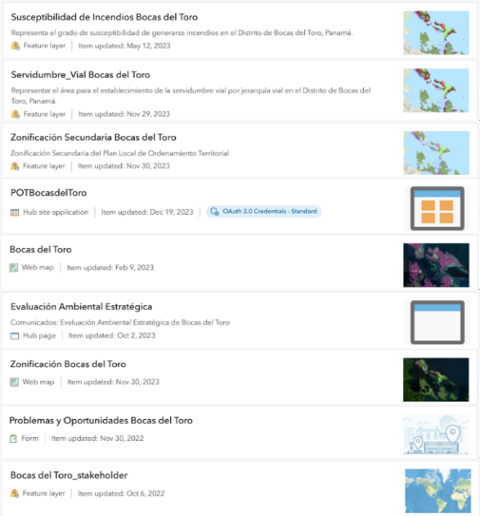
Results
Available information:
Atlases y Portals
ESRI
Examples of spatial layers in ESRI owned by the Panama Land Use Plan office

Slide 18
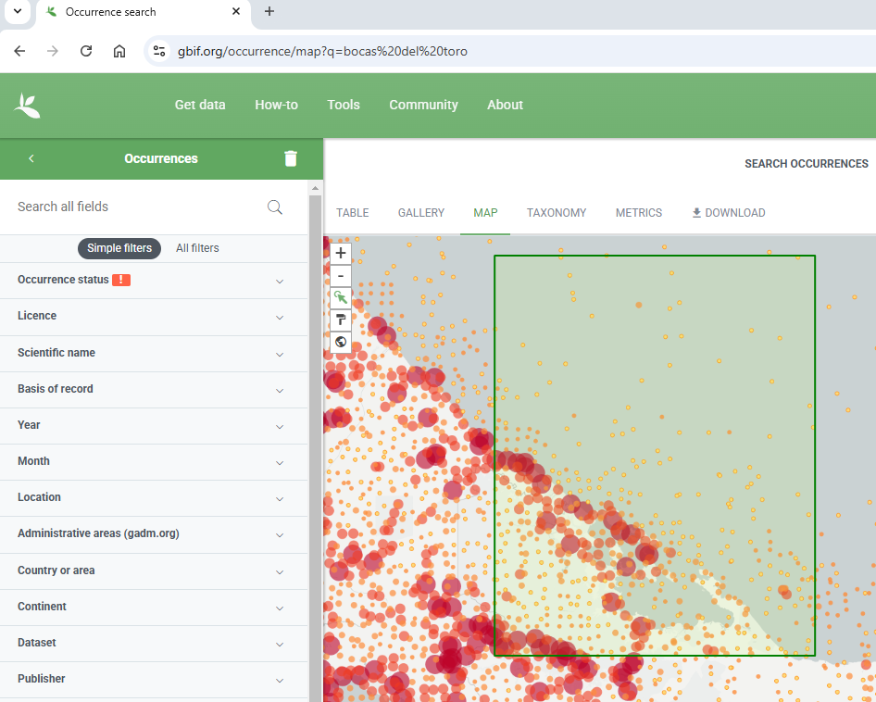
Results
Available information:
Atlases y Portals
Global Biodiversity Information— GBIF

Slide 19
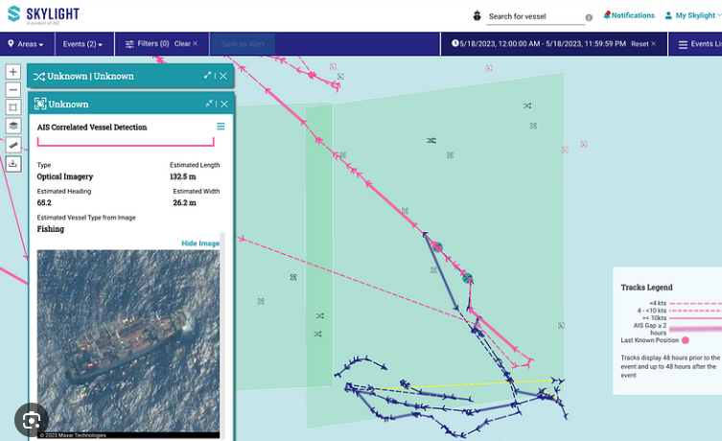
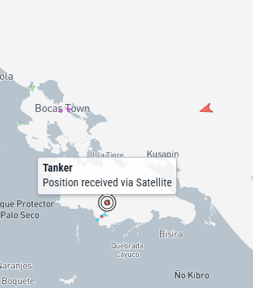
Results
Available information:
Atlases y Portals
Skylight
Marine Traffic

Slide 20
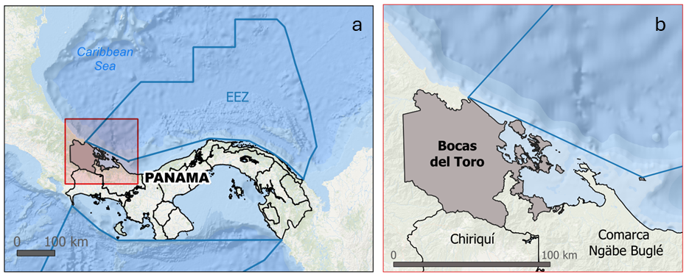
Results
Available information:
DATA | CAPAS | MAIN SOURCES
Marine Environment | Ambiente Marino
Boundaries | Límites | SINIA; ESRI; STRI GIS Data Portal, Atlas Ambiental de Panamá; Atlas Bocas del Toro
Country | Panamá
Administrative divisions | Provincia/Distrito/Corregimientos
Territorial Sea | Océano territorial
Exclusive economic zone | Zona económica exclusiva
Protected areas | Áreas protegidas
Watershed Units | Cuencas

Slide 21
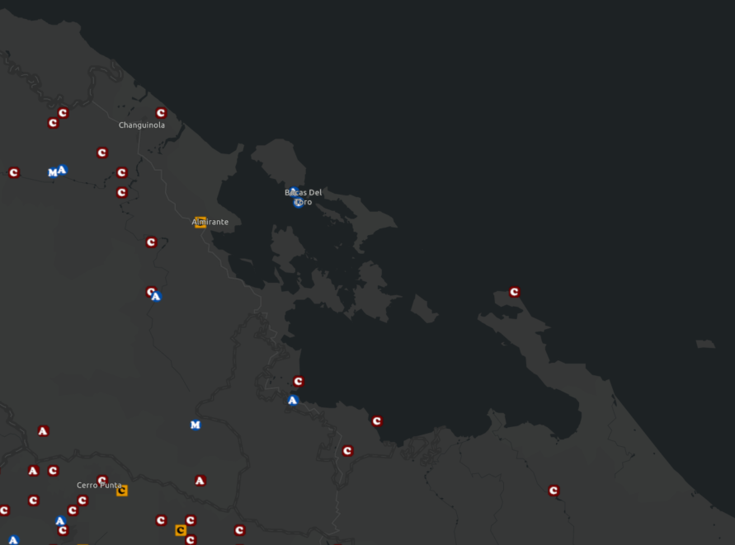
Estaciones Meteorológicas
Results
Available information:
STRI GIS Portal
DATA | CAPAS | MAIN SOURCES
Oceanographic conditions | Condiciones oceanográficas
Bathymetry | Batimetría | STRI website; STRI field station; Atlas de Bocas del Toro; ESRI; Resource Watch; Mapping Ocean Wealth; Atlas Ambiental Panamá; Atlas Bocas del Toro; Aviso+; Evaluación Ecorregiones Marinas Mesoamérica TNC-08; Bocas bathymetry map package
Sea surface temperature | Temperatura de la superficie del mar
Salinity | Salinidad
Currents | Corrientes oceanográficas
Nutrients | Nutrientes
Global tidal range | Rango global de mareas

Slide 22
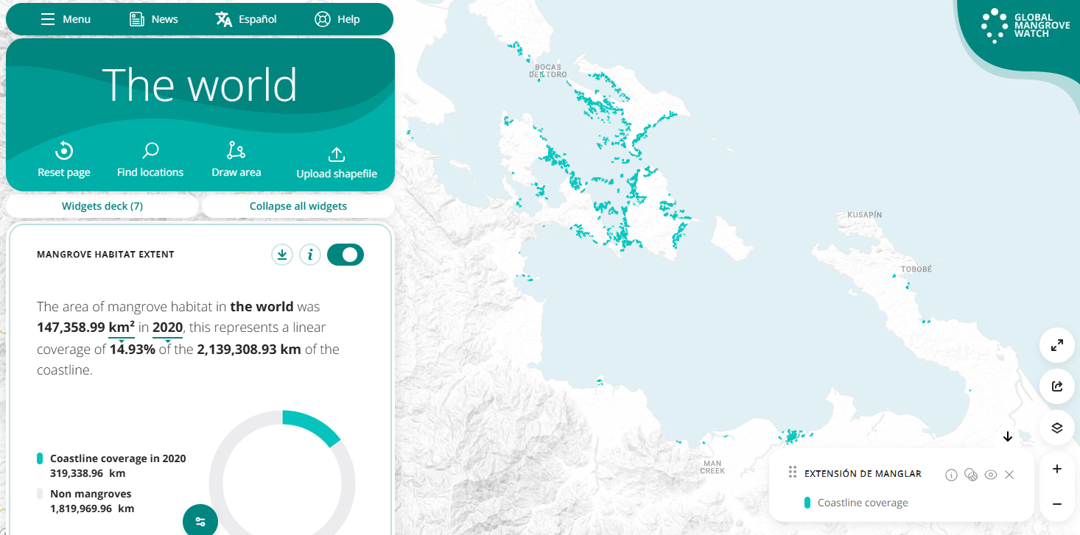
Extensión de Manglar
Results
Available information:
DATA | CAPAS | MAIN SOURCES
Marine Habitats | Hábitats Marinos
Coral reefs extent | Arrecifes de coral extensión | SINIA; ESRI; STRI GIS Data Portal; Atlas de Bocas del Toro; Allen Coral Atlas; Resource Watch; Mapping Ocean Wealth; Global Mangrove Watch, Atlas Ambiental Panamá; Atlas Bocas del Toro; Inventario Nacional de Humedales; Stewart et.al. 2022; Tiffany 2015; Guzman et.al., 1998; Guzman et.al., 2001; Guzman et.al., 2005; Kayes 2005; Thompson 2016; Shen 2016; Rodas, et.al., 2020; Seemann, et.al. 2014; Aronson et.al., 2014
Coral reef condition | Condición de los arrecifes de coral
Seagrass | Pastos marinos
Mangrove extent | Manglares
Salt marshes | Marismas
Swamps | Pantanos
Peatland (2018) | Turberas
Wetlands | Humedales

Slide 23
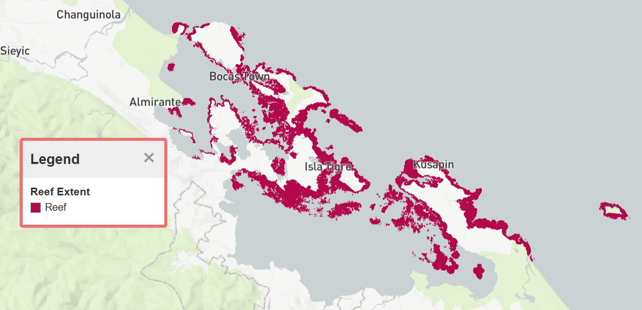
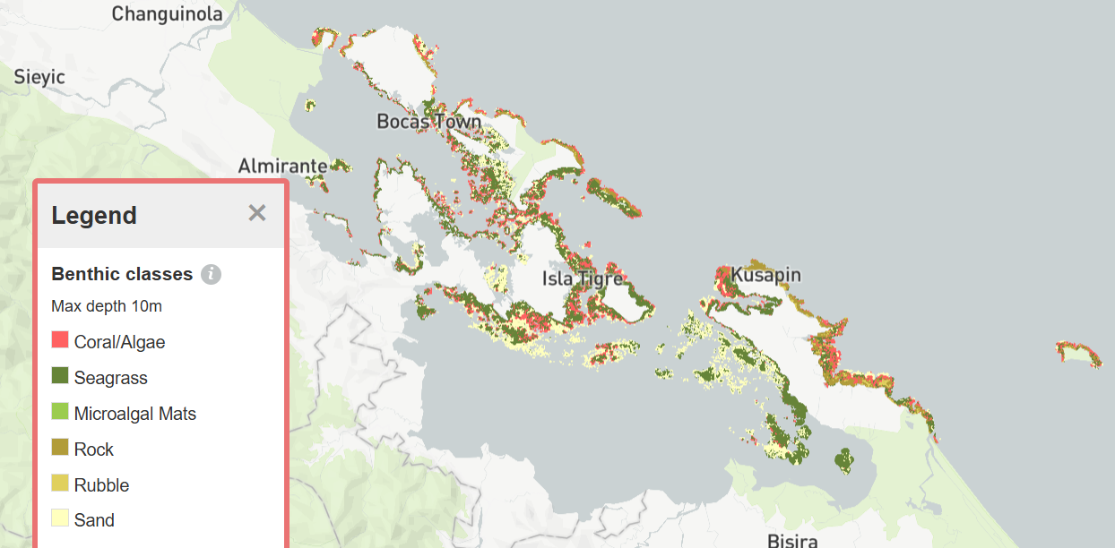
Results
The Allen Coral Atlas
Mangrove extension
https://allencoralatlas.org/
https://www.globalmangrovewatch.org/

Slide 24
Results
DATA | CAPAS | MAIN SOURCES
Species | Especies Marinas
Chlorophyl a | Clorofila a | Neo Nasa; Resource Watch; STRI field station; Cathalac
Fish species | Peces | Atlas de Bocas del Toro; Arocha et al., 2024; Gonzales Rodriguez, 2017; Liu 2018; Dominici and Wolff, 2005; Seemann, et.al. 2018
Sharks | Tiburones | Atlas de Bocas del Toro; Arocha et al., 2024; Gonzalez et.al., 2019; Collin 2005
Dolphins’ distribution | Delfines (distribución) | Atlas de Bocas del Toro; MiAmbiente; Lotzkat, et.al., 2010
Dolphin watching industry | Industria de observación de delfines | Barragán-Barrera, et.al., 2017; May-Collado, et. al., 2015; Lotzkat, et. al., 2010
Manatees | Manatíes | Atlas de Bocas del Toro; STRI; Reed 2017
Sea turtles nesting areas | Tortugas marinas (sitios de anidación) | Atlas de Bocas del Toro; MiAmbiente; STRI, INaturalist Parejo, et.al., 2025.
Sea turtles feeding grounds/migratory movements | Tortugas marinas (áreas alimentación/movimientos migratorios) | Meylan, et.al., 2013; Evans 2019; Guzman and Estevez, 2024; Pabon-Aldana, et.al., 2012

Slide 25
Results
DATA | CAPAS | MAIN SOURCES
Species | Especies Marinas
Sea cucumber distribution/abundance | Distribución/abundancia de pepino de mar | Atlas de Bocas del Toro; Merchan et.al., 2019
Star fish distribution/abundance | Distribución y abundancia de estrellas de mar | Atlas de Bocas del Toro; Guzman and Guevarra, 2002
Sponges’ distribution | Distribución de esponjas | Diaz 2005; Easson, et.al. 2015
Sea slugs’ distribution/identification | Distribución/identificación babosa marina | Goodheart, et.al., 2016; Neill, et.al., 2024
Spiny lobster distribution | Distribución de langostas | Atlas de Bocas del Toro; Arocha et al., 2024; Guzman and Tewfik, 2004
Sea lion (invasive) | Pez león (invasor) | Unión de pescadores artesanales bocatoreños (Almirante); ARAP
Sargassum | Sargazo | Atlantic Ocean Watch
Coral diseases/issues | Enfermedades/problemas de los arrecifes de coral | Mapping Ocean Wealth; Resource Watch; Li and Reidenback, 2014; Altieri, et.al., 2017; Berry, et.al., 2013

Slide 26
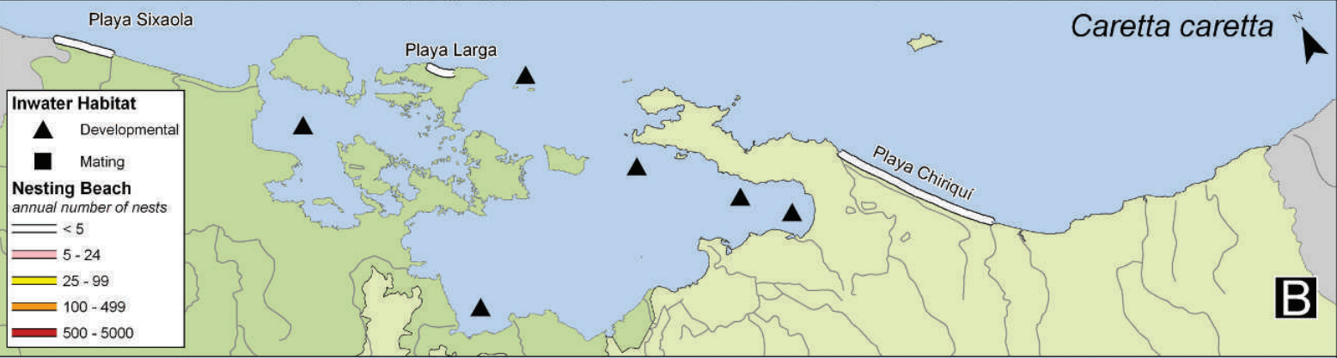
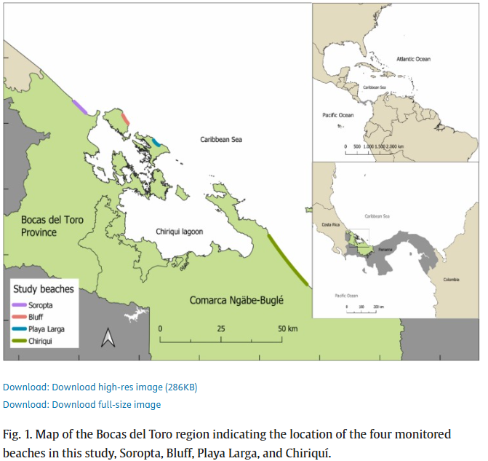
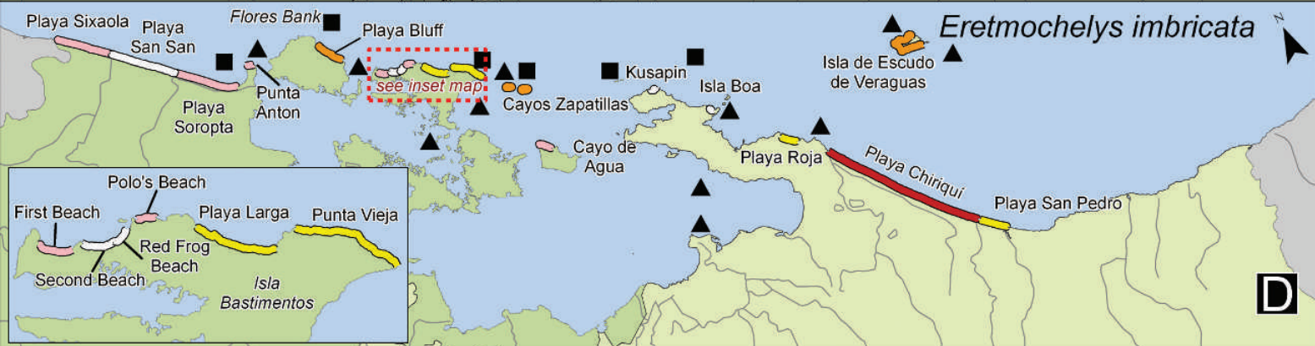
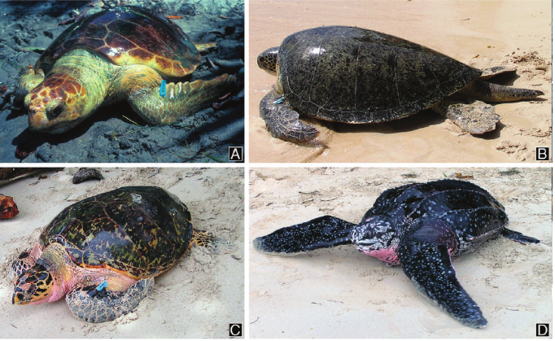
Nesting population trend of the leatherback sea turtle in Bocas del Toro province and Comarca Ngäbe-Buglé, Panama for the period 2002–2022.
Sea turtles of Bocas del Toro province and the comarca Ngöbe-Buglé, Republic of Panamá.
Meylan, A. B., Meylan, P. A., & Espinosa, C. O. (2013). Sea turtles of Bocas del Toro province and the comarca Ngöbe-Buglé, Republic of Panamá. Chelonian Conservation and Biology, 12(1), 17-33.
Parejo, S. G., Piacenza, S. E., García, R., Ordóñez, C., & Valverde, R. A. (2025). Nesting population trend of the leatherback sea turtle in Bocas del Toro province and Comarca Ngäbe-Buglé, Panama for the period 2002–2022. Global Ecology and Conservation, 57, e03415.

Slide 27
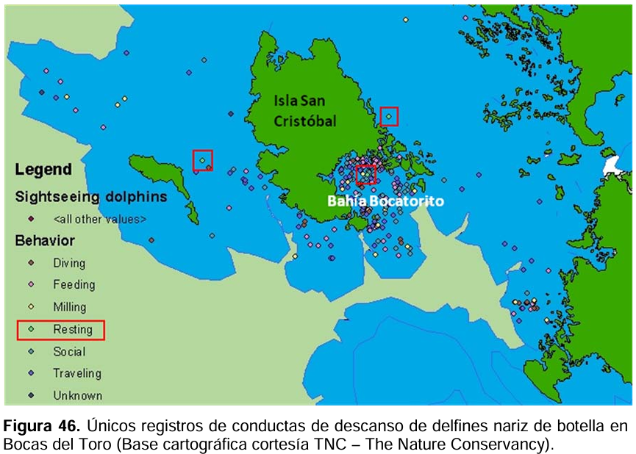
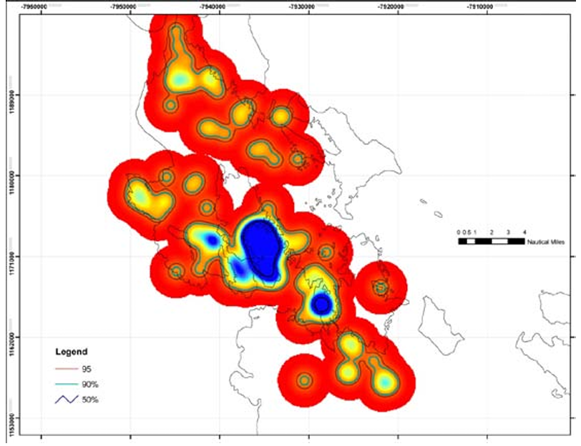
Notes on the easternmost population of Diploglossus bilobatus (Squamata: Anguidae) in Veraguas, Panama
Figura 24. Distribución del delfín nariz de Botella (análisis de densidad)
Lotzkat, S., Stadler, L., Carrizo, A., Hertz, A., & Kohler, G. (2010). Notes on the easternmost population of Diploglossus bilobatus (Squamata: Anguidae) in Veraguas, Panama. Salamandra, 46(1), 59-62.

Slide 28
DATA | CAPAS | MAIN SOURCES
Human activities | Actividades humanas
Maritime routes | Rutas marítimas (conocimiento local) | Atlas de Bocas del Toro; Global Fishing Watch; Skylight; Marine traffic; local maps at tourism operators
Commercial shipping lanes | Rutas de navegación comercial | Resource Watch
Fishing areas | Zonas de pesca | ARAP; Atlas de Bocas del Toro
Vessels distribution (based on AIS, SAR) | Distribución de embarcaciones (basado en AIS, SAR) | Skylight
Diving sites | Sities de buceo | Atlas de Bocas del Toro; Local maps at diving operators
Aids to navigation | Ayudas para la navegación | AMP; Atlas de Bocas del Toro
Buoys | Boyas | AMP; Atlas de Bocas del Toro
Landing sites/marinas/ports | Sitios de anclaje, marinas, y/o puertos | ARAP; AMP; Atlas de Bocas del Toro
Coral reef fisheries relative catch (2014) | Capturas relativas de las pesquerías de arrecifes de coral | Resource Watch; Atlas de Bocas del Toro
Mariculture sites | Compañías de Maricultura | ARAP; Bocas Mariculture; Dyer Aqua

Slide 29
DATA | CAPAS | MAIN SOURCES
Human activities | Actividades humanas
Modeled Fish Catch from the World's Coral Reefs | Captura de peces modelada de los arrecifes de coral del mundo | Mapping Ocean Wealth
Vessel and fishing statistics | Estadística de pesquería y registro de embarcaciones | ARAP; AMP
Captain licenses | Licencias para capitanes | AMP
Fishing licenses | Licencias de pesca | ARAP
Water tourism sites | Sitios de turismo acuático | Atlas de Bocas del Toro; Local maps at tourism operators
Value of coral reef tourism (2013) | Estimaciones del valor del turismo por arrecifes de coral | Resource Watch
Coral Reef Tourism Value and visitation | Estimaciones del valor y visitación en dólares de los arrecifes de coral para el sector turístico | Mapping Ocean Wealth
Tourism statistics | Estadísticas de turismo | Autoridad de Turismo de Panamá
Underwater archaeological sites | Sities arqueológicos subacuáticos | PANAMAR, 2021
Inspection reports | Reportes de inspecciones | AMP

Slide 30
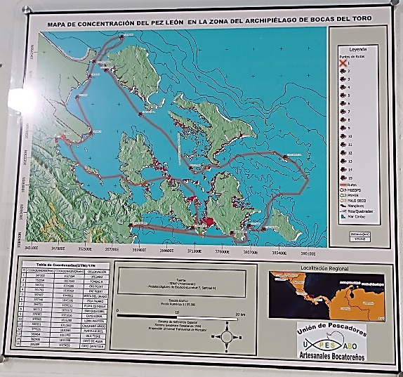
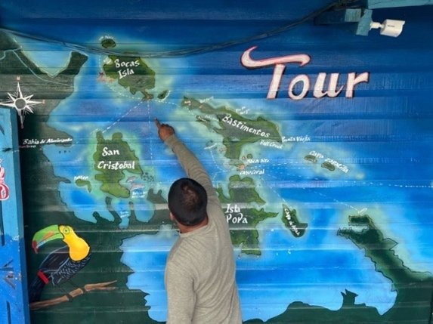
Local Knowledge
Maritime tourism transport Torres, S.A.
Members of the Union of Artisanal Fishermen of Bocas del Toro (UPESABO) documented the distribution of lionfish in the Bocas del Toro Archipelago. A framed poster version of the map was placed in its facilities.

Slide 31
Results
DATA | CAPAS | MAIN SOURCES
Climate Adaptation/Hazards | Adaptación climática/gestión de Riesgo
Susceptibility to Coastal Flooding in Bocas del Toro | Susceptibilidad a inundación costera en Bocas del Toro | Dirección de Cambio Climático del Ministerio del Ambiente; SINIA Atlas de Bocas del Toro; Atlas Ambiente República de Panamá; Instituto de Meteorología e Hidrología de Panamá
Rainfall deficit | Déficit de lluvias
Precipitation | Precipitación
Analysis of sea level rise in Isla Colon, Bocas del Toro | Análisis de aumento de nivel del mar en Isla Colón, Bocas del Toro | Ciniglio et. al. 2021; Grajales, et.al. 2022
Relative value of coral reef shoreline protection (2014) | Valor relativo de la protección de la costa de los arrecifes de coral (2014) | Resource Watch Atlas de Bocas del Toro, Atlas Ambiente República de Panamá
Landslide susceptibility | Susceptibilidad a deslizamientos de tierra
Predicted soil erosion prevalence (2020) | Prevalencia prevista de la erosión del suelo (2020)
Cumulative climate impacts on marine ecosystems (2017) | Impactos climáticos acumulativos en los ecosistemas marinos (2017)
Number of people avoiding damage from flooding per decade | Número de personas que evitan los daños causados por las inundaciones por década | Mapping Ocean Wealth; Atlas de Bocas del Toro; Atlas Ambiente República de Panamá
Economic values (GDP - PPP) protected from flooding per decade | Valores económicos (PIB - PPA) protegidos de las inundaciones por década | Mapping Ocean Wealth

Slide 32
Results
DATA | CAPAS | MAIN SOURCES
Climate Adaptation/Hazards | Adaptación climática/gestión de Riesgo
Fringing reefs providing protection to infrastructure/NTL | Importancia relativa de los arrecifes en la defensa de infraestructura contra inundaciones | Mapping Ocean Wealth
InVEST Hazards – Wind and Wave Index | Peligros InVEST – Índice de viento y olas | Mapping Ocean Wealth
Seasonal hypoxia and temperature inversions | Hipoxia estacional e inversiones de temperatura | Adelson, et.al., 2022
Climate and hydrological factors affecting variation in Chlorophyll concentration and water clarity | Factores climáticos e hidrológicos que afectan la variación en la concentración de clorofila y la claridad del agua | Collin, et.al. 2009
Impact of water runoff on marine environment | Impacto de la escorrentía de agua en el medio marino | |D’Croz, et.al., 2005; Pedersen, et.al. 2024;
Fire Susceptibility in Bocas del Toro | Susceptibilidad de incendios in Bocas del Toro | POT Atlas de Bocas del Toro, Atlas Ambiente República de Panamá
Global estimate of river plastic discharge into the world’s oceans for 2010 | Estimación mundial de la descarga de plástico en los océanos del mundo para 2010 | Resource Watch; Barragan-Barrera, et.al. 2024; Rhodes 2018
Mercury assessment on sharks | Evaluación de mercurio en tiburones
Total suspended matter | Materia total en suspensión
Water treatment plants in operation | Plantas de tratamiento de agua en funcionamiento | ESRI

Slide 33
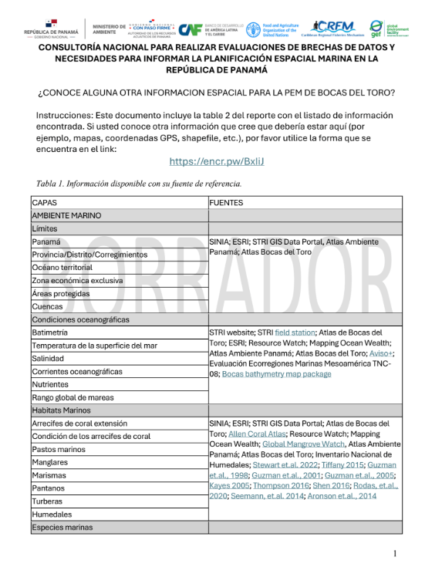
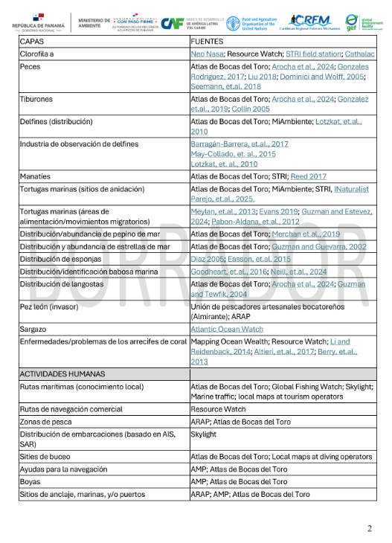
Form to suggest data sources:
https://encr.pw/BxIiJ
The deadline to submit suggestions is May 7, 2025
Table 2: Information available to inform MSP:
https://rb.gy/g216ad

Slide 34




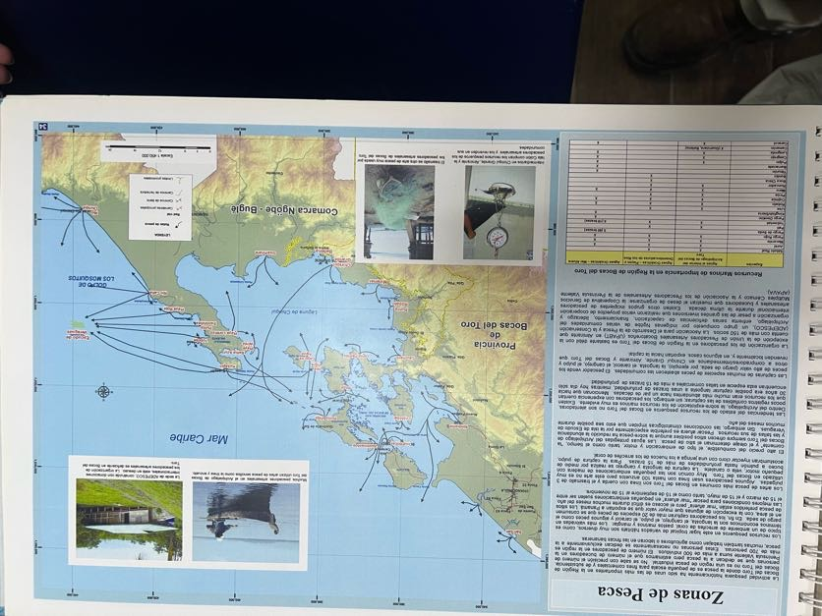
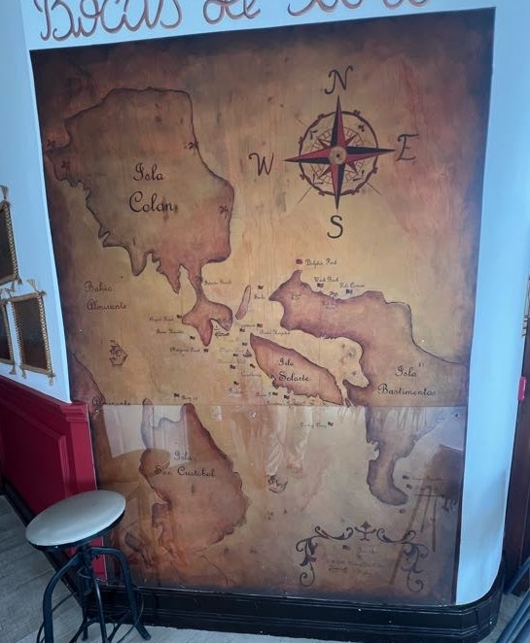
Results — Data gaps for MSP
The information (spatial format) is limited, it was produced for different purposes, at different scales, resolutions and periods...
Fishing Zones
(Atlas Bocas del Toro, 2008)
Participatory
Mapping
Atlases y Portals
Scientific Research
Fishing Areas
Sea routes
Marine habitats
Relevant marine species
Water Recreation Areas
Areas of conflict
Cultural or community sites
Economic value
Among others...
Diving sites

Slide 35
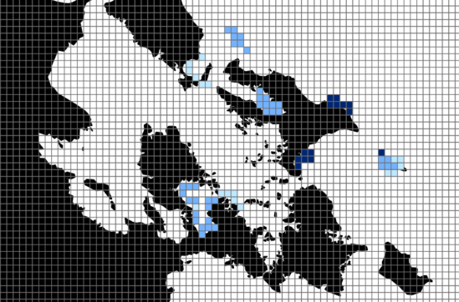


Isla Colon
Almirante
Bastimento
Isla
Cristóbal

Slide 36
Isla Colon
Almirante
Bastimento
Isla
Cristóbal

Slide 37
Isla Colon
Almirante
Bastimento
Isla
Cristóbal

Slide 38
Isla Colon
Almirante
Bastimento
Isla
Cristóbal

Slide 41
Results — Data need for MSP
Activity 2
Let's discuss the data needs tables and provide feedback as needed.
Are there any other spatial layers that you think should be included in this list?
Is there any feedback related to the priority given to each layer?
Who are the partners to collect this data (synergies to improve the current data catalog)?

Slide 42
Results — Data needs for MSP
Fisheries Data Distribution/location data: Small-scale fishery Recreational fishery Commercial fishery User conflict areas Diving sites for commercial species (e.g., lobster) Landing site’s locations Anchorages/mooring areas/locations Marina’s location Location of law enforcement reports Mariculture (current) Mariculture (potential areas) Statistical data: Fishing vessel characteristics (# of registered vessels by year/captain licenses) Estimated marine fish production for artisanal finfish, and spiny lobster (weight and value) Fisheries socio-economic data (fishers age and gender) Different font colors indicate the priority of data collection: High priority is red, medium priority is green, and low priority is purple. | Current/existing data situation: Data is available only for certain layers, such as diving sites and small-scale fishery, but must be updated and developed using a consistent spatial scale. Data collection methods: A participatory mapping methodology could be employed during the baseline assessment for collecting data on distributions. As the MSP progresses, other methods with higher spatial resolution could be used (e.g., distribution models and vessel tracking system). Satellite data could be used to estimate the location of medium/large size features. However, events should be ground truthing. The statistical fisheries data must use data from official reports. Partners for data collection: MiAmbiente ARAP SINIA Universities Cooperatives /Associations

Slide 43
Results — Data needs for MSP
Habitat/Biological Data Distribution data: Coral reefs Seagrass Mangrove Salt marshes Swamps Peat bogs Degraded habitats extent (e.g., coral bleach, seagrass loss, etc.) Fish species Areas of high biodiversity Nursing areas Lobster Sea turtle (nesting, feeding/resting areas) Dolphin Manatees Sea cucumber Starfish Invasive species (e.g., lionfish, sargassum, starfish) Different font colors indicate the priority of data collection: High priority is red, medium priority is green, and low priority is purple. | Current/existing data situation: Generalized habitat layers (coral reef and mangrove) information is available at different temporal and spatial scales. Data on the distribution and abundance of most of the marine species is scares, aged, and site specific. Data collection methods: Current information could be used for the baseline assessment. Further analyses would require higher resolution data from monitoring systems. A participatory mapping methodology could also be employed during the baseline assessment. This could be followed by the implementation of specific studies. Partners for data collection: MiAmbiente SINIA Universities Cooperatives /Associations

Slide 44
Results — Data needs for MSP
Oceanographic Data Distribution data: Bathymetry Chlorophyll a concentration Nutrients Ocean currents Prevailing winds Salinity Sea surface temperature pH Dissolve oxygen Ocean acidification Changes in sea surface temperature Changes in tides and waves Different font colors indicate the priority of data collection: High priority is red, medium priority is green, and low priority is purple. | Current/existing data situation: Satellite imagery provides much of this data, though the scale is often coarse. Data collection methods: Continue using global digital elevation models (DEM) (e.g., GEBCO, Seabed 2030). Based on specific objectives of MSP, obtain higher resolution data such as lidar data. Initiate analysis with current satellite derived data. Increase the number of oceanographic buoys to increase the resolution of the data throughout the entire archipelago. Partners for data collection: MiAmbiente SINIA Climate Change Directorate Universities Cooperatives /Associations

Slide 45
Results — Data needs for MSP
Tourism Data Distribution data: Distribution of tourist Watersports areas Diving and snorkeling areas Destination sites (on the water) Tourism statistics (passengers by airport, purpose of trip, expenditure, etc.) Visitor by resort and accommodation type Number of tour operators by activities (e.g., sightseeing, snorkeling, diving, etc.) Different font colors indicate the priority of data collection: High priority is red, medium priority is green, and low priority is purple. | Current/existing data situation: Tourism and water transportation businesses generally display destination or diving site maps in their facilities on walls or banners. However, digitized layers need to be updated for use in a MSP process. The country gathers tourism statistics. There is an opportunity to suggest/gather additional local statistical information for the MSP process. Data collection methods: A participatory mapping methodology could be employed during the baseline assessment for collecting data on distributions. As the MSP progresses, other methods with higher spatial resolution could be used (e.g., distribution models and vessel tracking system). National yearly tourism and recreation statistics. Partners for data collection: MiAmbiente SINIA Panama Tourism Authority Universities

Slide 46
Results — Data needs for MSP
Transportation Data Distribution/location data: Large ships distribution (AIS) Port locations Aids to navigation Buoys Obstacles and wrecks Different font colors indicate the priority of data collection: High priority is red, medium priority is green, and low priority is purple. | Current/existing data situation: The AIS of large vessels provides some information. Current data (e.g., aids to navigation, buoys, etc.) needs updating and verification. Data collection methods: Vessel tracking system (AIS). This information is already available. However, it is important to verify and keep up to date by ground truthing it. Partners for data collection: MiAmbiente SINIA AMP

Slide 47
Results — Data needs for MSP
Other Data Distribution data: Seafloor infrastructure (cables, pipes, etc.)/ Infrastructure marina (cables, pipas, etc.) Pollution (agricultural discharge, plastic and solid waste, etc.) Hazard risk coastal areas (vulnerability assessments) Different font colors indicate the priority of data collection: High priority is red, medium priority is green, and low priority is purple. | Current/existing data situation: Outdated site-specific data is available. Data collection methods: Implementation of specific studies. Improve agencies internally communication and data sharing mechanisms related to military operations and infrastructure related to coastal defense and maritime law enforcement, as allowed by national security policies. Partners for data collection: MiAmbiente SINIA AMP Climate Change Directorate

Slide 48

MSP Trainings
Activity 3
Do you have any recommendations for training courses about PEM?
1.

Slide 49

RECOMMENDATIONS — Gathering information
Indigenous communities
Maricultors
Participatory Mapping: is a methodology that allows local communities to actively participate in the creation of maps that reflect their knowledge, use of the territory, problems and aspirations. This is built from the experience and perspective of the inhabitants of the place themselves.
Scientists
Technicians
Stakeholders
Tour operators
NGOs
Participatory mapping also helps engage stakeholders in the early stages of the PEM process
Fisherfolk
Participatory mapping
Maritime transportation
Other
Government
It is essential to follow the guidelines of social, environmental and gender inclusion, treating fishers and communities as partners in the management of marine resources. Value their traditional knowledge and opinions, clearly communicating interests about biodiversity, and maintain a constant commitment to local participation.
It is recommended to partner with academic centers and NGOs to collect specific data, improving baseline assessment.

Slide 50


RECOMMENDATIONS — PEM Analyses
ESRI has the leading software that allows you to capture, manage, analyze, visualize, and share geospatial information, i.e., data related to locations on the Earth's surface. Many organizations already use their products.
The government of Panama should look to negotiate access to the ESRI license (e.g., ArcGIS, dahsboards, etc.)for its main agencies in PEM.
The use of specialized software such as Marxan is suggested.
This program, used worldwide, manages complex planning solutions and evaluates the impact of different scenarios, complemented by spatial analysis in GIS software such as ArcGIS Pro and QGIS.
Average Risk: 12.55
Low risk
High risk
Count: 113
Min: 0.002
Max:94.08
Sum:1418
Mean:12.56
Std. Dev:16.04
Planning Units

Slide 51

RECOMMENDATIONS — Capacity building and information exchange
Panama has experience in the development of onshore projects and government agencies have qualified technicians and necessary resources such as computer equipment and software.
Staff at most agencies is limited and manages multiple projects.
Ideally, an MSP team would include a project manager, a GIS specialist, a marine ecologist, a stakeholder engagement and communications specialist, a policy and legal expert, an information technology specialist, an economist, and field technicians or data collectors.
The MSP process should be designed and implemented with the
assistance of a multisectoral technical advisory committee.
Panama has developed the National Environmental Information System (SINIA) to facilitate access to information. The collaboration with the SINIA team offers the opportunity to create and test MSP tools within the platform, starting with Bocas del Toro and potentially extending to other MSP initiatives in the country.

Slide 52

Agenda
MARINE
SPATIAL PLANNING
Data gap and needs assessment
Bocas del Toro Archipelago
Thanks
Dr. Nancy Montes
nancymontes@gmail.com

