Slide 1
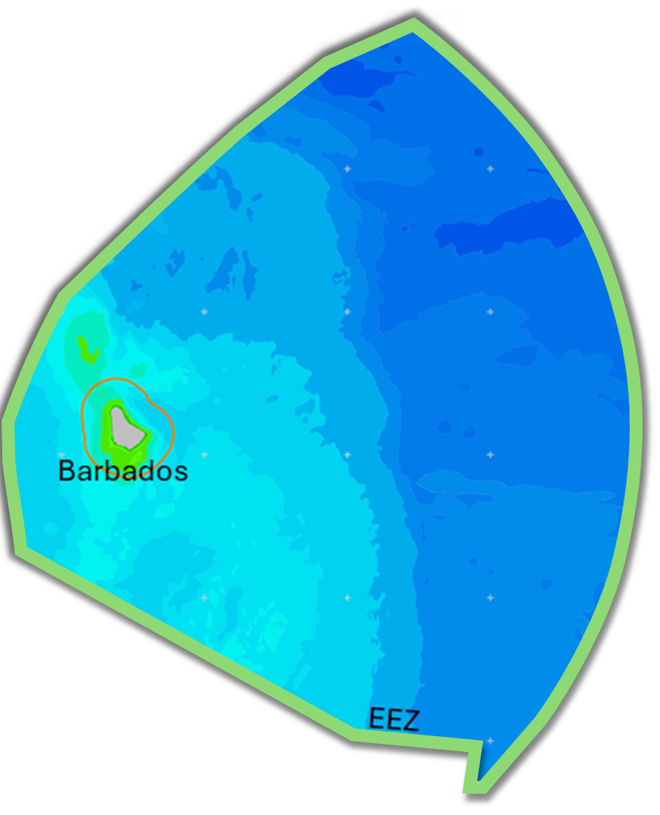
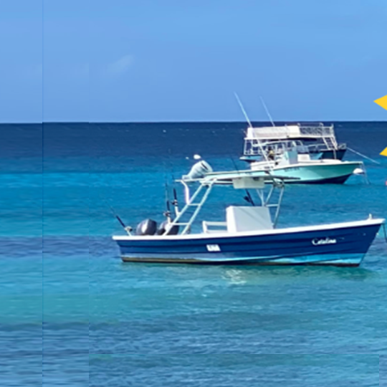





National Validation Workshop
DATA GAP AND NEEDS ASSESSMENT
FOR THE FISHERIES SECTOR
TO INFORM MARINE SPATIAL PLANNING IN BARBADOS
Dr. Nancy Montes
BE-CLME+ Project: Promoting National Blue Economy Priorities Through Marine Spatial Planning in the Caribbean Large Marine Ecosystem Plus (GEF Project ID 10211).

Slide 2

BE-CLME+ Project: Promoting National Blue Economy Priorities Through Marine Spatial Planning in the Caribbean Large Marine Ecosystem Plus (GEF Project ID 10211).
DATA GAP AND NEEDS ASSESSMENTS FOR THE FISHERIES SECTOR
TO INFORM MARINE SPATIAL PLANNING IN BARBADOS
Agenda
1. Welcome and Overview of Workshop
2. Overview of BE CLME+ Project
3. Blue Economy Roadmap Fisheries Sector Strategy and Implementation Plan
4. Data Gap and Needs Assessments for the Fisheries Sector to Inform MSP in Barbados
4.1. Assess the status of MSP processes in Barbados
4.2. Data currently available that could be used to inform MSP
4.3. Data needs to inform MSP
4.4. Data access.
Data sharing mechanism
Training and resource needs
4.5. Conclusions and recommendations
5. Closing remarks
Overview
Background
Objectives
Approach
Results
Conclusions
Notes:
.

Slide 3

BE-CLME+ Project: Promoting National Blue Economy Priorities Through Marine Spatial Planning in the Caribbean Large Marine Ecosystem Plus (GEF Project ID 10211).
DATA GAP AND NEEDS ASSESSMENTS FOR THE FISHERIES SECTOR
TO INFORM MARINE SPATIAL PLANNING IN BARBADOS
Promoting Barbados Blue Economy
Through Marine Spatial Planning
The Blue Economy
refers to the sustainable use of ocean resources for economic growth, improved livelihoods, and jobs while preserving the health of ocean ecosystem.
It emphasizes balancing economic development with the preservation of marine environments.
Marine Spatial Planning is a process that guides where and when human activities occur in the marine environment.
It aims to optimize the use of marine space and resources while minimizing conflicts and impacts on the marine ecosystem.
Overview
Background
Objectives
Approach
Results
Conclusions

Slide 4

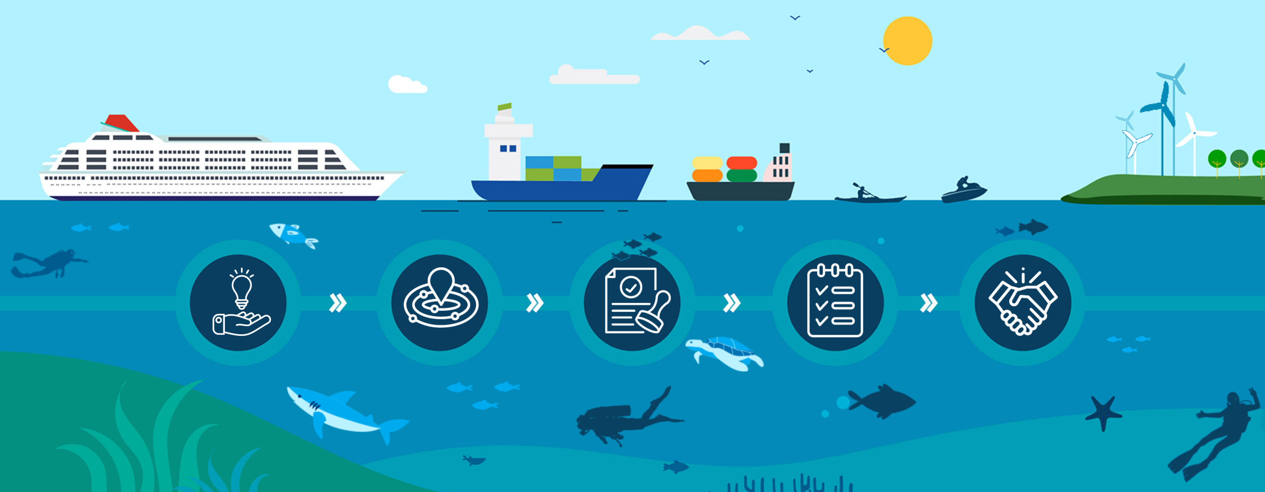
BE-CLME+ Project: Promoting National Blue Economy Priorities Through Marine Spatial Planning in the Caribbean Large Marine Ecosystem Plus (GEF Project ID 10211).
DATA GAP AND NEEDS ASSESSMENTS FOR THE FISHERIES SECTOR
TO INFORM MARINE SPATIAL PLANNING IN BARBADOS
MARINE SPATIAL PLANNING
Overview
Background
Objectives
Approach
Results
Conclusions
https://barbadosmarinespatialplan.com/

Slide 5
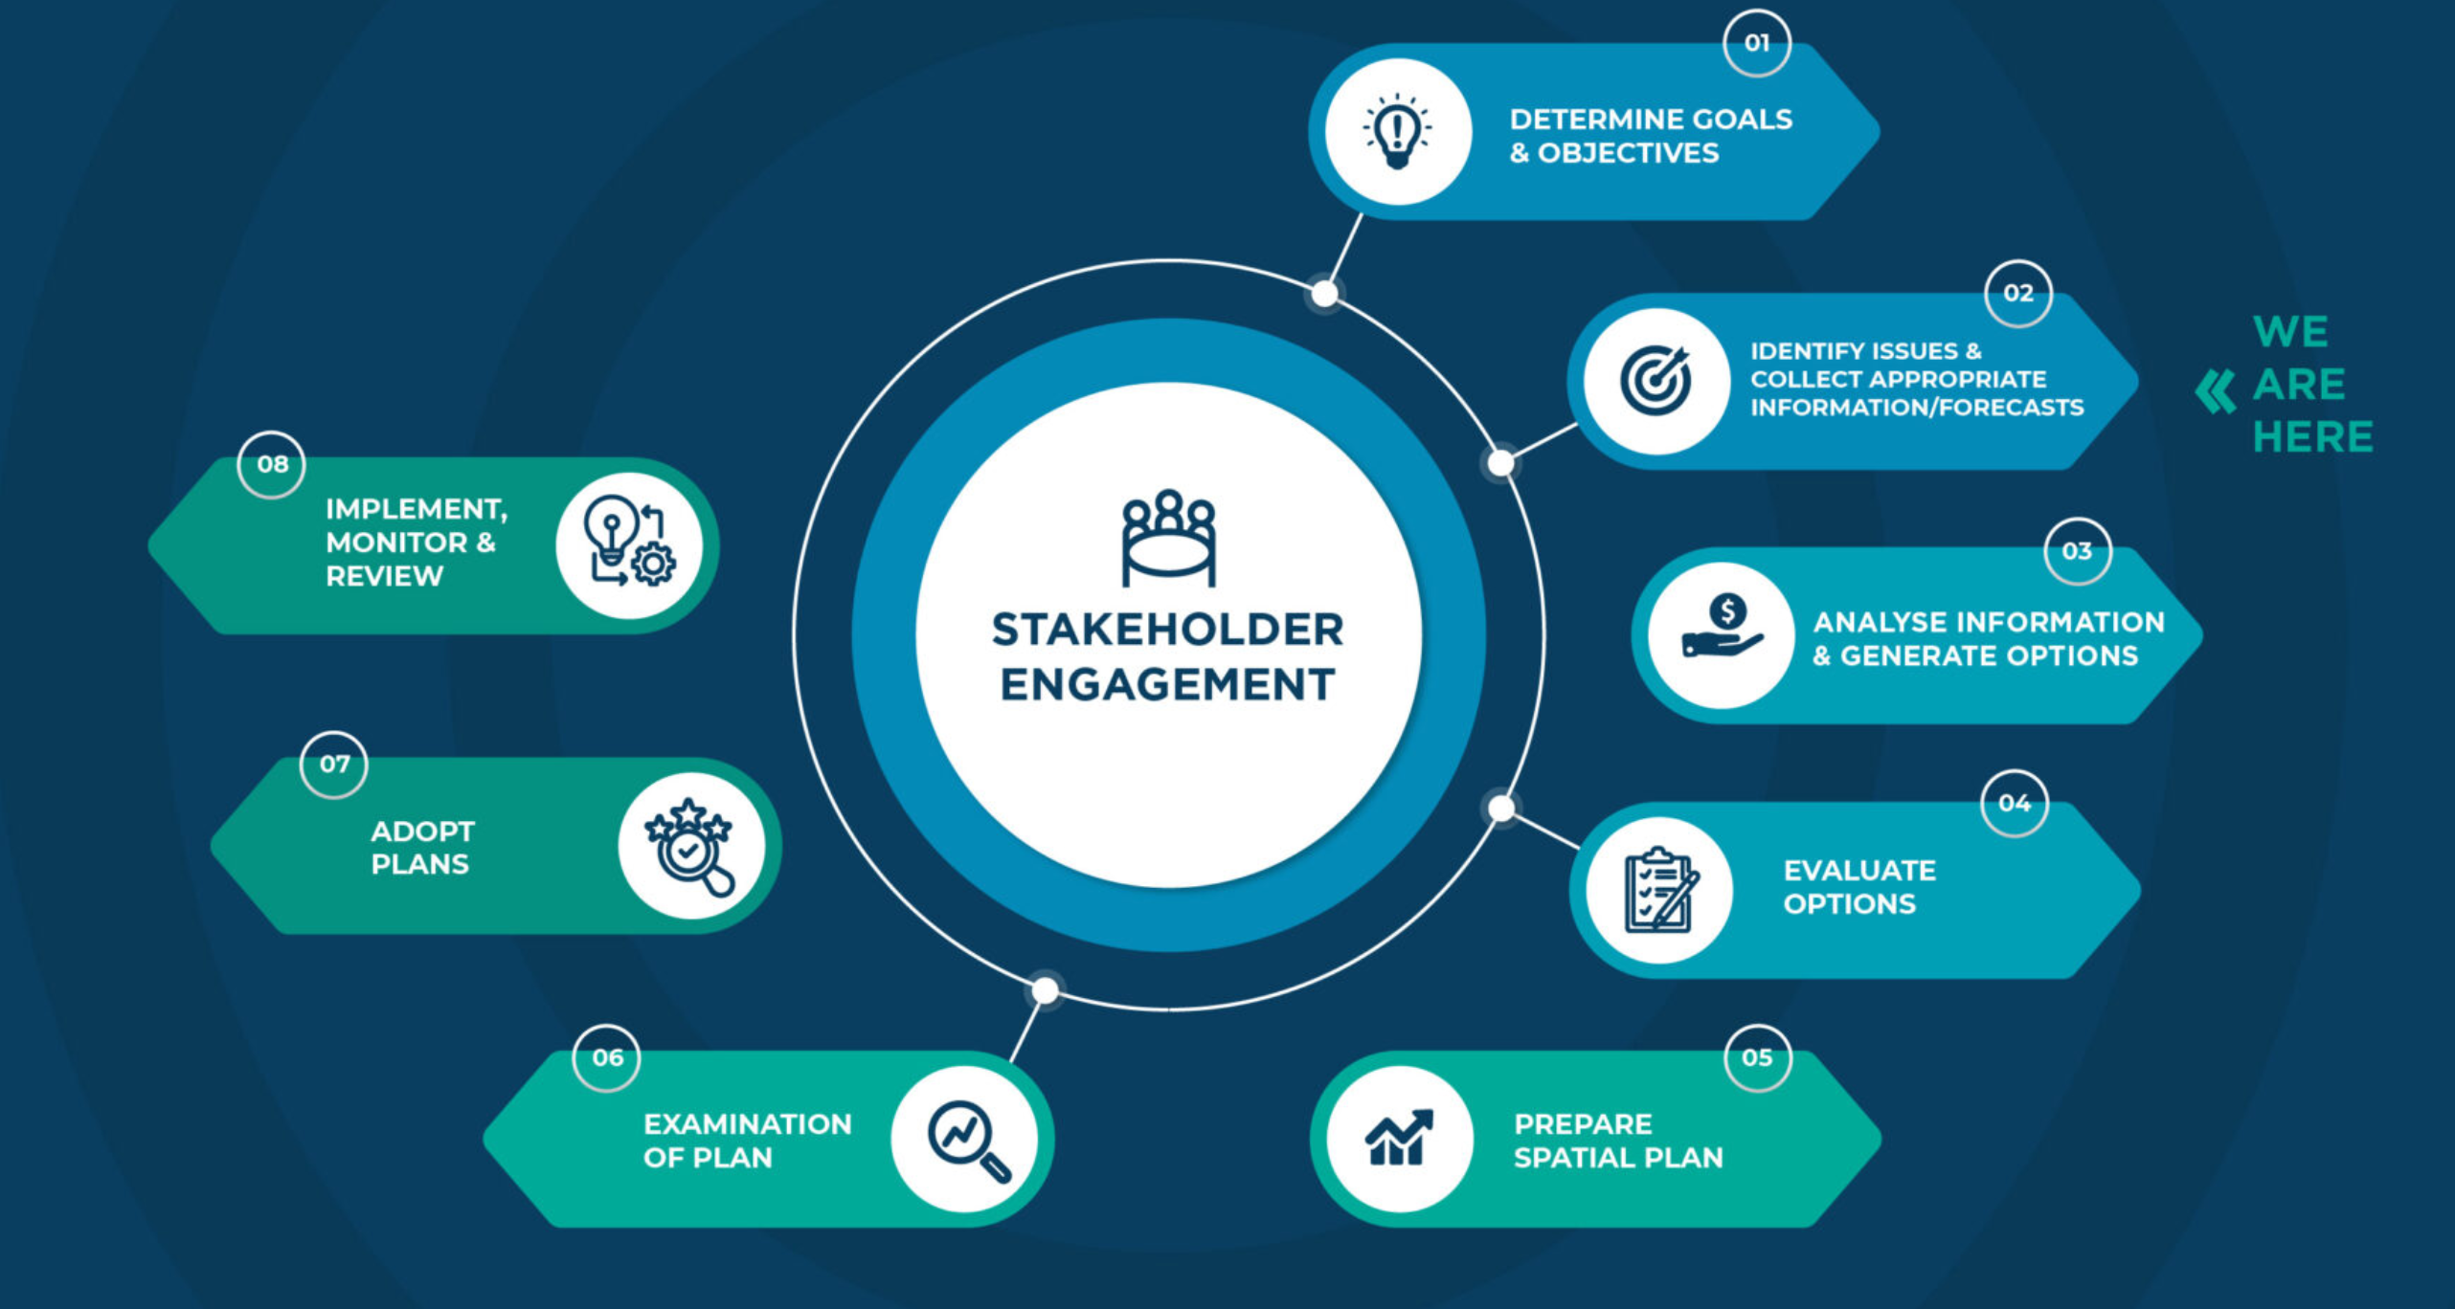
BE-CLME+ Project: Promoting National Blue Economy Priorities Through Marine Spatial Planning in the Caribbean Large Marine Ecosystem Plus (GEF Project ID 10211).
DATA GAP AND NEEDS ASSESSMENTS FOR THE FISHERIES SECTOR
TO INFORM MARINE SPATIAL PLANNING IN BARBADOS
MARINE SPATIAL PLANNING
The Barbados Marine Spatial Plan Project Steering Committee
Overview
Background
Objectives
Approach
Results
Conclusions
https://barbadosmarinespatialplan.com/

Slide 6
DATA GAP AND NEEDS ASSESSMENTS FOR THE FISHERIES SECTOR
TO INFORM MARINE SPATIAL PLANNING IN BARBADOS
Objective
The objective of this consultancy is to comprehensively assess data availability, data gaps, and an assessment of needs specifically related to the fisheries sector to inform MSP in Barbados.
Overview
Scope of Work
Background
Types and sources of data being used to inform MSP
Assess spatial and temporal data needs relevant to Blue Economy planning
Terms to access data, including an assessment of barriers to access data
Recommend data sources, acquisition costs
Capacity needs for data analysis and interpretation to inform MSP
Objectives
Approach
Results
Conclusions

Slide 7

DATA GAP AND NEEDS ASSESSMENTS FOR THE FISHERIES SECTOR
TO INFORM MARINE SPATIAL PLANNING IN BARBADOS
Methodology
Systematic literature review
Structured Interviews
Geospatial files
Overview
GPS information
Background
Maps
Objectives
Google Scholar (97 results)
CERMES (109 results)
AquaDocs (35 results)
Snowball review
Suggestions from interviews
Spatial atlases and databases (7)
“Barbados” “GIS” “Fisheries”
Participatory mapping exercise
Approach
1. Current fishing grounds
2. Historical fishing grounds
3. Fish nursing grounds
4. Fish spawning aggregation areas
5. Locations of known conflict
6. Locations of fish aggregation devices
Results
Conclusions

Slide 8
DATA GAP AND NEEDS ASSESSMENTS FOR THE FISHERIES SECTOR
TO INFORM MARINE SPATIAL PLANNING IN BARBADOS
Results
Fisheries distribution
  Mapping exercise
Marine habitats
Species distribution
Oceanographic data
Other relevant layers for the fisheries sector
Overview
Background
Objectives
Activity 1: ARE THERE ANY MISSING DATA?
Please let us know if there are any SPATIAL data (e.g., maps, GPS coordinates, shapefiles, etc.) that you are aware of, but it was not included in the report/presentation by using the form in the link:
Approach
Results
Activity 1
https://rb.gy/r8nk1v

Slide 9
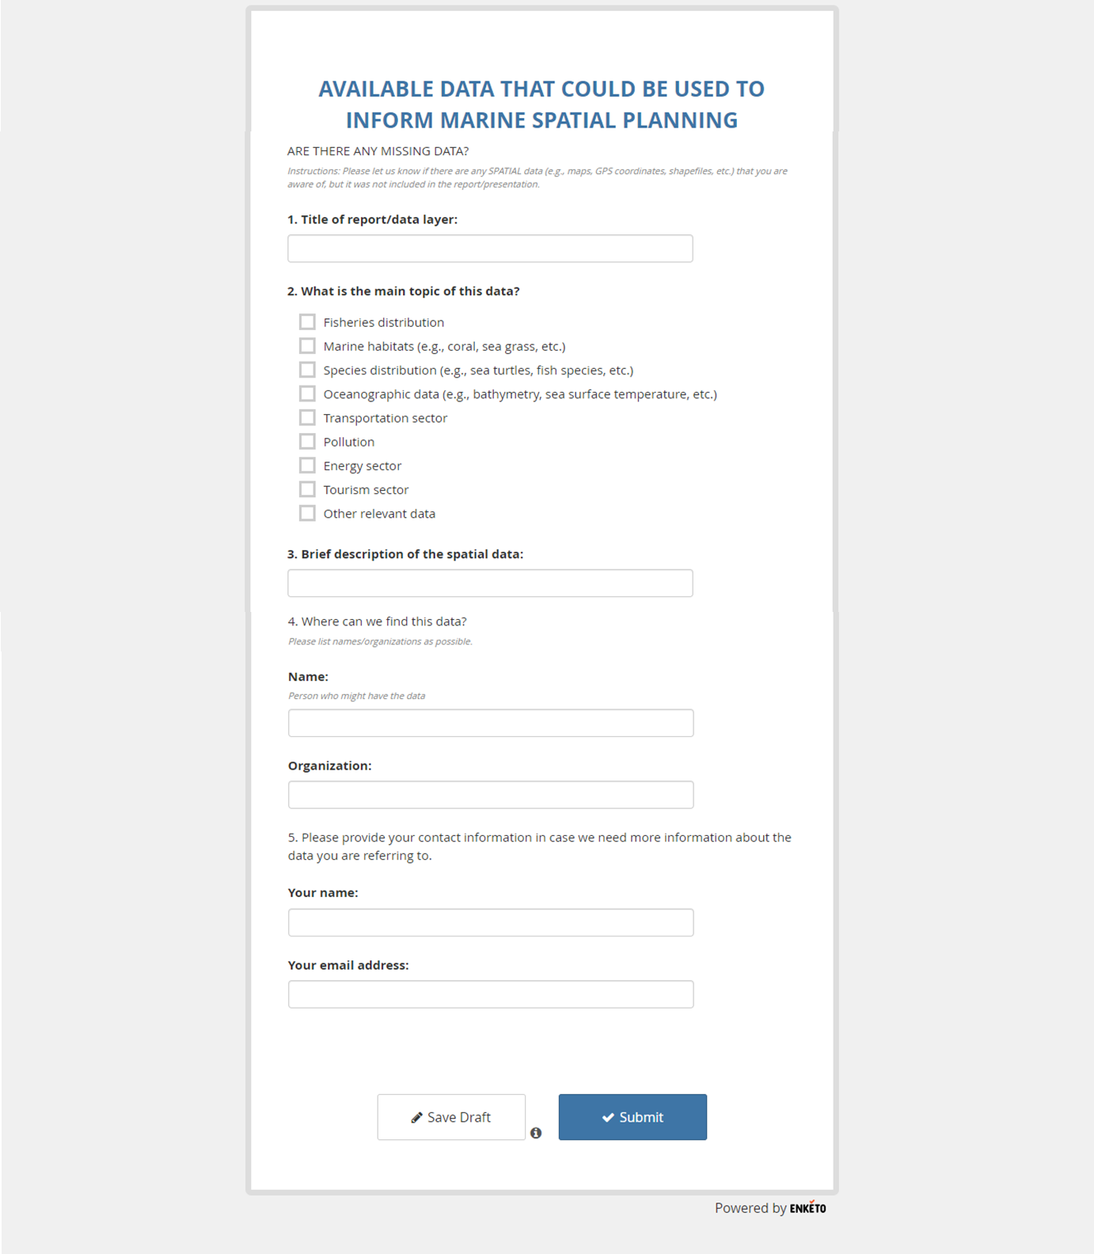
DATA GAP AND NEEDS ASSESSMENTS FOR THE FISHERIES SECTOR
TO INFORM MARINE SPATIAL PLANNING IN BARBADOS
Overview
Background
Objectives
Approach
Results
Activity 1

Slide 10
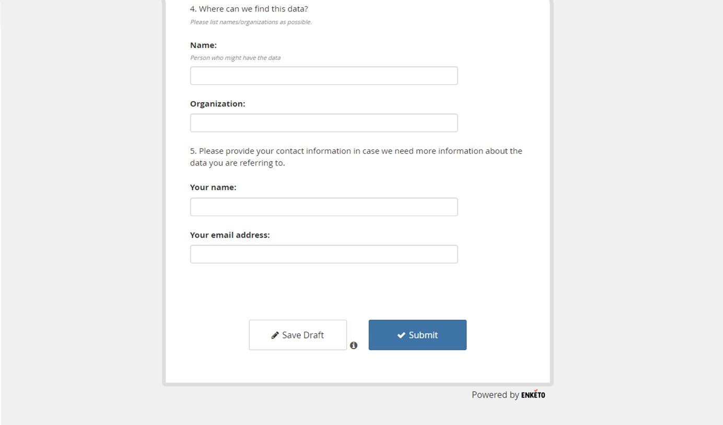
DATA GAP AND NEEDS ASSESSMENTS FOR THE FISHERIES SECTOR
TO INFORM MARINE SPATIAL PLANNING IN BARBADOS
Overview
Background
Objectives
Approach
Results
Activity 1

Slide 11
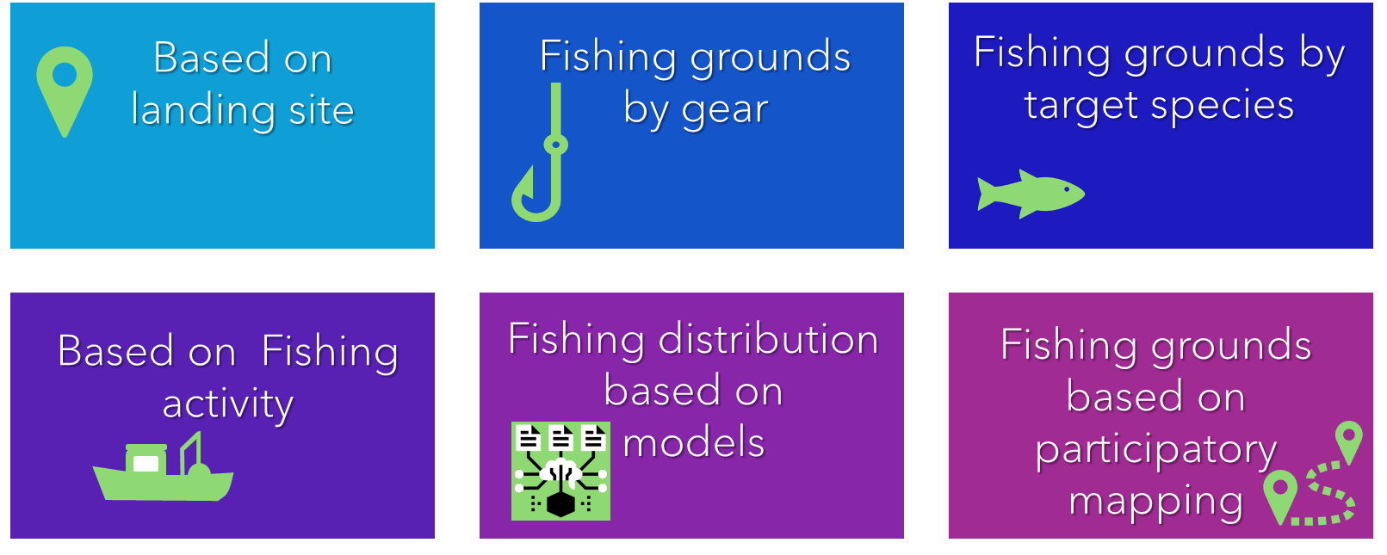
DATA GAP AND NEEDS ASSESSMENTS FOR THE FISHERIES SECTOR
TO INFORM MARINE SPATIAL PLANNING IN BARBADOS
Results
Fisheries distribution
Overview
Background
Objectives
Approach
Results
Activity 1

Slide 12
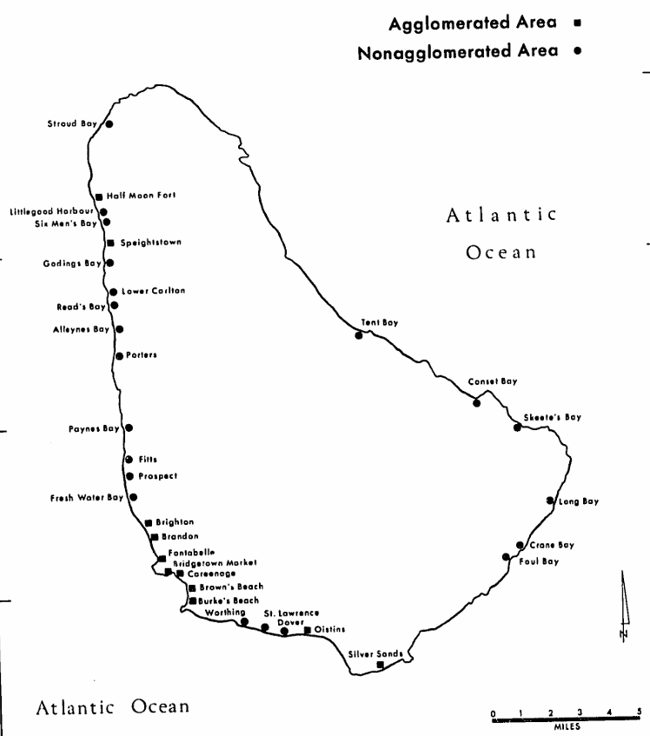
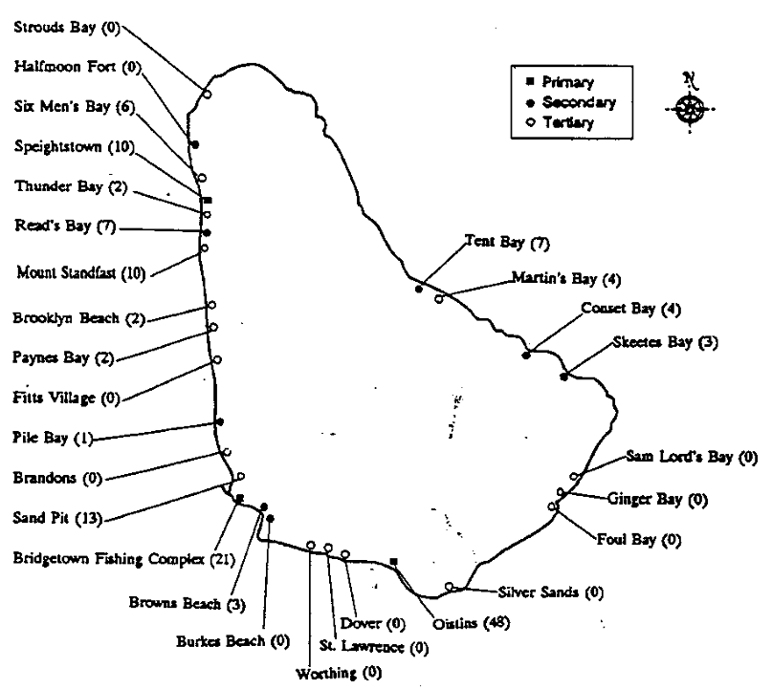
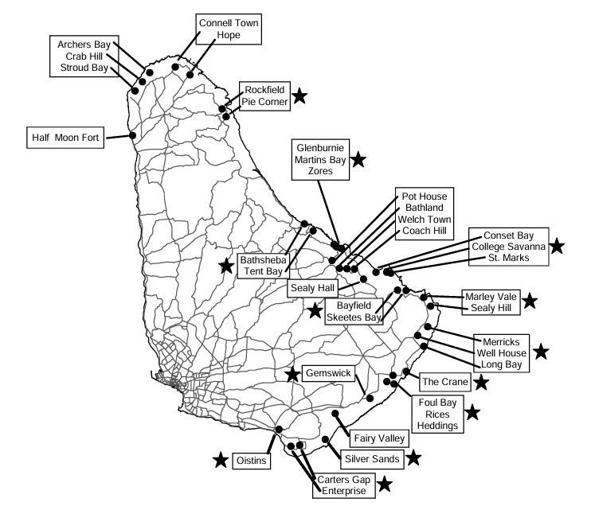
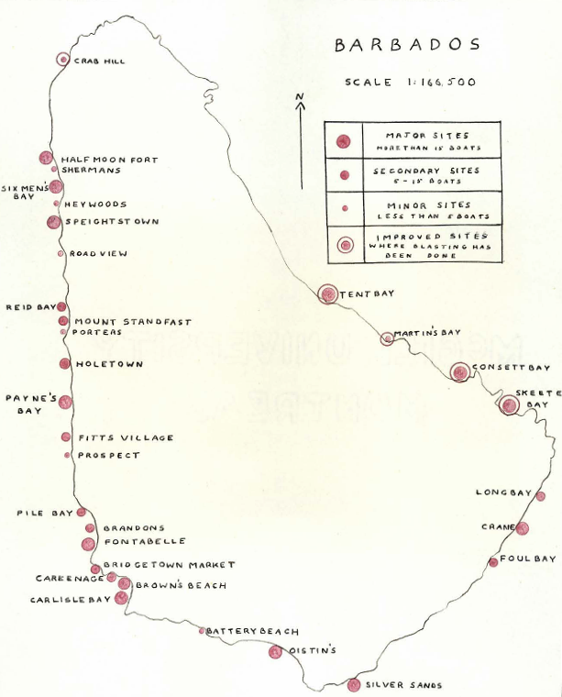
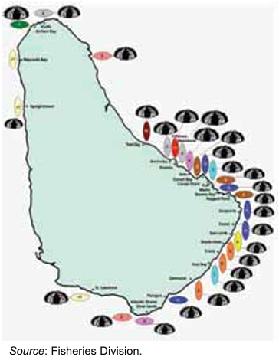
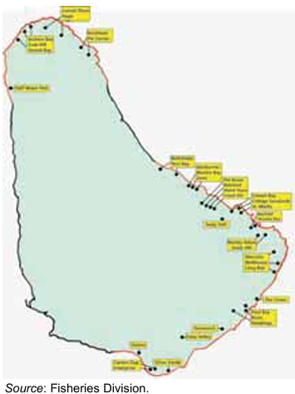
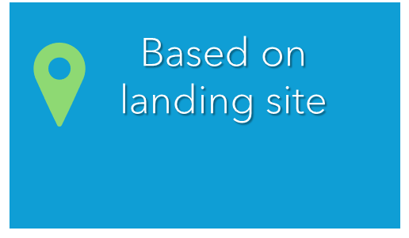
DATA GAP AND NEEDS ASSESSMENTS FOR THE FISHERIES SECTOR
TO INFORM MARINE SPATIAL PLANNING IN BARBADOS
Results — Fisheries distribution by landing site
Bair 1962
Cecil 1973
Prescod et al. 1996
Mahon et al. 2003
Salas et al. 2011

Slide 13
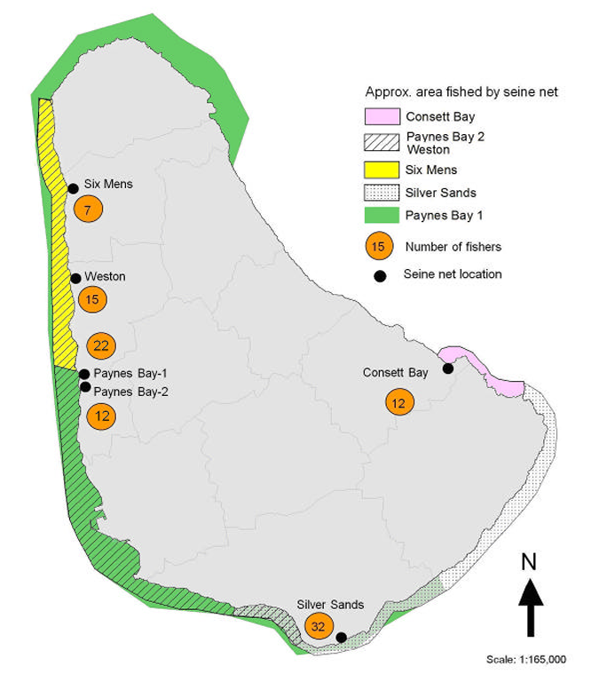
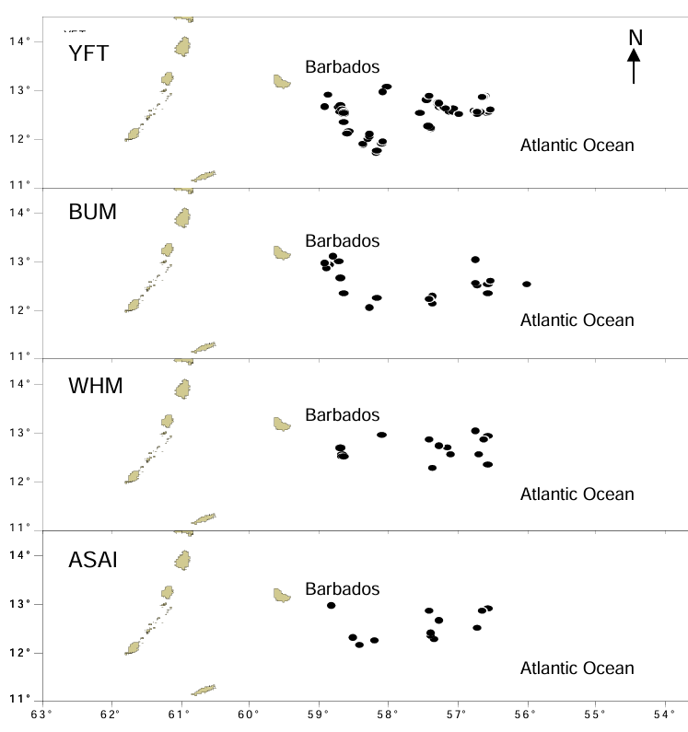
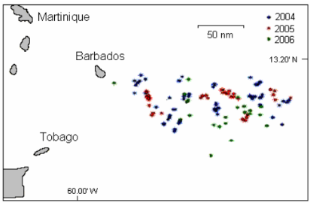
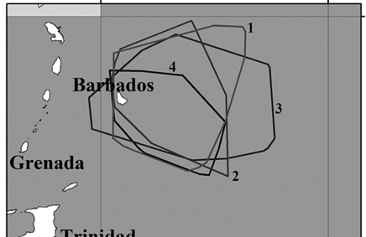
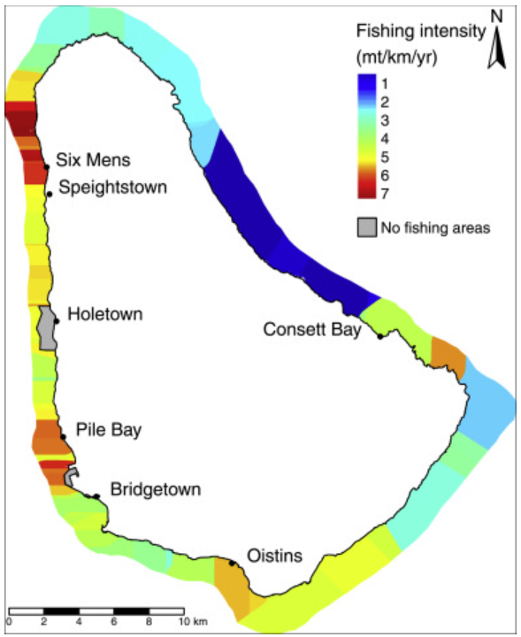
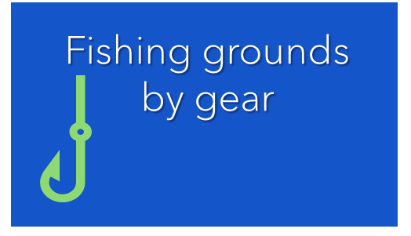
DATA GAP AND NEEDS ASSESSMENTS FOR THE FISHERIES SECTOR
TO INFORM MARINE SPATIAL PLANNING IN BARBADOS
Maraj et al. 2011
Seine fisheries
Results — Fisheries distribution by gear
Rawins et al. 2007
Longline fishery
Walcott et al. 2008
Longline fishery
Blades et al. 2019
Longline fishery
Gill et al. 2017
Spear fishing, trap fishing, line fishing, seine fishing

Slide 14
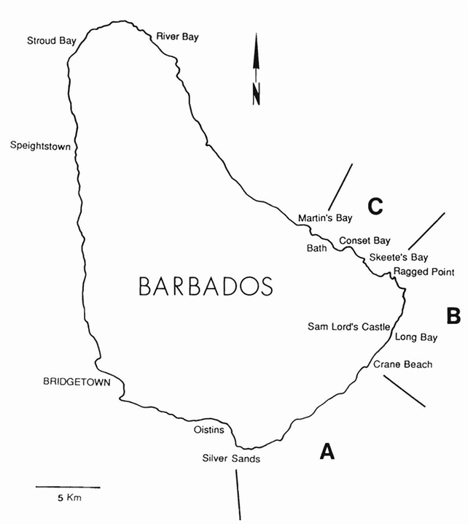
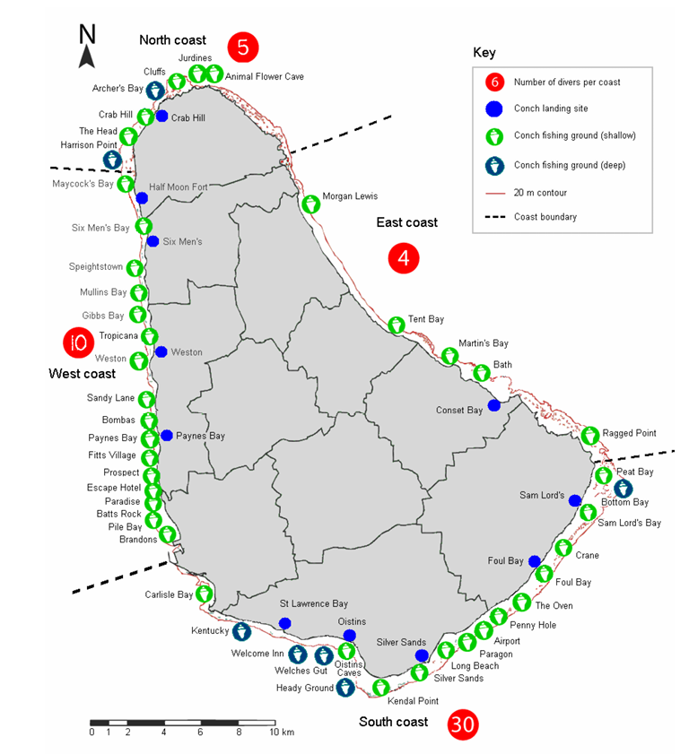
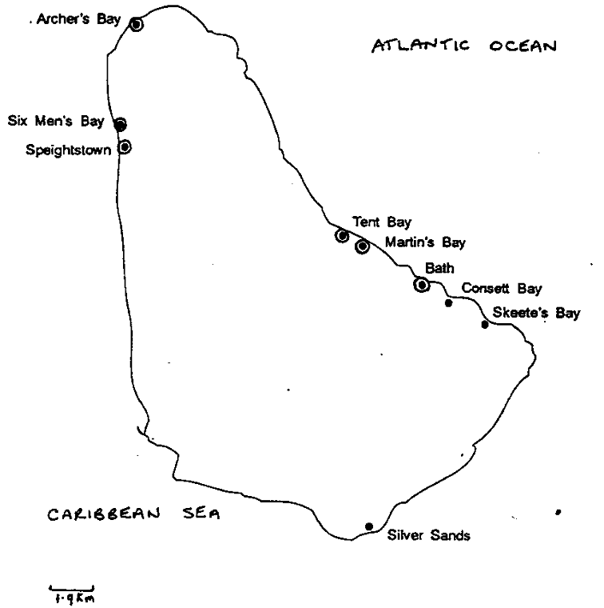
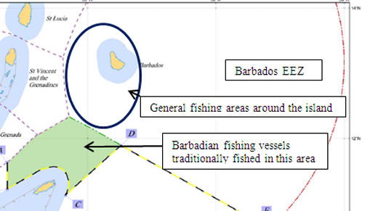
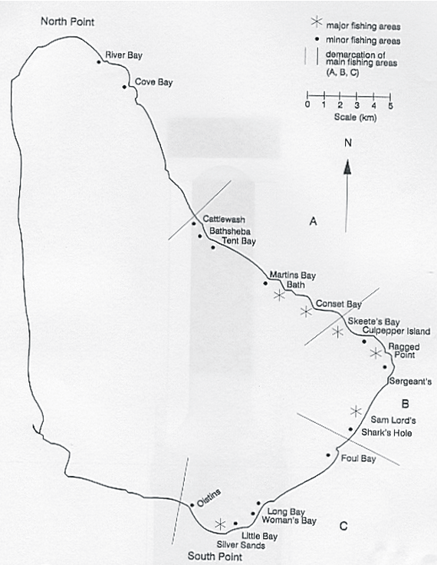
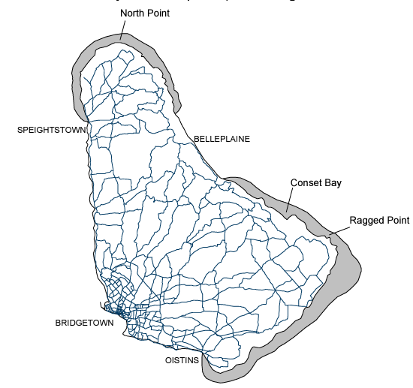
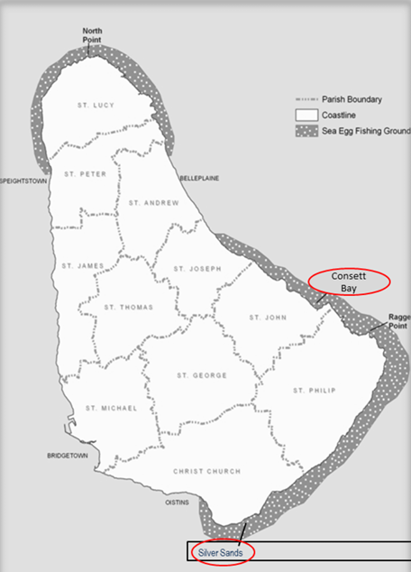
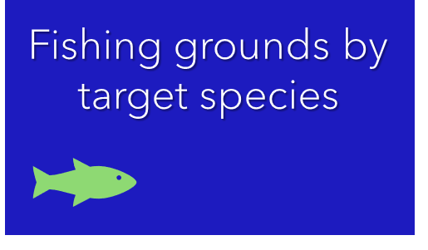
DATA GAP AND NEEDS ASSESSMENTS FOR THE FISHERIES SECTOR
TO INFORM MARINE SPATIAL PLANNING IN BARBADOS
Results — Fisheries distribution by target species
Mitchell 1999
Spiny lobster
Oxenford et al. 2007
Conch fishing grounds
Sobers 2010
Flying fish area
Sheibling & Mladeno 1987
Sea urchin grounds
Vermeer et al. 2005
Sea urchin
McConney et al. 2003
Sea egg fishing
Cox & McConney 2012
Sea urchin fisheries

Slide 15
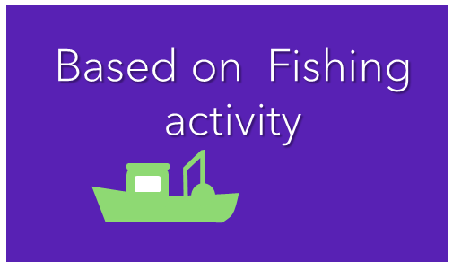
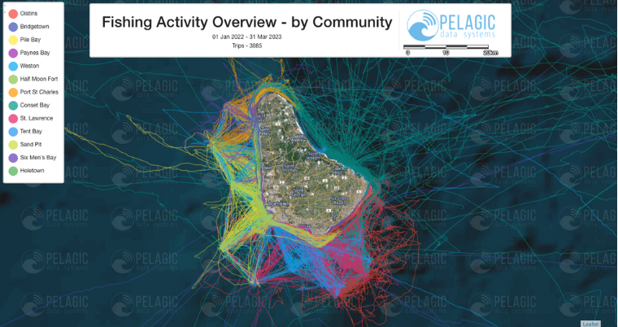
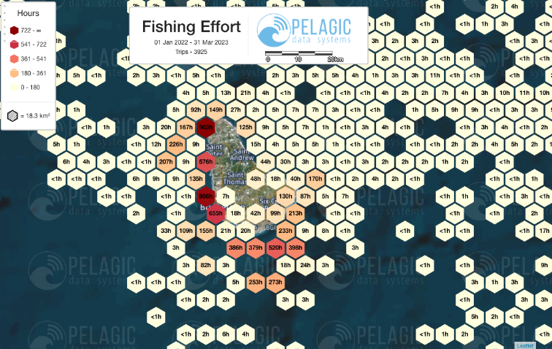
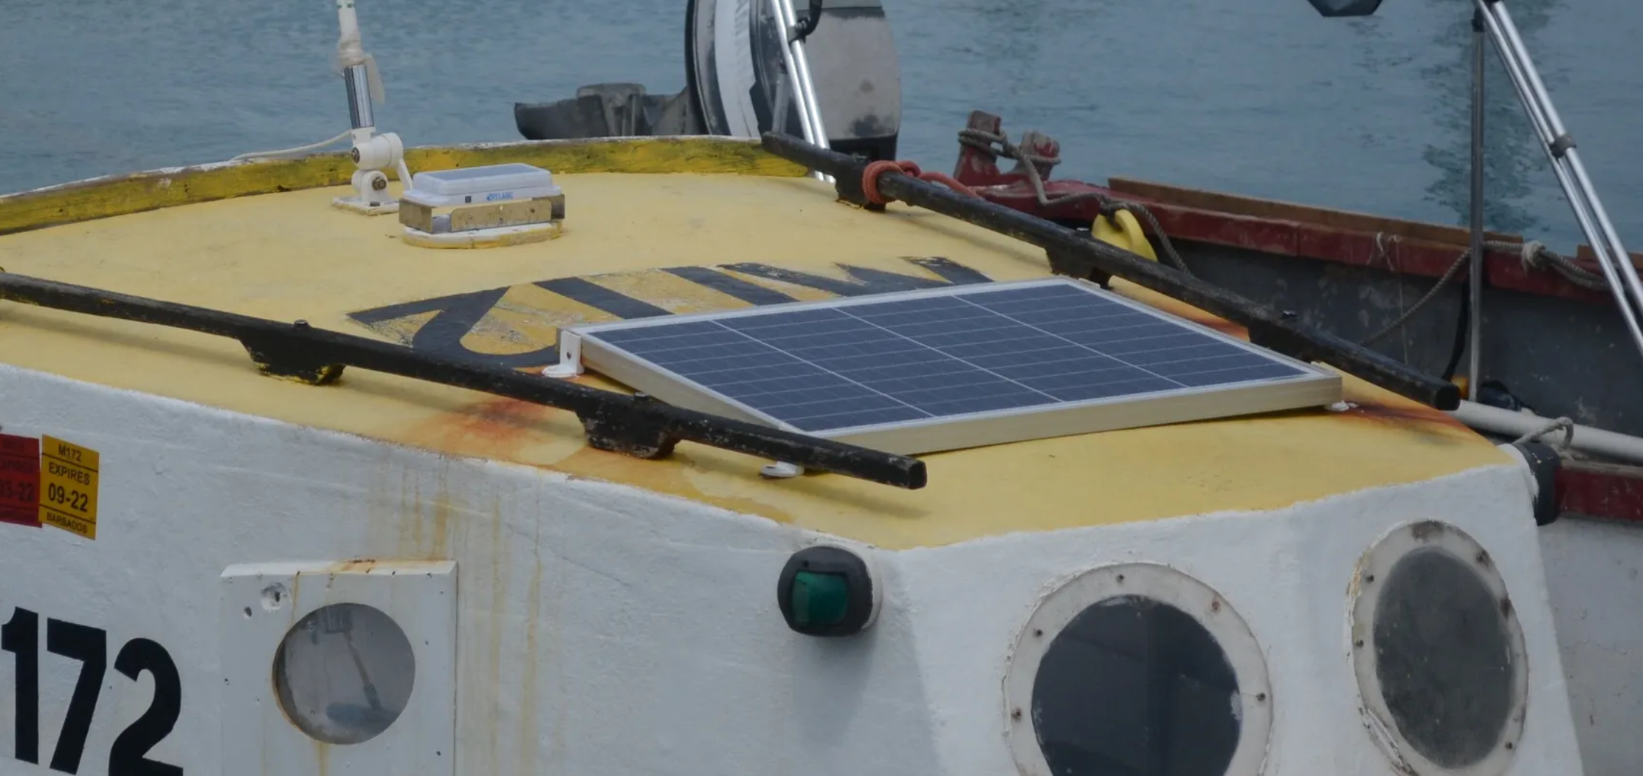
DATA GAP AND NEEDS ASSESSMENTS FOR THE FISHERIES SECTOR
TO INFORM MARINE SPATIAL PLANNING IN BARBADOS
Results — Fisheries distribution by vessel tracking system
Digifish 2023
Robust database of location data and analytical tools to support MSP and inform decision-making by fisherfolk and fisheries management officials.
1-year project funded by the Barbados Environmental Conservation Trust (BECT)
30 Pelagic Data Systems (PDS) vessel tracking devices on small vessels in Barbados were installed (pilot).
The data classification algorithms is used to illustrate how fishing effort changes through space and time.
Source https://barnufo.org/projects

Slide 16
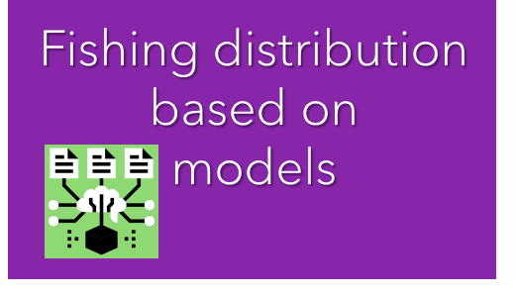
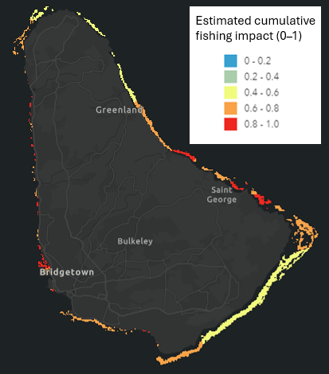
DATA GAP AND NEEDS ASSESSMENTS FOR THE FISHERIES SECTOR
TO INFORM MARINE SPATIAL PLANNING IN BARBADOS
Results — Fisheries distribution by modelling approach
Mapping Ocean Wealth
Estimated cumulative fishing impact
Overview
Background
Objectives
Estimated cumulative fishing impact calculated based on parrotfish mean size.
Values scaled from 0 (no fishing) to 1 (highest fishing).
Impact values are relative to the fishing impact across the entire study region (Anguilla to Grenada).
Approach
Results
Activity 1

Slide 17
DATA GAP AND NEEDS ASSESSMENTS FOR THE FISHERIES SECTOR
TO INFORM MARINE SPATIAL PLANNING IN BARBADOS
Results
Fisheries distribution
Overview
Activity 1: ARE THERE ANY MISSING DATA?
Please let us know if there are any SPATIAL data (e.g., maps, GPS coordinates, shapefiles, etc.) that you are aware of, but it was not included in the report/presentation by using the form in the link:
Background
Objectives
Approach
https://rb.gy/r8nk1v
Results
Activity 1

Slide 18
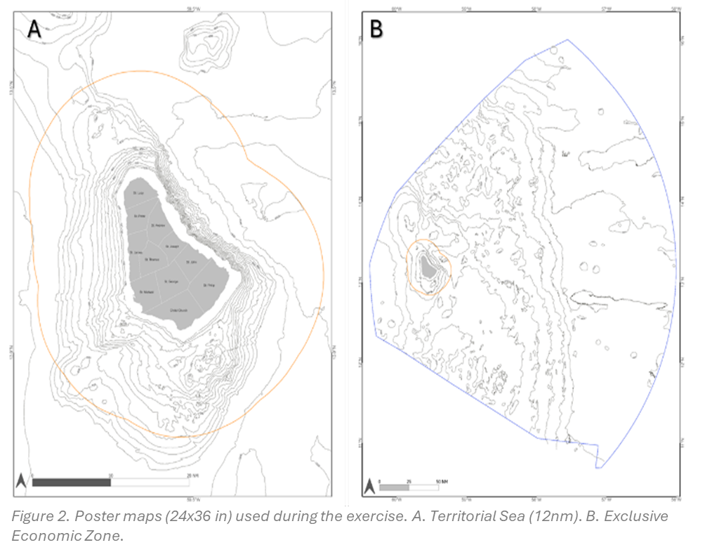
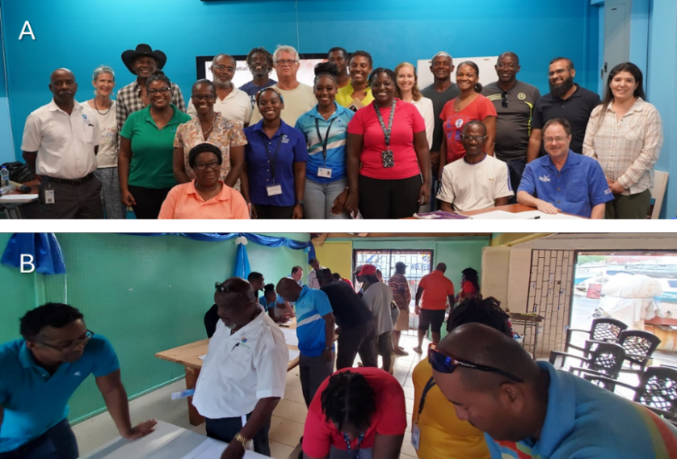
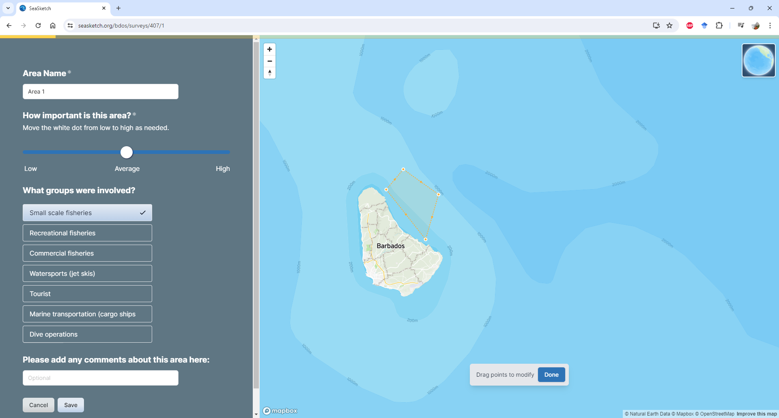
DATA GAP AND NEEDS ASSESSMENTS FOR THE FISHERIES SECTOR
TO INFORM MARINE SPATIAL PLANNING IN BARBADOS
Results — Fisheries distribution by participatory mapping
We conducted 2 mapping session (Bridgetown and Oistins) in May 2024 with 28 participants.
1. Current fishing grounds
2. Historical fishing grounds
3. Fish nursing grounds
4. Fish spawning aggregation areas
5. Locations of user conflict
6. Locations of fish aggregation devices
For the exercise in May, we printed out poster size maps:
Overview
Background
Objectives
Originally a SEASKETCH project was created to collect data digitally.
Approach
Figure 1. Mapping exercise. A) Fisheries Division May 6, 2024. B) Oistins fisher cooperative May 7, 2024.
Results
Activity 1

Slide 19
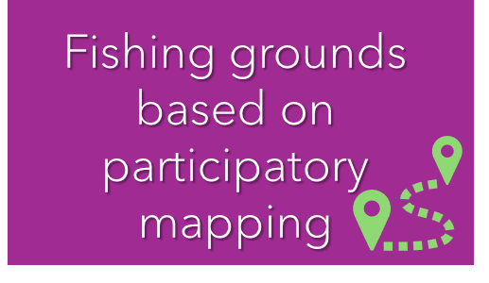
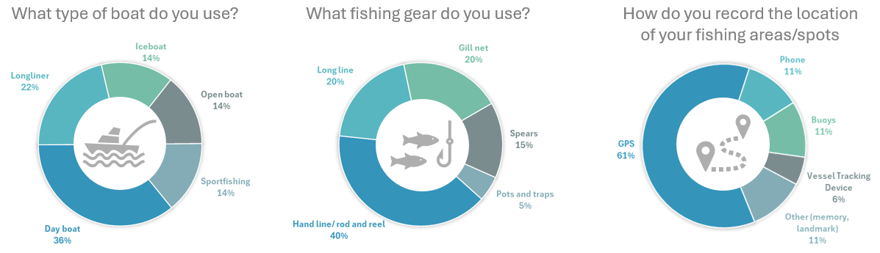
DATA GAP AND NEEDS ASSESSMENTS FOR THE FISHERIES SECTOR
TO INFORM MARINE SPATIAL PLANNING IN BARBADOS
Results — Fisheries distribution by participatory mapping
From the 2 mapping sessions: The majority (57%) participate in commercial fishing while 21% participate in small-scale fishing and recreational fishing.
Overview
Background
Objectives
Approach
Results
Activity 1
Figure 15. Participants boat, gear, and positioning system characteristics (n=14).

Slide 20
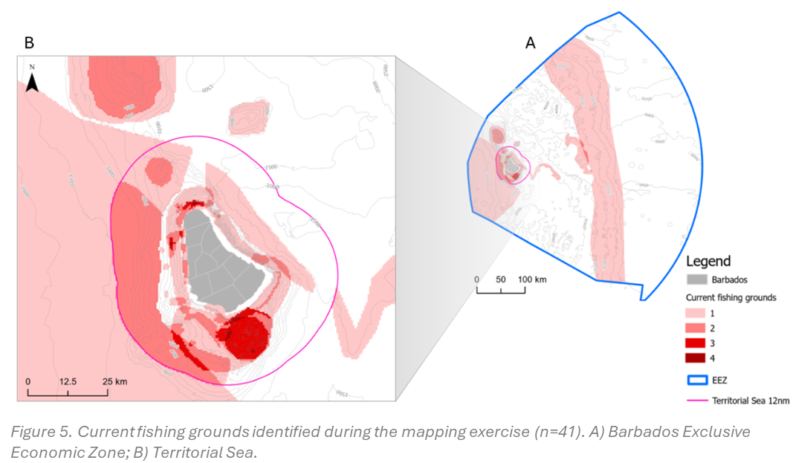
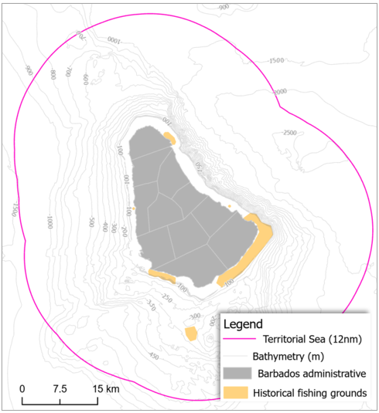
DATA GAP AND NEEDS ASSESSMENTS FOR THE FISHERIES SECTOR
TO INFORM MARINE SPATIAL PLANNING IN BARBADOS
Results — Fisheries distribution by participatory mapping
Historical fishing grounds
Current fishing grounds
Figure 6. Historical fishing grounds identified during the mapping exercise (n=6).

Slide 21
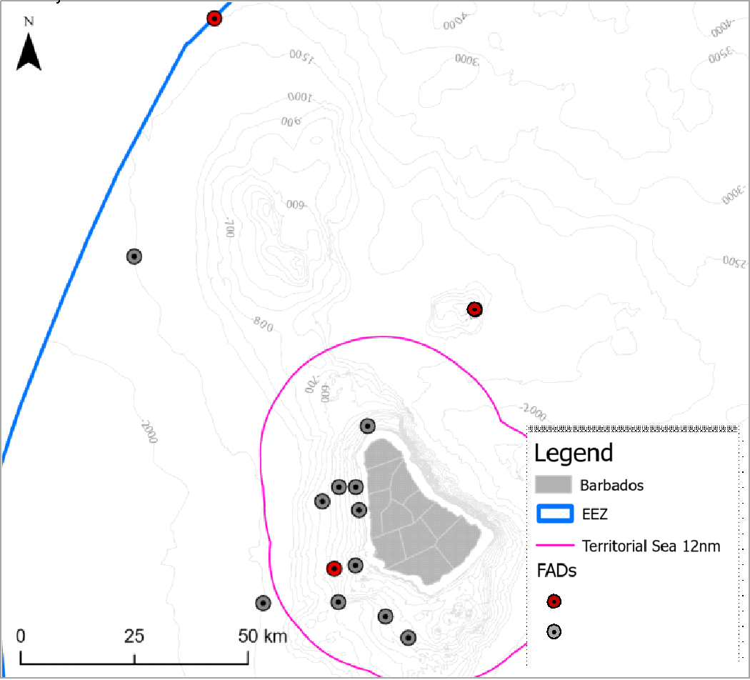
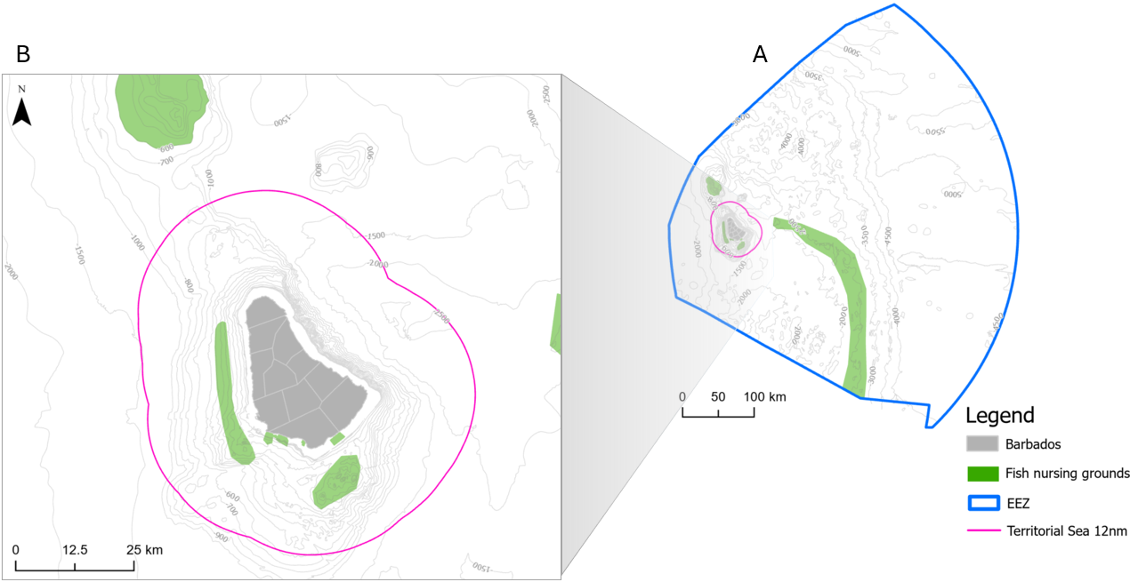
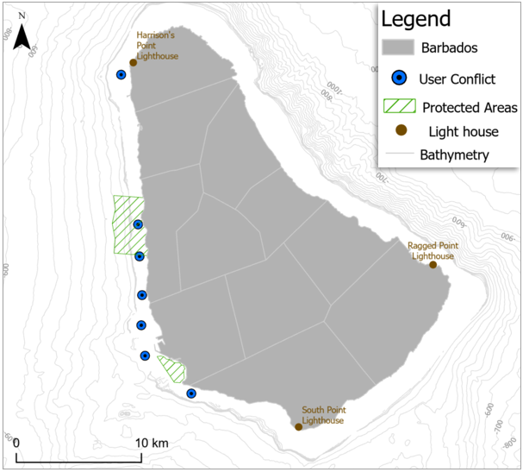
DATA GAP AND NEEDS ASSESSMENTS FOR THE FISHERIES SECTOR
TO INFORM MARINE SPATIAL PLANNING IN BARBADOS
Results — Fisheries distribution by participatory mapping
Fish spawning aggregation areas
Fish aggregation devices
Fish nursing grounds
Users conflict
Figure 8. FADs locations identified during the mapping exercise (n=14).
Figure 7. Fish nursing grounds identified during the mapping exercise (n=11). A) Barbados Exclusive Economic Zone; B) Territorial Sea.
Figure 9. Observed user conflict locations identified during the mapping exercise (n=7).

Slide 22

DATA GAP AND NEEDS ASSESSMENTS FOR THE FISHERIES SECTOR
TO INFORM MARINE SPATIAL PLANNING IN BARBADOS
Results — Fisheries distribution by participatory mapping
Fish spawning aggregation areas
Fish aggregation devices
The results of the mapping exercise described above have limitations.
Currently, there are over one-thousand licensed fisherfolks in Barbados, therefore, these results are not representative of the target population because of the low number of participants.
The BFD will organize and implement further mapping sessions to increase sample size and representativeness of this information.
Although some authors (Brown & Pullar, 2012) have suggested an acceptable sample size of 25 participants (to obtain 100 – 125 polygons or features per mapped attribute), we suggest following Carrie and others (2022) recommendation by using a data spatial agreement (measure by polygon overlap) instead to determine an acceptable sample size.
Fish nursing grounds
Users conflict
Figure 8. FADs locations identified during the mapping exercise (n=14).
Figure 7. Fish nursing grounds identified during the mapping exercise (n=11). A) Barbados Exclusive Economic Zone; B) Territorial Sea.
Figure 9. Observed user conflict locations identified during the mapping exercise (n=7).

Slide 23
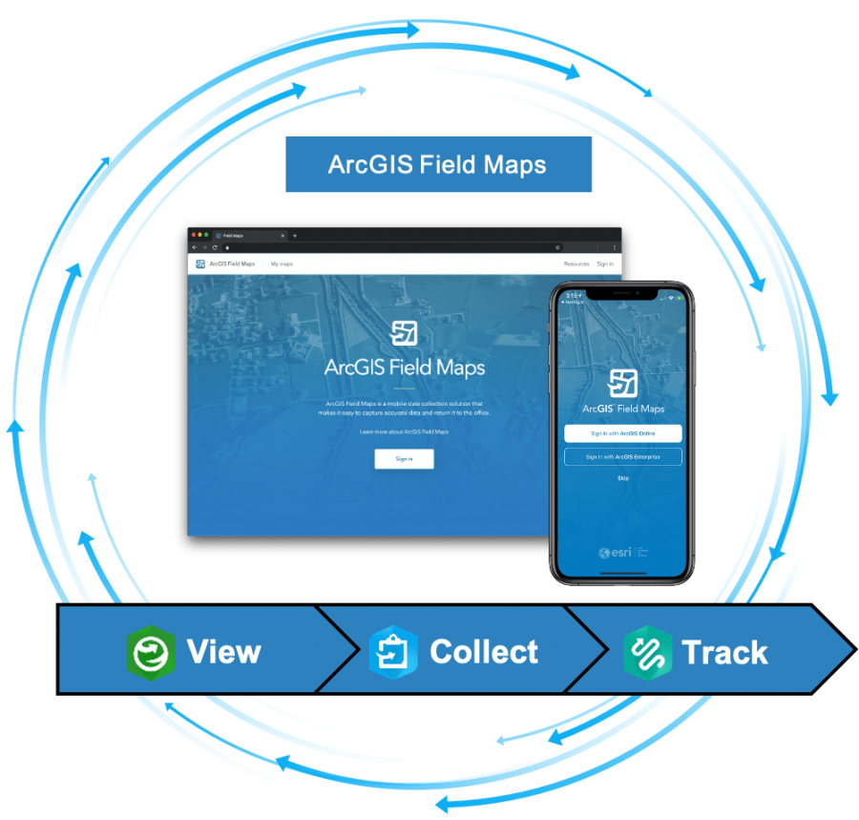
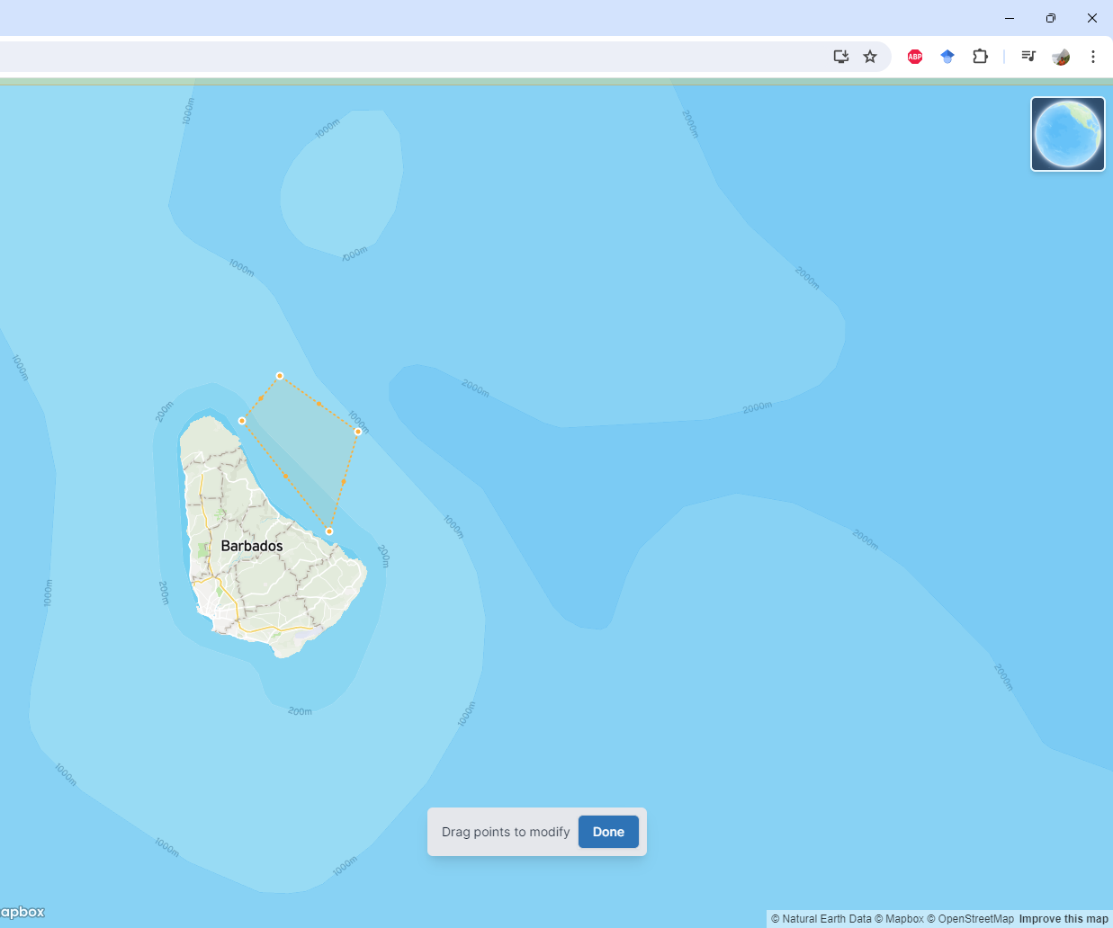
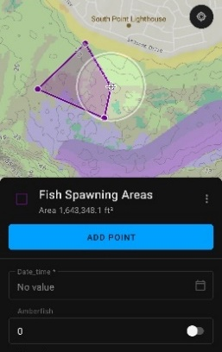
DATA GAP AND NEEDS ASSESSMENTS FOR THE FISHERIES SECTOR
TO INFORM MARINE SPATIAL PLANNING IN BARBADOS
Results — Fisheries distribution by participatory mapping
Future mapping exercises
Pre-mapping exercise
May’s mapping exercise
Overview
Originally a SEASKETCH project was created to collect data digitally.
Background
Objectives
Approach
Results
Activity 1
An ArcGIS Field Maps project was created.
Fisheries Division personnel was trained collect data using tablets.
They will continue collecting data.

Slide 24
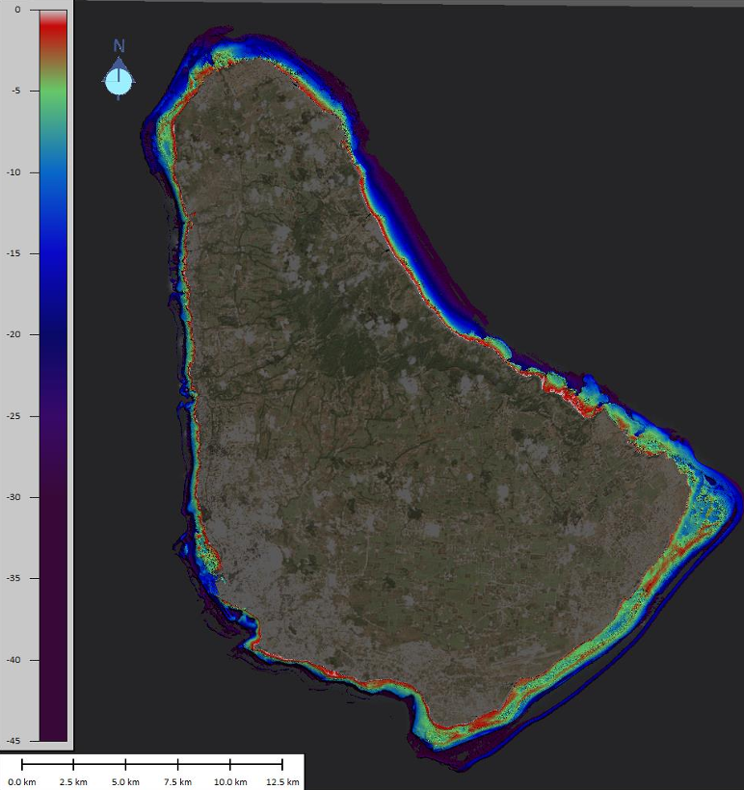
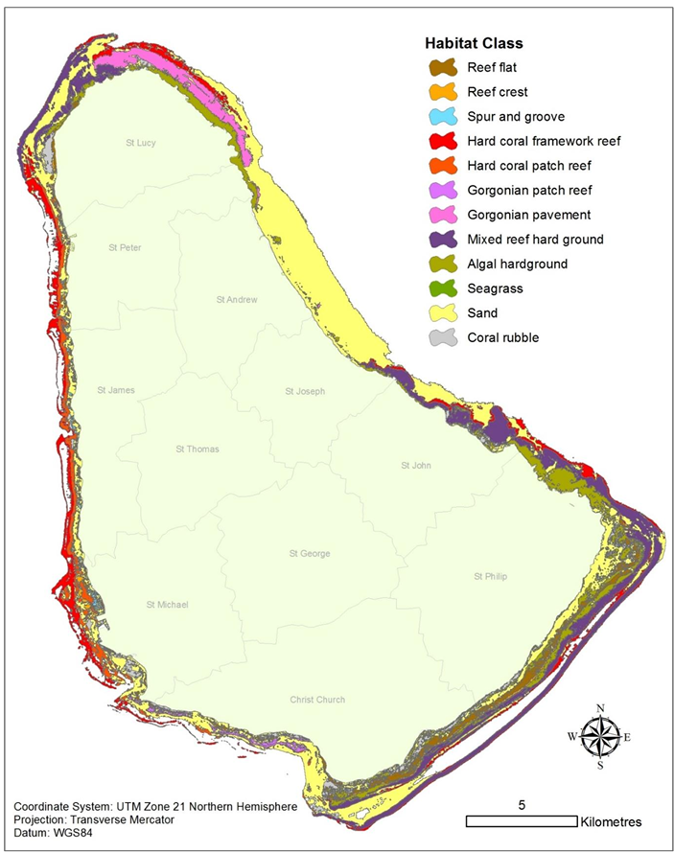
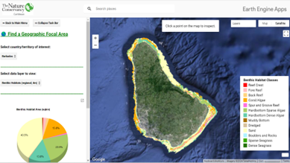


DATA GAP AND NEEDS ASSESSMENTS FOR THE FISHERIES SECTOR
TO INFORM MARINE SPATIAL PLANNING IN BARBADOS
Results — Nearshore benthic habitats
Peterson et al. 2014
Baldwin et al. 2019
Caribbean Science Atlas
Mapping Ocean Wealth
Coral refugia ranking
Modeled coral reef fisheries catch

Slide 25





DATA GAP AND NEEDS ASSESSMENTS FOR THE FISHERIES SECTOR
TO INFORM MARINE SPATIAL PLANNING IN BARBADOS
Results — Species distribution
Global Biodiversity Information Facility
OBIS-SEAMAP
Mapping Ocean Wealth
154,672 records found for Barbados area
104 records found for Barbados area
Coral reef fisheries: current biomass (snapper/grouper)
Coral reef fisheries: current biomass (parrotfish)
Chapman & Kramer 2000
Other layers in MOW:
Predicted gain in biomass (snapper/grouper)
Potential biomass (parrotfish, snapper/grouper)
Movement of fishes within and among fringing coral reefs

Slide 26





DATA GAP AND NEEDS ASSESSMENTS FOR THE FISHERIES SECTOR
TO INFORM MARINE SPATIAL PLANNING IN BARBADOS
Results — Species distribution
Review of biological data, spatial distribution of the stocks and ecological connectivity between areas beyond national jurisdiction and exclusive economic zones in the Western Central Atlantic Fishery Commission Region
Arocha et al. 2024
Red grouper
Spiny lobster
Nassau grouper

Slide 27


DATA GAP AND NEEDS ASSESSMENTS FOR THE FISHERIES SECTOR
TO INFORM MARINE SPATIAL PLANNING IN BARBADOS
Results — Species distribution: Queen Conch
Phillips et al. 2011
Bissada-Gooding & Oxenford 2010
Estimating home range and density of a Queen Conch aggregation using acoustic telemetry and conventional tagging
Preliminary Investigation of the Movements, Density, and Growth of Juvenile Queen Conch in a Nursery Area in Barbados

Slide 28





DATA GAP AND NEEDS ASSESSMENTS FOR THE FISHERIES SECTOR
TO INFORM MARINE SPATIAL PLANNING IN BARBADOS
Results — Species distribution: Sea turtles nesting
Horrocks & Scott 1991
Horrocks & Willoughby 1991
Horrocks & Walcott 2016
Dow et al. 2007
Horrocks 1992

Slide 29




DATA GAP AND NEEDS ASSESSMENTS FOR THE FISHERIES SECTOR
TO INFORM MARINE SPATIAL PLANNING IN BARBADOS
Results — Species distribution: Sea turtles' nearshore movements
Walcott et al. 2009
Walcott et al. 2014
Walcott et al. 2012
Walcott et al. 2014b

Slide 30






DATA GAP AND NEEDS ASSESSMENTS FOR THE FISHERIES SECTOR
TO INFORM MARINE SPATIAL PLANNING IN BARBADOS
Results — Species distribution: Sea turtles' international movements
Horrocks et al. 2001
Luke et al. 2004
Browne et al. 2010
Krueger et al. 2011

Slide 31




DATA GAP AND NEEDS ASSESSMENTS FOR THE FISHERIES SECTOR
TO INFORM MARINE SPATIAL PLANNING IN BARBADOS
Results — Species distribution: Others
Basran et al. 2023
Humpback whale
Valles et al. 2023
Lionfish
Willoughby et al. 2002
Mass fish mortality
CERMES Bulletin

Slide 32





DATA GAP AND NEEDS ASSESSMENTS FOR THE FISHERIES SECTOR
TO INFORM MARINE SPATIAL PLANNING IN BARBADOS
GEBCO
Bathymetry
Results — Oceanographic
CZMU
Nearshore Bathymetry contours
NOAA
Near-surface currents
Sea surface temperature

Slide 33





DATA GAP AND NEEDS ASSESSMENTS FOR THE FISHERIES SECTOR
TO INFORM MARINE SPATIAL PLANNING IN BARBADOS
Results — Other relevant spatial layers
Mahon & Mascia 2023
Wetland inventory
BADASS’n
SCUBA dive sites
Global Fish Watch
Vessel abundance (AIS)
Vessel detected (RADAR)
Small & Oxenford 2021
Anchoring impacts of cruise ships

Slide 34




DATA GAP AND NEEDS ASSESSMENTS FOR THE FISHERIES SECTOR
TO INFORM MARINE SPATIAL PLANNING IN BARBADOS
Results — Other relevant spatial layers
Alleyne-Greene 2016
Vulnerability to climate change — Six Men’s Bay
Alleyne 2019
Vulnerability se level rise Holetown
Mycoo et al. 2021
Coastal hazards Bridgetown
Degia et al. 2022
Hazard risk — Sargassum

Slide 35





DATA GAP AND NEEDS ASSESSMENTS FOR THE FISHERIES SECTOR
TO INFORM MARINE SPATIAL PLANNING IN BARBADOS
Results — Other relevant spatial layers
Mapping Ocean Wealth
Population under 10m elevation (per sq km)
InVEST Wind and Wave hazards
The Caribbean GeoPortal
Several spatial layers for hurricanes, land use/cover from 2017-2021 (regional analysis)
Fringing reef providing protection to infrastructure
# of people avoiding damage from flooding per decade

Slide 36




DATA GAP AND NEEDS ASSESSMENTS FOR THE FISHERIES SECTOR
TO INFORM MARINE SPATIAL PLANNING IN BARBADOS
Results — Other relevant spatial layers
Caribbean Science Atlas
Tourism value (on reef)
Mapping Ocean Wealth
Modeled total dollar value of reef tourism (per km2)
Overview
Background
Objectives
Approach
Tourism value (reef adjacent)
Recreation and tourism
Results
Activity 1
Activity 2
Activity 3

Slide 37
DATA GAP AND NEEDS ASSESSMENTS FOR THE FISHERIES SECTOR
TO INFORM MARINE SPATIAL PLANNING IN BARBADOS
Results
Fisheries distribution
  Mapping exercise
Marine habitats
Species distribution
Oceanographic data
Other relevant layers for the fisheries sector
Overview
Background
Objectives
Approach
Results
Activity 1: ARE THERE ANY MISSING DATA?
Please let us know if there are any SPATIAL data (e.g., maps, GPS coordinates, shapefiles, etc.) that you are aware of, but it was not included in the report/presentation by using the form in the link:
Activity 1
Activity 2
Activity 3
Deadline August 23, 2024
https://rb.gy/r8nk1v

Slide 38
DATA GAP AND NEEDS ASSESSMENTS FOR THE FISHERIES SECTOR
TO INFORM MARINE SPATIAL PLANNING IN BARBADOS
DATA NEEDS TO INFORM MSP
Activity 2
Let’s discuss current data needs tables and provide feedback as needed.
Are there any other spatial layers that you think should be included in this list?
Are there any comments related to the priority score for these layers?
Are you aware of other methods to collect this data?
Who are the partners for collecting this data (synergies for improving current data catalog)?
Overview
Background
Objectives
Approach
Results
Activity 1
Activity 2
Activity 3

Slide 39





Examples of data used for MSP
Depends on the objectives:
  Habitat
  Users (fisheries, transportation, aquaculture, tourism)
  Species distribution
  Other (mining, pollution, communications, military, etc.)

Slide 40
DATA GAP AND NEEDS ASSESSMENTS FOR THE FISHERIES SECTOR
TO INFORM MARINE SPATIAL PLANNING IN BARBADOS
DATA NEEDS TO INFORM MSP
Activity 2
Instructions (40 min):
Online participants will work as one group with Dr. Montes. She will facilitate the discussion and include your input to the working document.
In person participants:
Please join a group.
Using the designated computer (one per group) download the data needs table from https://rb.gy/12e1f4.
Discuss current data needs tables (5) and provide input by answering the 4 questions by table.
At the end of the activity, please email the working table to nancymontes@gmail.com
Overview
Background
Objectives
Approach
Results
Activity 1
Activity 2
Activity 3

Slide 41
DATA GAP AND NEEDS ASSESSMENTS FOR THE FISHERIES SECTOR
TO INFORM MARINE SPATIAL PLANNING IN BARBADOS
DATA ACCESS
“Data accessibility refers to the ease with which users can find, retrieve, understand, and use data within an organization.”
Overview
Background
Data
Manage-
ment
Objectives
Current limitations for accessing data encountered:
Data
format
Approach
Closed data
Decen-
tralize
Results
Activity 1
Data
quality
Outdated
Activity 2
Original
purpose
Data integration
Activity 3

Slide 42
DATA GAP AND NEEDS ASSESSMENTS FOR THE FISHERIES SECTOR
TO INFORM MARINE SPATIAL PLANNING IN BARBADOS
Some of the current data is not in spatial format (PDF, image, etc.) and will have to be requested and/or digitize into GIS software.
Data
format
Overview
The marine environment is very dynamic and some of the current available data for some species are from 5–10-year-old reports.
Background
Outdated
Objectives
Approach
Results
In several cases, the reference found is in a peer-reviewed publication that requires a fee to access the information (USD$20 to $40).
Closed data
Activity 1
Activity 2
Activity 3
Most of the current data was collected with specific objectives, which can affect or limit its use to inform MSP.
Original
purpose

Slide 43
DATA GAP AND NEEDS ASSESSMENTS FOR THE FISHERIES SECTOR
TO INFORM MARINE SPATIAL PLANNING IN BARBADOS
Data should meet acceptable standards, contain a file describing how spatial data was collected (scale & resolution) and analyzed ->understand data limitations.
Data
format
Data
quality
Overview
Background
Data
Manage-
ment
Understand and plan for data management (collecting, keeping, and using data efficiently) ->coordinate system, identify data error, etc.
Outdated
Objectives
Approach
Results
Online database (index) in which authors can enter the description of their research and or project. Ideally, also a description of their spatial data.
Decen-
tralize
Closed data
Activity 1
Activity 2
Activity 3
Data integration
Development of an online portal to host and share data and encourage stakeholder participation-> long term.

Slide 44


DATA GAP AND NEEDS ASSESSMENTS FOR THE FISHERIES SECTOR
TO INFORM MARINE SPATIAL PLANNING IN BARBADOS
DATA SHARING MECHANISM FOR MSP
Activity 3
Using the whiteboard, please provide your feedback regarding strengths, weaknesses, opportunities, and treats (SWOT) of a data sharing mechanism for MSP in Barbados.
Overview
Background
https://rb.gy/07urgc
Objectives
Approach
Results
Activity 1
Activity 2
Activity 3

Slide 45
DATA GAP AND NEEDS ASSESSMENTS FOR THE FISHERIES SECTOR
TO INFORM MARINE SPATIAL PLANNING IN BARBADOS
DATA SHARING MECHANISM FOR MSP
Activity 3
SWOT
What: is a technique use for planning and strategic analysis
Why: to explore new solutions, identify barriers, as a brainstorming exercise
Overview
Background
Objectives
Approach
Results
Activity 1
Activity 2
Activity 3

Slide 46
DATA GAP AND NEEDS ASSESSMENTS FOR THE FISHERIES SECTOR
TO INFORM MARINE SPATIAL PLANNING IN BARBADOS
DATA SHARING MECHANISM FOR MSP
Activity 3
Instructions (20 minutes):
Online participants can open the whiteboard and provide input individually.
In person participant can provide input using the group’s computer. The link to the whiteboard is
I will display the online whiteboard so we all can see what others are typing.
Everyone is welcome to provide input verbally and/or discuss any entry or input as needed.
Overview
Background
Objectives
https://rb.gy/07urgc
Approach
Results
Activity 1
Activity 2
Activity 3

Slide 47

DATA GAP AND NEEDS ASSESSMENTS FOR THE FISHERIES SECTOR
TO INFORM MARINE SPATIAL PLANNING IN BARBADOS
TRAININGS
Overview
Are there any training suggestions?
Background
Objectives
Approach
Results
Activity 1
Activity 2
Activity 3

Slide 48
DATA GAP AND NEEDS ASSESSMENTS FOR THE FISHERIES SECTOR
TO INFORM MARINE SPATIAL PLANNING IN BARBADOS
SWOT DATA GAP AND NEEDS ASSESSMENT
STRENGTHS
There is some basic data that can be used during the early stages of the MSP process.
There are some methodologies such as participatory mapping that can be applied to collect initial data (e.g., fisherfolks, experts, etc.).
There is technical and resource capacity within the CZMU and BFD to support data collection, analysis and reporting.
WEAKNESSES
Current data is limited and dispersed (not centralized).
Current data was obtained with specific objectives, timeframes, methodologies, scales, and resolutions.
Most of the current information is located nearshore with limited data in the rest of Barbados EEZ.
There is paucity of information to support the growth of some potential opportunities (e.g., mariculture).

Slide 49
DATA GAP AND NEEDS ASSESSMENTS FOR THE FISHERIES SECTOR
TO INFORM MARINE SPATIAL PLANNING IN BARBADOS
SWOT DATA GAP AND NEEDS ASSESSMENT
OPPORTUNITIES
Stakeholder engagement (participatory mapping) at early stages of the MSP process.
Increase funding and support through the BE initiatives.
Develop and customize a platform for data curation and sharing, presenting timely interactive results that promote collaboration among stakeholders (e.g., dashboards, discussion forums, etc.).
THREATS
It can be difficult and time-consuming to integrate and effectively apply current data.
Funding and resources (personnel) uncertainty.
Regulatory and legal barriers (data sharing).
MSP is a long process that requires a long-term vision.
Overview
Background
Objectives
Approach
Results
Activity 1
Activity 2
Activity 3

Slide 50
BE-CLME+ Project: Promoting National Blue Economy Priorities Through Marine Spatial Planning in the Caribbean Large Marine Ecosystem Plus (GEF Project ID 10211).
DATA GAP AND NEEDS ASSESSMENT FOR THE FISHERIES SECTOR TO INFORM MARINE SPATIAL PLANNING IN BARBADOS
Thanks
Dr. Nancy Montes
nancymontes@gmail.com
WhatsApp +1 (352)204-7723

