Slide 1

Mainstreaming the Small-scale Fisheries (SSF) Guidelines into Caribbean Fishery Value Chains
Belize: communication and visibility content

Slide 2

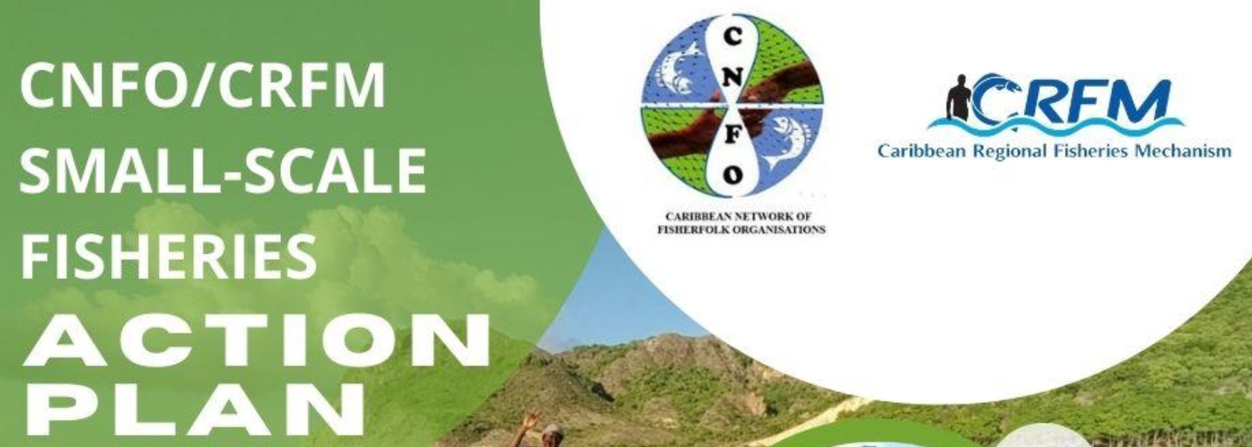
Project Profile and Partnerships
To equip stakeholders at all levels with the knowledge and skills necessary to effectively integrate the Voluntary Guidelines for Securing Sustainable Small-Scale Fisheries in the Context of Food Security and Poverty Eradication (SSF Guidelines) into seafood value chains with a specific focus on market dynamics and the role of the private sector.
Executing Agency: Caribbean Regional Fisheries Mechanism (CRFM)
Co-Implementing Agencies: Development Bank of Latin America and the Caribbean (CAF) and Food and Agriculture Organization (FAO) of the United Nations
Funder: Global Environment Facility (GEF)
Co-financing project countries: Barbados, Belize, Guyana, Jamaica, Saint Lucia, and Panama
Notes:
Promoting National Blue Economy Priorities Through Marine Spatial Planning in the Caribbean Large Marine Ecosystem Plus (BE-CLME+ Project) - a regional initiative aimed at promoting blue economy development in the Caribbean region through marine spatial planning (MSP) and marine protected areas (MPAs), an ecosystem approach to fisheries (EAF), development of climate-smart sustainable fisheries value chains, and knowledge management.

Slide 3
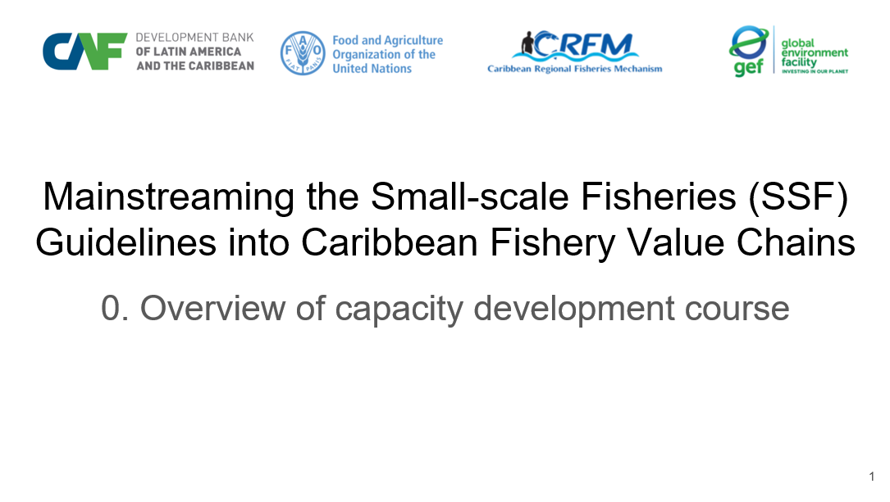
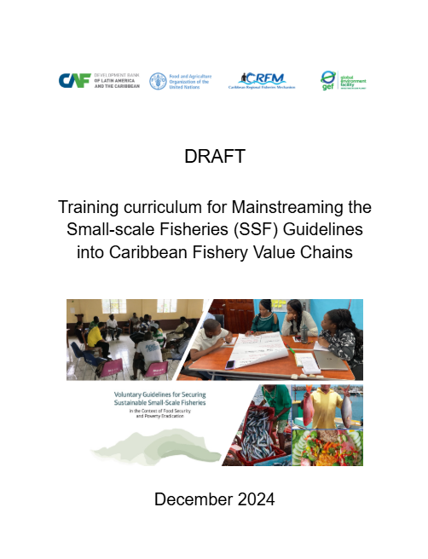
Contributions to Country Capacity Development
Training Curriculum - A structured guide of key module topics with learning objectives for integrating the SSF Guidelines into fisheries value chains.
Training Manual - A detailed manual on curriculum delivery modes, module design, resources and instructional materials informed by fisheries leaders. Training Modules - Fifteen capacity development slide modules setting out the relevance of the SSF guidelines to Caribbean fisheries value chains.
Training Workshop - Report on and validation of practical sessions to train leading fisherfolk by demonstrating the effectiveness of the training materials. Reference Resources - Global, regional and national lists of documents, videos, slides and other training materials suitable for Caribbean fisherfolk. Country Resources - Project country collection of slides, photographs, documents, videos etc, suitable to be built upon by fisherfolk trainers.

Slide 4
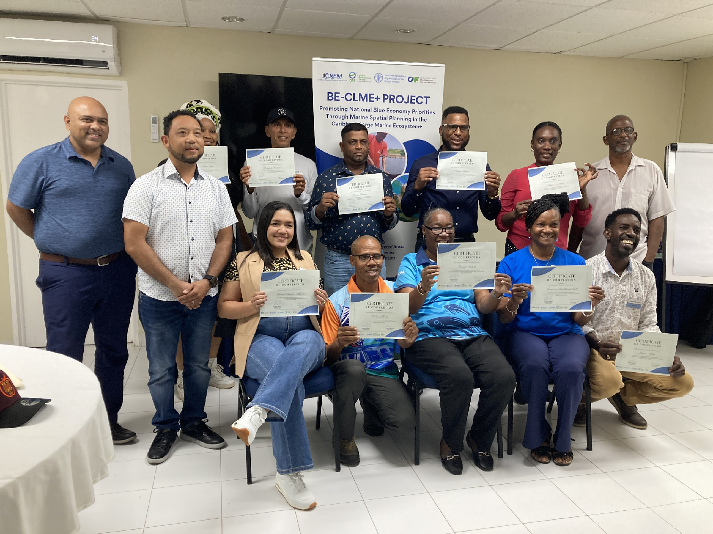
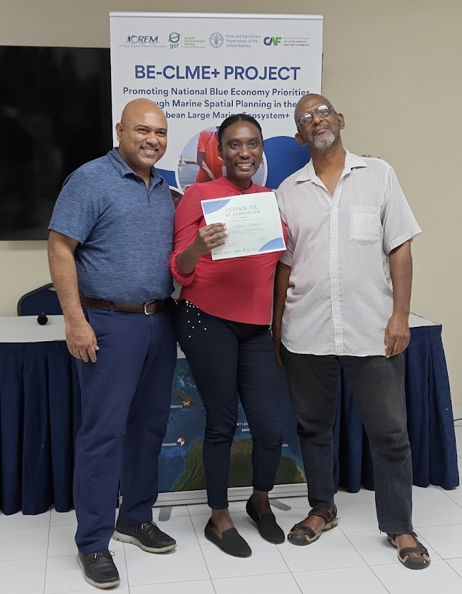
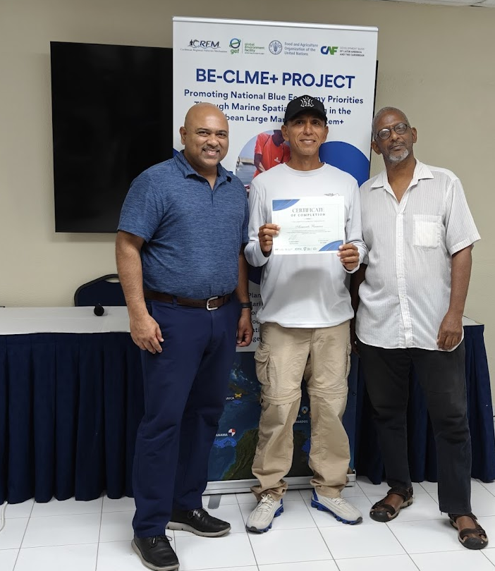
Participants
Workshop participants after receiving certificates of participation. Belize participants from left to right: Nadine Nembhard and Armando Ramirez with Regional Project Coordinator, Dr. Dayne Buddo and Dr. Patrick McConney

Slide 5
Project benefits
The project equipped fisherfolk leaders as trainers with the knowledge and tools to integrate SSF Guidelines into fisheries value chains.
From the regional CNFO, Miss Nembhard who is based in Belize is better informed with more resources as the regional administrator of value chain initiatives in all of the member countries at national and local level. Mr. Ramirez as a local and national fisherfolk organization leader in Belize is in a good position to offer his support both to the CNFO as well as other nearby project countries sharing Spanish language in fisheries.
Belize has a critical role to play in SSF value chain development and leadership given its geographic location and linkages to diverse seafood markets.
The incorporation of the SSF Guidelines is critical to further strengthening the above important roles of Belize and its fisheries leadership. This includes the advanced approaches to fisheries management ecosystem approaches in general that have been a hallmark of the blue economy in Belize.

