Slide 1

Mainstreaming the Small-scale Fisheries (SSF) Guidelines into Caribbean Fishery Value Chains
Guyana: communication and visibility content

Slide 2

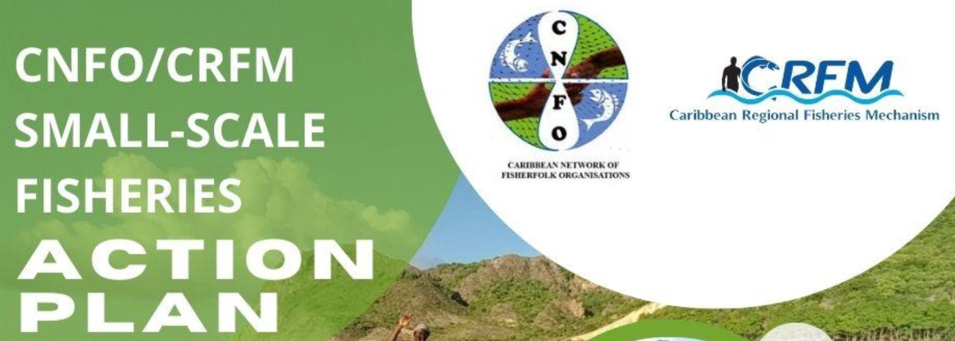
Project Profile and Partnerships
To equip stakeholders at all levels with the knowledge and skills necessary to effectively integrate the Voluntary Guidelines for Securing Sustainable Small-Scale Fisheries in the Context of Food Security and Poverty Eradication (SSF Guidelines) into seafood value chains with a specific focus on market dynamics and the role of the private sector.
Executing Agency: Caribbean Regional Fisheries Mechanism (CRFM)
Co-Implementing Agencies: Development Bank of Latin America and the Caribbean (CAF) and Food and Agriculture Organization (FAO) of the United Nations
Funder: Global Environment Facility (GEF)
Co-financing project countries: Barbados, Belize, Guyana, Jamaica, Saint Lucia, and Panama

Slide 3
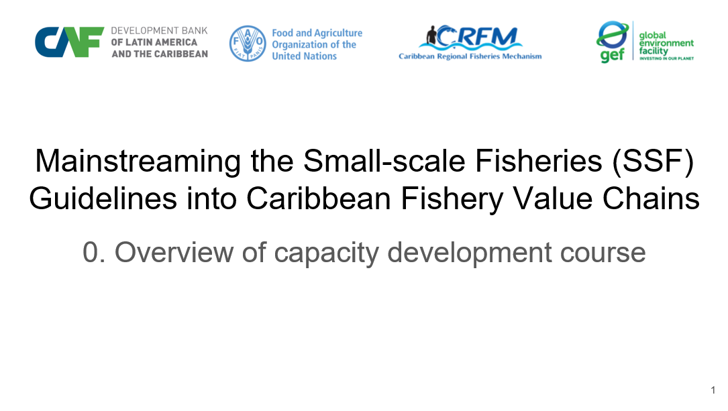
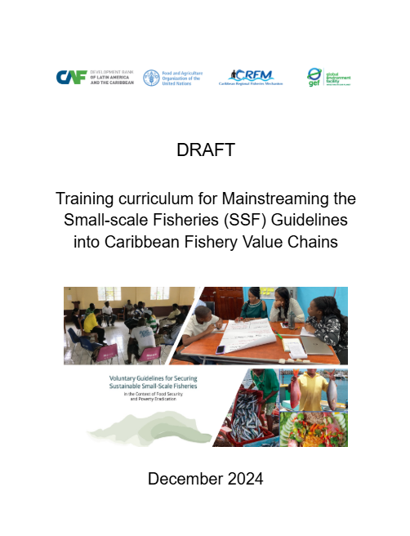
Contributions to Country Capacity Development
Training Curriculum - A structured guide of key module topics with learning objectives for integrating the SSF Guidelines into fisheries value chains.
Training Manual - A detailed manual on curriculum delivery modes, module design, resources and instructional materials informed by fisheries leaders. Training Modules - Fifteen capacity development slide modules setting out the relevance of the SSF guidelines to Caribbean fisheries value chains.
Training Workshop - Report on and validation of practical sessions to train leading fisherfolk by demonstrating the effectiveness of the training materials. Reference Resources - Global, regional and national lists of documents, videos, slides and other training materials suitable for Caribbean fisherfolk. Country Resources - Project country collection of slides, photographs, documents, videos etc, suitable to be built upon by fisherfolk trainers.

Slide 4
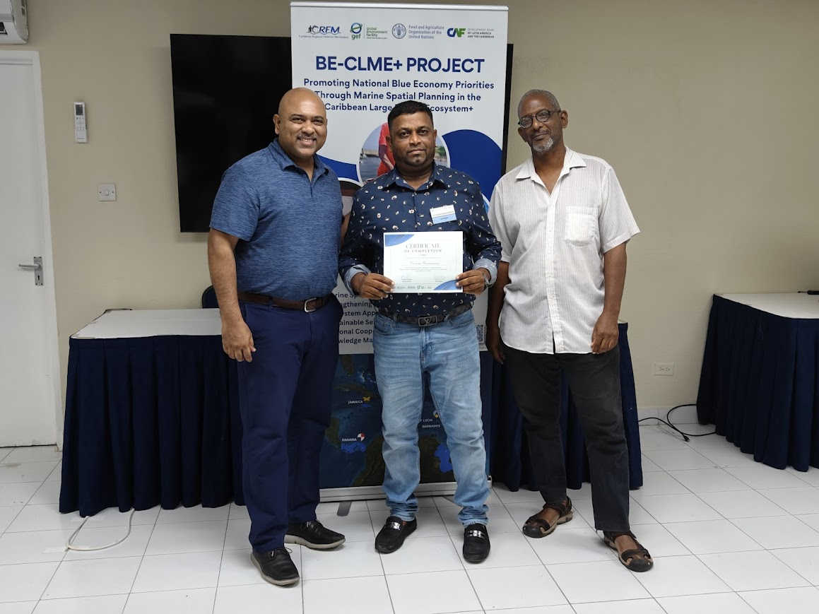
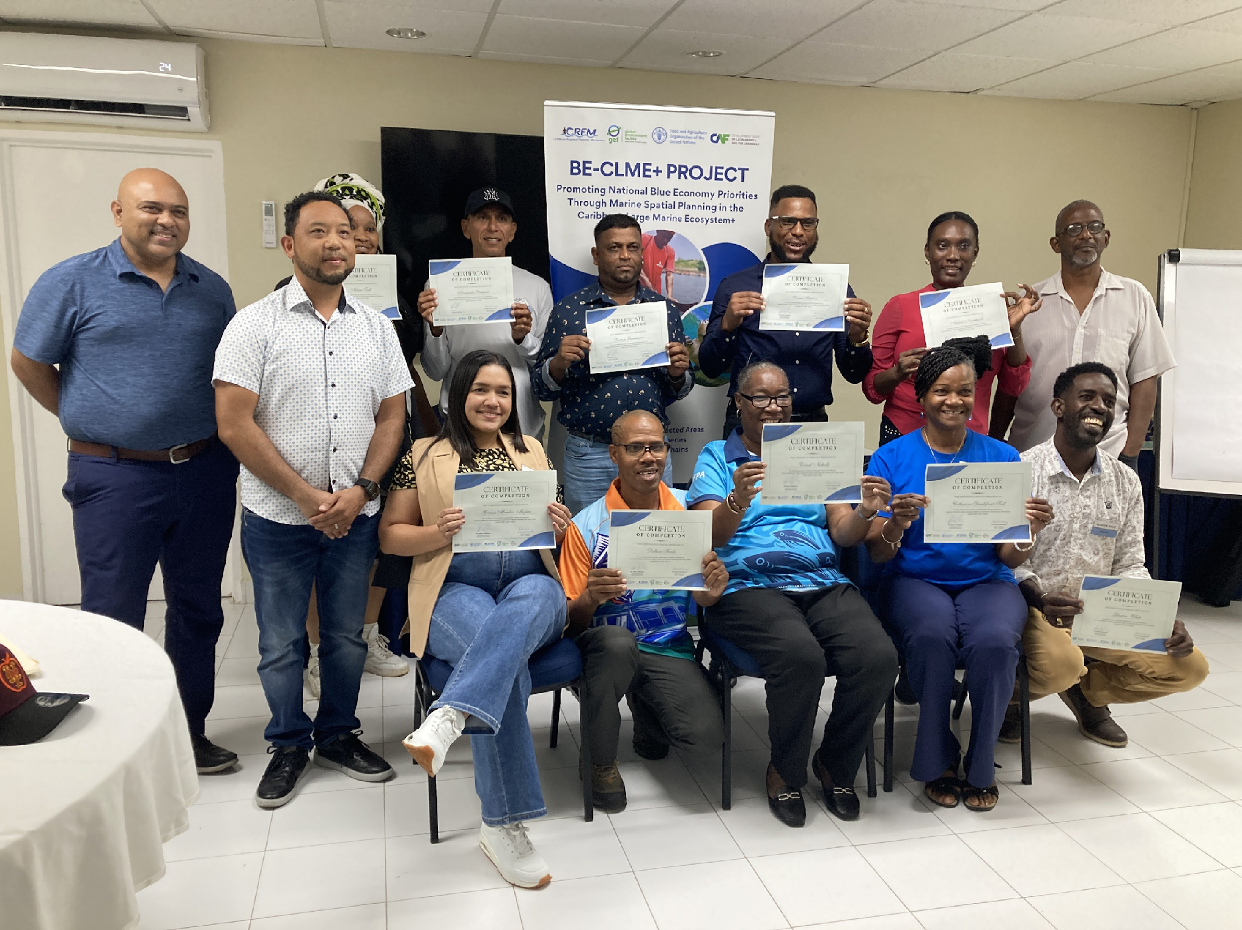
Participants
Workshop participants after receiving certificates of participation. Participant from Guyana Veeram Ramsarran receives certificate from Regional Project Coordinator, Dr. Dayne Buddo and Dr. Patrick McConney

Slide 5
Project benefits
In Guyana, the importance of incorporating the SSF Guidelines into fishery value chains was well illustrated during International Year of Artisanal Fisheries and Aquaculture (IYAFA) 2022. One of the key themes of IYAFA 2022 in the region was the coordination and interaction of SSF with other socio-economic sectors. The interaction between SSF and the oil and gas industry was one of the key areas of concern for fisherfolk such as members of the Guyana National Fisherfolk Organization (GNFO).
The strong human rights based principles of the SSF Guidelines provided important guidance as fisherfolk sought value chain opportunities, and also encountered new value chain constraints as the national economy evolved with local value chain relationships also changing over time. The marginalization of fisherfolk livelihood more powerful industries is a global threat for which the GNFO is now better prepared through the recently completed project.
Project partners of the GNFO have already committed to assistance in fisheries such as the artisanal seabob and other SSF that are pursuing ecosystem approaches. The training that can now be undertaken by better equipped fisherfolk leaders will be critical in ensuring the sustainability of SSF livelihoods in the midst of broader economic growth. Modules, such as that on environmental impact assessment will greatly expand the capacity of fisherfolk leaders to be equal partners at the many tables of value chain negotiation likely to develop.

