Slide 1

Mainstreaming the Small-scale Fisheries (SSF) Guidelines into Caribbean Fishery Value Chains
Saint Lucia: communication and visibility content

Slide 2

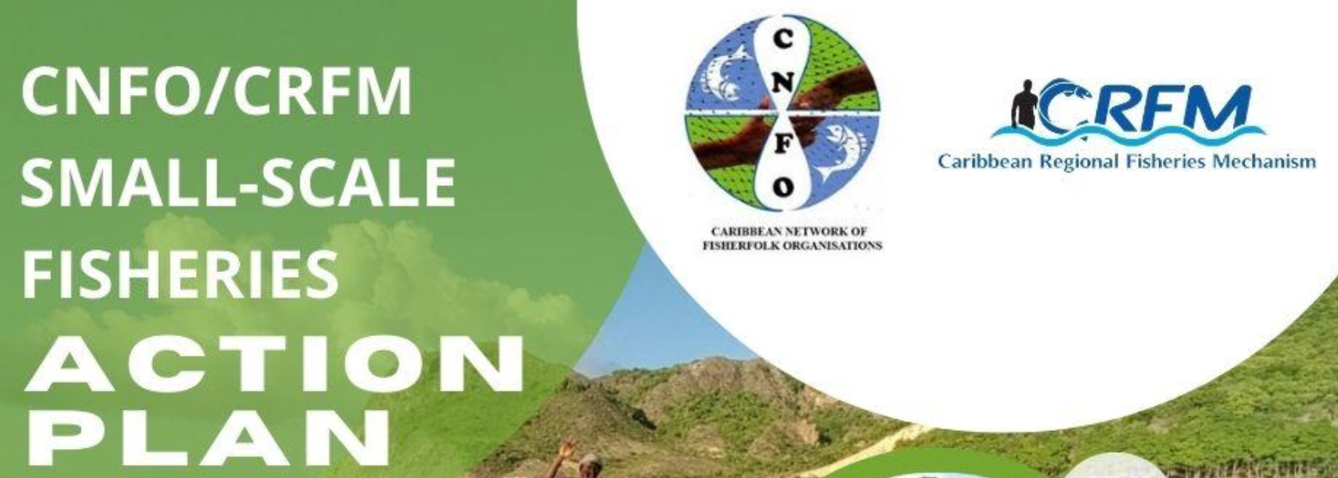
Project Profile and Partnerships
To equip stakeholders at all levels with the knowledge and skills necessary to effectively integrate the Voluntary Guidelines for Securing Sustainable Small-Scale Fisheries in the Context of Food Security and Poverty Eradication (SSF Guidelines) into seafood value chains with a specific focus on market dynamics and the role of the private sector.
Executing Agency: Caribbean Regional Fisheries Mechanism (CRFM)
Co-Implementing Agencies: Development Bank of Latin America and the Caribbean (CAF) and Food and Agriculture Organization (FAO) of the United Nations
Funder: Global Environment Facility (GEF)
Co-financing project countries: Barbados, Belize, Guyana, Jamaica, Saint Lucia, and Panama

Slide 3
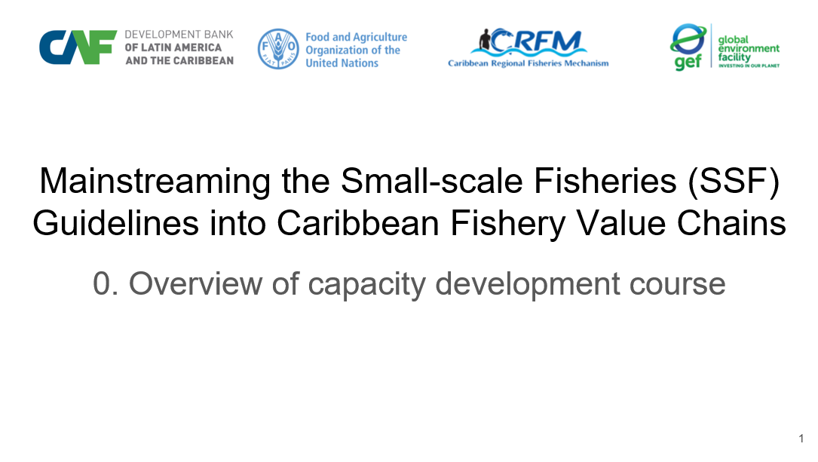
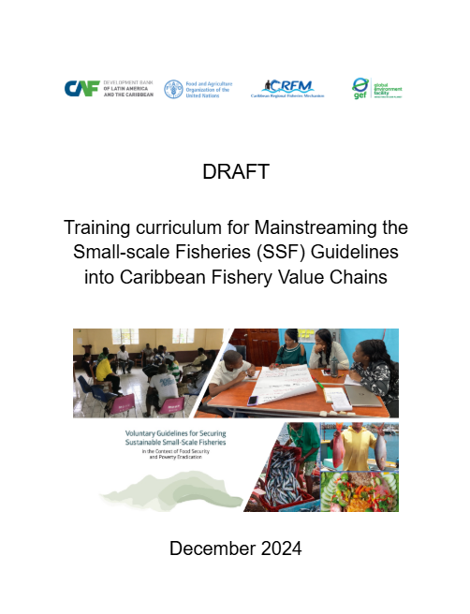
Contributions to Country Capacity Development
Training Curriculum - A structured guide of key module topics with learning objectives for integrating the SSF Guidelines into fisheries value chains.
Training Manual - A detailed manual on curriculum delivery modes, module design, resources and instructional materials informed by fisheries leaders. Training Modules - Fifteen capacity development slide modules setting out the relevance of the SSF guidelines to Caribbean fisheries value chains.
Training Workshop - Report on and validation of practical sessions to train leading fisherfolk by demonstrating the effectiveness of the training materials. Reference Resources - Global, regional and national lists of documents, videos, slides and other training materials suitable for Caribbean fisherfolk. Country Resources - Project country collection of slides, photographs, documents, videos etc, suitable to be built upon by fisherfolk trainers.

Slide 4
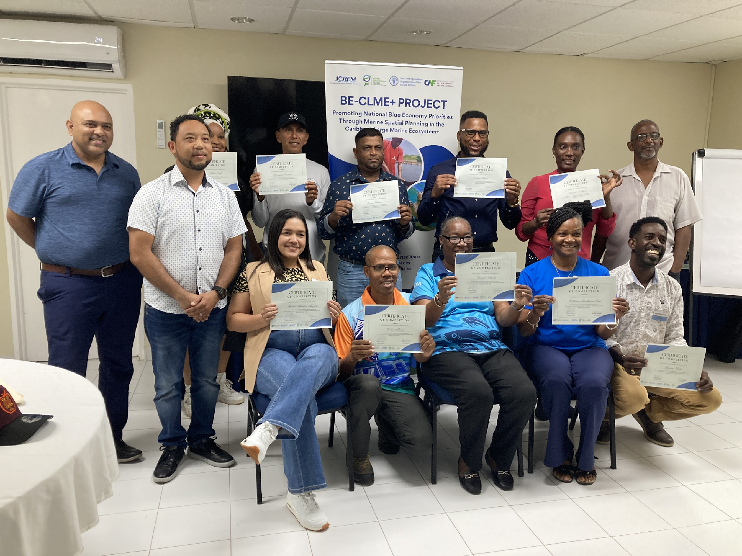
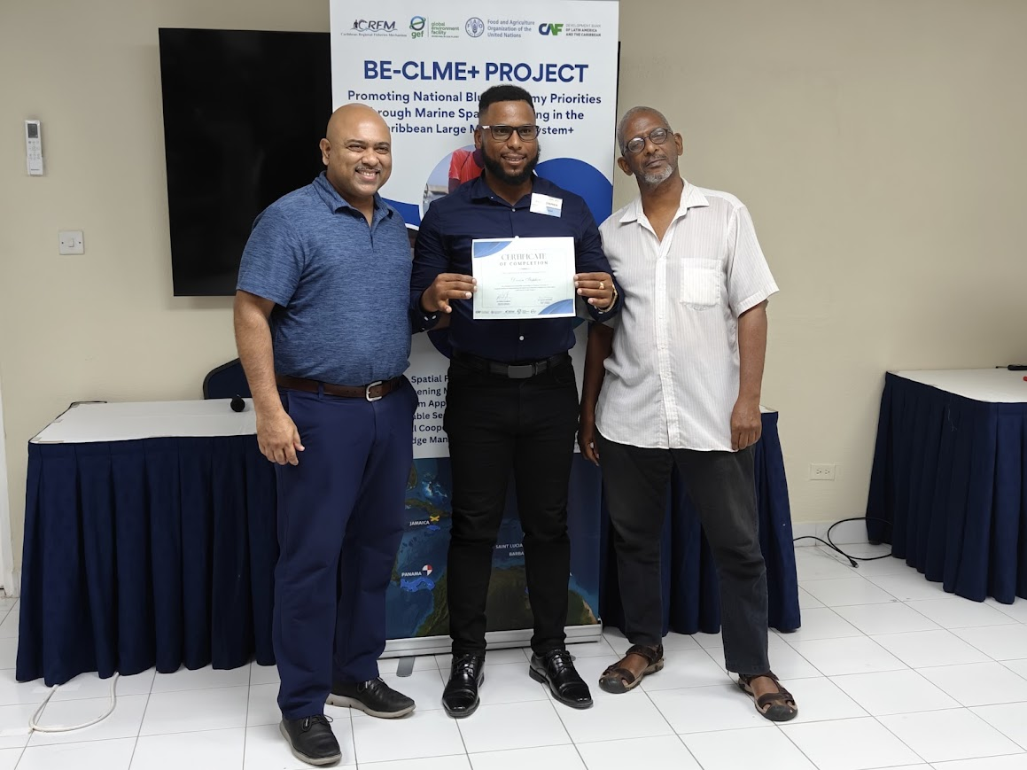
Participants
Workshop participants after receiving certificates of participation. Participant from Saint Lucia Devon Stephen received certificate from Regional Project Coordinator, Dr. Dayne Buddo and Dr. Patrick McConney

Slide 5
Project benefits
Saint Lucia has a variety of policy, management, and strategic investment guidance documents and initiatives relevant to capacity development in SSF fisheries value chains and also the integration of the SSF Guidelines. These national fisheries instruments collectively and actively promote SSF value chain development towards the optimum utilization of seafood supply, to ensure high relative employment within the national fishing industry.
Fisherfolk organizations in Saint Lucia are well developed at local and national level with highly capable leadership. Fisherfolk capacity has been further enhanced through this regional project. They can work with the Department of Fisheries and other government plus non-government partners to improve value chain profitability, as well as sustained fisherfolk socio-economic resilience. Such collaboration in the use of the training modules and resources is appropriate for other areas such as climate change adaptation, ecosystem approaches, and other issues addressed by the SSF Guidelines.
The SSF Guidelines value chain training and resources should serve to prepare fisherfolk for the diverse uncertainties with inevitable mitigation and adaptation challenges expected as climate change proceeds within the vulnerable Caribbean region. Managing fisherfolk operating and transaction costs along rapidly changing value chains are also included as components of the capacity development. Given the training received by one of the country’s most prominent fisherfolk leaders, and the government’s attention to national ocean policy and climate change, the prospects for improving SSF value chain resilience are in good hands.

